Slide 1

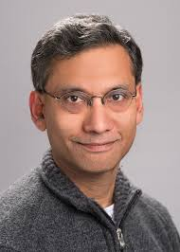

SeF: A Secure Fountain Architecture for Slashing Storage Costs in Blockchains
Swanand Kadhe
UC Berkeley
Joint Work with
Jichan Chung
Kannan Ramchandran
Scaling Bitcoin
Tel Aviv
Sep 12, 2019

Slide 2
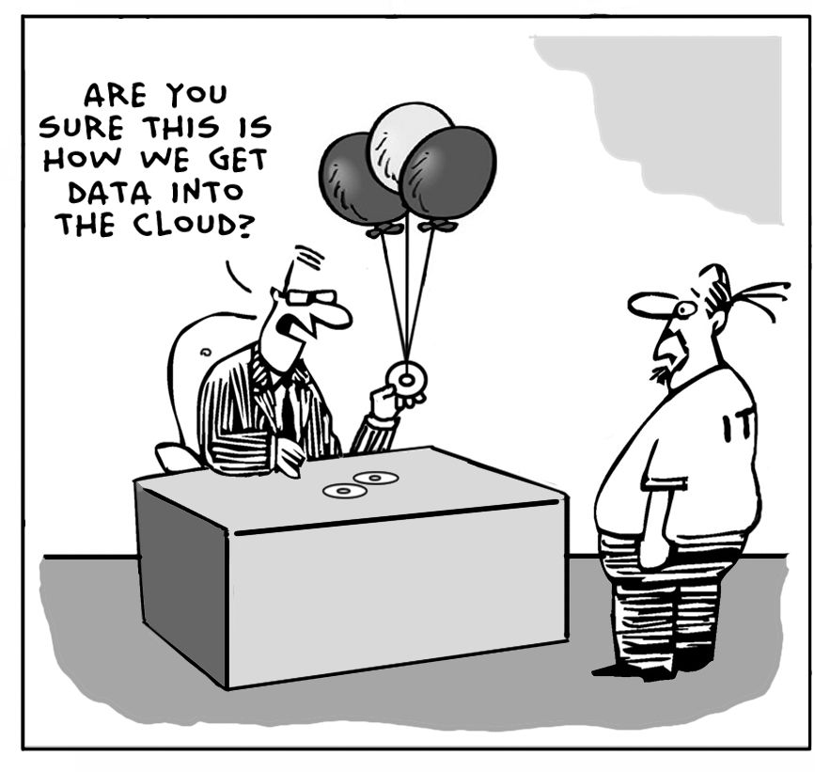
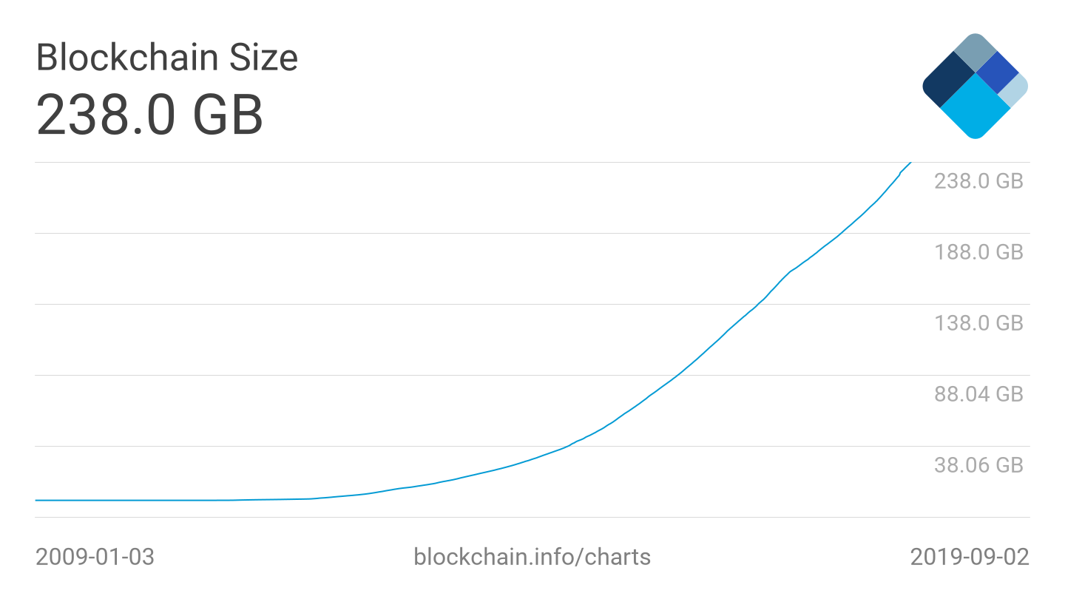

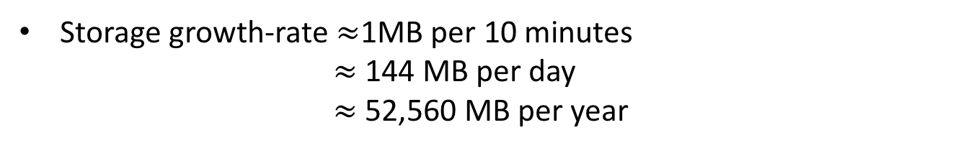
Is Bitcoin/Blockchain Storage Really an Issue?
Blockchain size is an ever growing problem!
Storage growth-rate $≈$1MB per 10 minutes
$≈$ 144 MB per day
$≈$ 52,560 MB per year
Scaling throughput 1000 fold 52 TB storage per year!

Slide 3
Scaling Bitcoin!
How can we securely scale the bitcoin/blockchain network allowing nodes to save storage costs by orders of magnitude?
Blockchain size is a growing problem!
Storage growth-rate $≈$1MB per 10 minutes
$≈$ 144 MB per day
$≈$ 52,560 MB per year
Scaling throughput 1000 fold 52 TB storage per year!

Slide 4
Bitcoin Ecosystem

Slide 5
Bitcoin Ecosystem: (Archival) Full Nodes
Most Secure Way to Join Bitcoin
Download and validate the full history
Independently validate every transaction and block thereafter
Contribute to the health of the network
Safeguard security and trustlessness
Archival full nodes store all the blocks
Help to bootstrap new nodes joining the network
Ensure decentralization and scalability
Businesses, miners, and exchanges are recommended to run a full node
Heavy price in terms of storage (and computation) costs
☹️

Slide 6
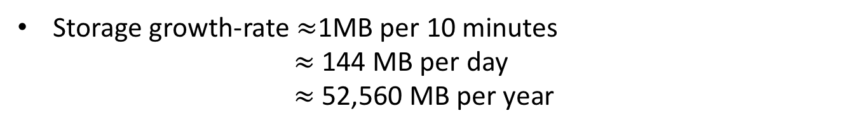
Bitcoin Ecosystem: (Archival) Full Nodes
Blockchain size is a growing problem!
Storage growth-rate $≈$1MB per 10 minutes
$≈$ 144 MB per day
$≈$ 52,560 MB per year
Scaling throughput 1000 fold 52 TB storage per year!

Slide 7
Bitcoin Ecosystem: Light Clients
Most Economical Way to Join Bitcoin
Simple Payment Verification (SPV) Clients [Nakamoto ‘09]
Download and store only block headers
Do not validate transactions Rely on full nodes
Vulnerable to several security and privacy attacks
☹️

Slide 8
Bitcoin Ecosystem: Pruned Nodes
Bitcoin’s solution to storage bloat
Act as a full node, but store a subset of blocks
Store only a budgeted number of most recent blocks
Fixed storage overhead!
Individually (almost) as secure as full nodes
How do they contribute to network health?

Slide 9
Bitcoin Ecosystem: Full Nodes
Most secure way to join Bitcoin
Every new full node enhances system security by validating history

Slide 10
Bitcoin Ecosystem: Archival Full Nodes
Most secure way to join Bitcoin
Every new full node enhances system security by validating history
Archival full nodes help in bootstrap in new full nodes
  Crucial for securely scaling up the network!

Slide 11
Bitcoin Ecosystem: Archival Full Nodes are Vital!
What if every user runs a pruned node or an SPV client?

Slide 12
Bitcoin Ecosystem: Archival Full Nodes are Vital!
No scalability if every user runs a pruned node or an SPV client!

Slide 13
SeF: Full Node on a Storage-Constrained Device
SeF: Secure Fountain architecture to enable storage-constrained machines to act as archival full nodes without compromising security and decentralization!

Slide 14
Challenges
How to design protocols that enable storage-constrained machines to act as archival full nodes without affecting security properties of blockchain?
Security: network must scale up in a secure manner even if a subset of storage-constrained full nodes are adversarial
Decentralization: full nodes must perform their computations without relying on others
Low Computation Cost: low complexity at storage-constrained nodes as well as new nodes
Low Bootstrap Cost: number of storage-constrained full nodes that a new node needs to contact in order to recover the blockchain

Slide 15

Storage Savings vs. Bootstrap Cost: Fundamental Trade-Off
Blockchain size = 238GB
10GB per node
$≥$24

Slide 16

Storage Savings vs. Bootstrap Cost: Fundamental Trade-Off
Blockchain size = 238GB
1GB per node
$≥$240

Slide 17
Storage Savings vs. Bootstrap Cost: Fundamental Trade-Off
Information-theoretic trade-off
$γ$ – fold storage savings per node Bootstrap cost $≥γ$

Slide 18




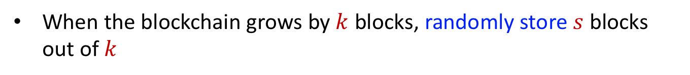










Decentralization via Random Sampling
When the blockchain grows by $k$ blocks, randomly store $s$ blocks out of $k$
$$B_{1}$$
$$B_{2}$$
$$B_{3}$$
$$B_{k}$$
$$B_{k+1}$$
$$B_{k+2}$$
$$B_{k+3}$$
$$B_{2k}$$
$$B_{i_{1}}$$
$$B_{i_{s} }$$
$$B_{j_{1}}$$
$$B_{j_{s}}$$
Storage savings $=k/s$
  $k=10,000;s=10$ $⟹$ 1000–fold savings
Used in history sharding

Slide 19
Storage Savings vs. Bootstrap Cost: Random Sampling
Prohibitive bootstrap cost!

Slide 20
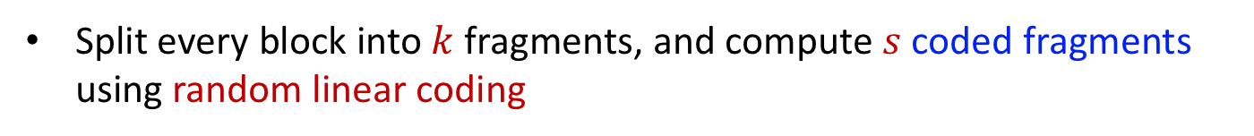
Erasure Coding: Random Linear Codes
Split every block into $k$ fragments, and compute $s$coded fragments using random linear coding
Storage savings $=k/s$
Small bootstrap cost
Not possible to detect malicious coded fragments due to mixing
Recovering the block involves matrix inversion: $O(k^{2})$ coputations
[Perard et al. ‘18, Dai et al. ‘18]

Slide 21
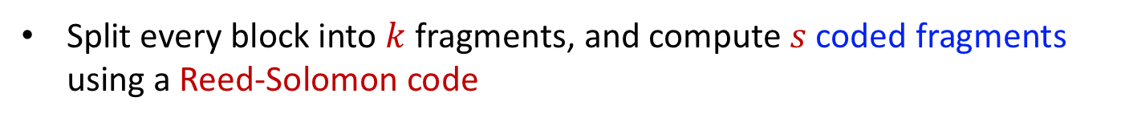
Erasure Coding: Reed-Solomon Codes
Split every block into $k$ fragments, and compute $s$coded fragments using a Reed-Solomon code
Storage savings $=k/s$
Small bootstrap cost
Reed-Solomon codes are error-correcting codes
  Malicious coded fragments can be corrected!
Finite field size should grow with size of network
  Prohibitive computation costs
[Raman-Varshney ‘18, Li et al. ‘18]

Slide 22
SeF: A Secure Fountain Architecture
How to achieve nearly-optimal bootstrap cost with low computational complexity without compromising security and decentralization?
Notes:
Mention here tension between mixing and identifying malicious droplets!!

Slide 23
SeF: A Secure Fountain Architecture
We envision a blockchain network consisting of droplets
Droplet: a storage-constrained node acting as a full node

Slide 24
SeF: A Secure Fountain Architecture
During bootstrap, a new node, called a bucket node, collects sufficiently many droplets, and recovers the blockchain

Slide 25

SeF: A Secure Fountain Architecture
Blockchain should be recoverable even when some droplet nodes are adversarial, providing malicious droplets

Slide 26
SeF: A Secure Fountain Architecture
After recovering and validating the blockchain, a bucket node turns itself into a droplet node
Droplet nodes will slowly replace full archival nodes

Slide 27





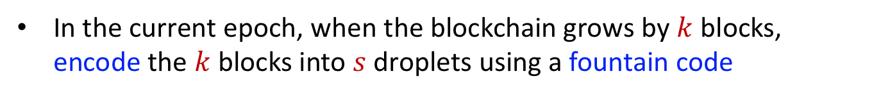
SeF Encoder
Epoch: time required for blockchain to grow by $k$ blocks
In the current epoch, when the blockchain grows by $k$ blocks, encode the $k$ blocks into $s$ droplets using a fountain code
$$B_{1}$$
$$B_{2}$$
$$B_{3}$$
$$B_{k}$$
$$B_{k+1}$$
$$B_{k+2}$$
$$B_{k+3}$$
$$B_{2k}$$
$$C_{1,1}$$
$$C_{1,s}$$
$$C_{2,1}$$
$$C_{2,s}$$
Storage savings $=k/s$
  $k=10,000;s=10$ $⟹$ 1000–fold savings
Most recent $τ$ blocks are stored in uncoded format to handle forks

Slide 28
Fountain Codes: A Quick Primer
Encoder: metaphorical fountain takes fixed size input symbols and produces an endless supply of encoded symbols
Decoder: original symbols can be recovered from any subset of encoded symbols of sufficient size
[Byers et al. ‘98, Luby ‘02]

Slide 29
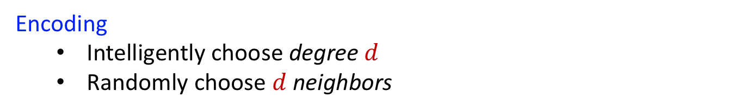
Luby-Transform (LT) Codes
Encoding
  Intelligently choose degree $d$
  Randomly choose $d$ neighbors

Slide 30
Peeling Decoding
Peel-off its contribution
Pick a singleton
Collect an arbitrary subset of droplets of sufficient size
  Peeling decoder recovers original source symbols

Slide 31
Peeling Decoding
Repeat
Collect an arbitrary subset of droplets of sufficient size
  Peeling decoder recovers original source symbols
How to make sure peeling decoder finds a singleton in every iteration?
  Intelligently choose degrees
  [Luby ‘02] designed a robust soliton degree distribution that guarantees successful recovery from

Slide 32

SeF: Luby-Transform (LT) Encoder
Blocks from an epoch
Choose 3 random blocks
Robust Soliton
Degree Distribution
XOR
3
Weight
Prob
1
0.055
Note which blocks are XORed
2
0.3
3
0.1
4
0.08
Droplet
Also store header-chain
k = 10000
0.0004
Rateless property $⟹$ every node can independently store droplets
[Luby ‘02]
Notes:
Mention Robust soliton, Random sampling is a special case

Slide 33
We cannot use Peeling Decoder Directly!
What if any droplet is maliciously formed?
  Error propagation and we will decode to garbage

Slide 34
We cannot use Peeling Decoder Directly!
What if any droplet is maliciously formed?
  Error propagation and we will decode to garbage
We leverage hash-chain structure + Merkle roots!

Slide 35

SeF Peeling Decoder
Obtain the longest valid header chain
Notes:
Present holistically

Slide 36
SeF Peeling Decoder

Slide 37
SeF Peeling Decoder
Decoder does not know which droplets are malicious!

Slide 38
SeF Peeling Decoder
Side information!

Slide 39
SeF Peeling Decoder
Droplets 2 and 6 are malicious
Pick a singleton droplet

Slide 40

SeF Peeling Decoder
Droplets 2 and 6 are malicious

Slide 41
SeF Peeling Decoder
Droplets 2 and 6 are malicious
Malicious droplet is detected (only) when it becomes a singleton
Peeling is crucial in detecting malicious droplets!

Slide 42
SeF Peeling Decoder
Droplets 2 and 6 are malicious
Delete the malicious droplet

Slide 43
SeF Peeling Decoder
Droplets 2 and 6 are malicious

Slide 44
SeF Peeling Decoder
Droplets 2 and 6 are malicious

Slide 45
SeF Peeling Decoder
Droplets 2 and 6 are malicious

Slide 46
SeF Peeling Decoder
Droplets 2 and 6 are malicious
Continue until all blocks are decoded
Decoding failure if there is no more singleton

Slide 47
SeF Peeling Decoder
Droplets 2 and 6 are malicious
Continue until all blocks are decoded
Decoding failure if there is no more singleton
Simply download more droplets!

Slide 48
Performance Analysis: Threat Model
Adversary can control an arbitrary subset of storage-constrained nodes
  These malicious nodes may collude with each other and can deviate from the protocol in any arbitrary manner
Adversarial node
Colluding
adversarial nodes
Honest node
Oblivious adversary: cannot observe storage contents of nodes before choosing which nodes to corrupt
Honest minority: at least a specific number of nodes are honest
Notes:
Honest minority!

Slide 49
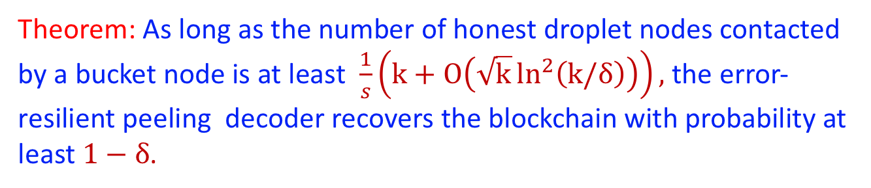
Performance Analysis
If a malicious droplet becomes a singleton, it is rejected
Oblivious adversary cannot influence probability of decoding failure for honest droplets
Theorem: As long as the number of honest droplet nodes contacted by a bucket node is at least $\frac{1}{s}\left(k+O\left(\sqrt{k}\ln^{2}\left(k/δ\right)\right)\right),$ the error-resilient peeling decoder recovers the blockchain with probability at least $1−δ$.

Slide 50












Comparison with Existing Solutions
Random Sampling
Random Linear Coding
Reed-Solomon Codes
Used in
history sharding
[Perard et al. ’18]
[Dai et al. ’18]
[Raman and Varshney ’18]
[Li et al. ‘18]
Encoding: $O\left(1\right)$
Encoding: $O\left(k\right)$
Encoding: $O\left(k\right)$
Decoding: $O\left(1\right)$
Decoding: $O\left(k^{2}\right)$
Decoding: $O\left(n^{2}\right)$
Bootstrap: $O\left(klog k\right)$
Bootstrap: $O\left(k\right)$
Bootstrap: $O\left(k\right)$
Runs into coupon collector problem
How to deal with malicious nodes?
Field size grows with the size of network: poor scalability
SeF Architecture
Encoding: $O\left(\log{k}\right)$
Decoding: $O\left(k log k\right)$
Bootstrap:$k+O\left(\sqrt{k}\ln^{2}\left(k/δ\right)\right)$
Notes:
Italicizing ‘solutions’, because these are not really solutions. Color for SeF, Table!

Slide 51
Numerical Results
Bootstrap cost versus storage savings

Slide 52
Numerical Results
Bootstrap cost versus storage savings

Slide 53
Tackling Block Size Variability
Adaptive zero-padding: while computing bit-wise XOR, a node zero-pads the blocks to the largest block among the d blocks
Block concatenation: A natural way to reduce variance in block-size is to first concatenate blocks to form super-blocks of approximately same size, and then perform encoding on the super-blocks
Notes:
Move later

Slide 54
Experimental Results
Paper available on arXiv: https://arxiv.org/abs/1906.12140

Slide 55
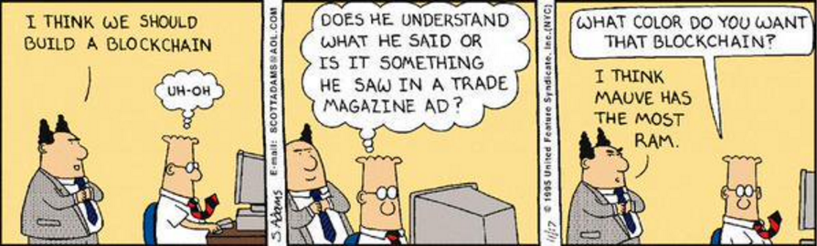
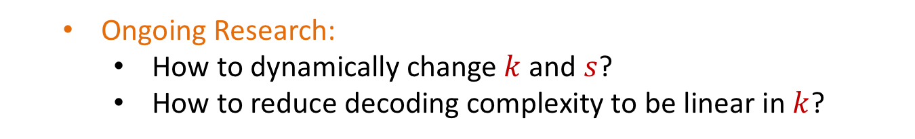
Summary
  SeF can reduce storage costs by orders of magnitude without compromising security of the blockchain network
  Can be directly applied on top of bitcoin
  Ongoing Research:
    How to dynamically change $k$ and $s$?
    How to reduce decoding complexity to be linear in $k$?
Scalable
Questions!

Slide 56
Additional Slides

Slide 57
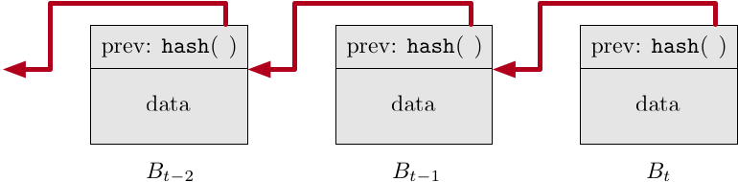
Blockchain Format
Hash-chain of blocks
  Tamper resistant
We need more ingredients to turn it into a distributed ledger!

Slide 58
Structure of a Block
Previous hash
Merkle Root
Merkle tree (hash tree) of transactions in the block

Slide 59
Structure of a Block
Previous hash
Merkle Root
Proof-of-Work
70+ leading zeros

Slide 60
Blockchain Format
Hash-chain of block headers
Merkle tree (hash tree) of transactions in the block

Slide 61
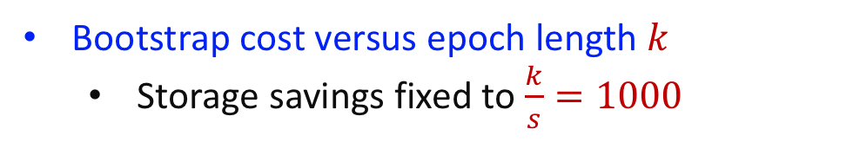
Numerical Results
Bootstrap cost versus epoch length $k$
  Storage savings fixed to $\frac{k}{s}=1000$

Slide 62
Numerical Results
Bandwidth overhead versus fraction of malicious nodes for SeF codes

Slide 63
Experimental Results

Slide 64
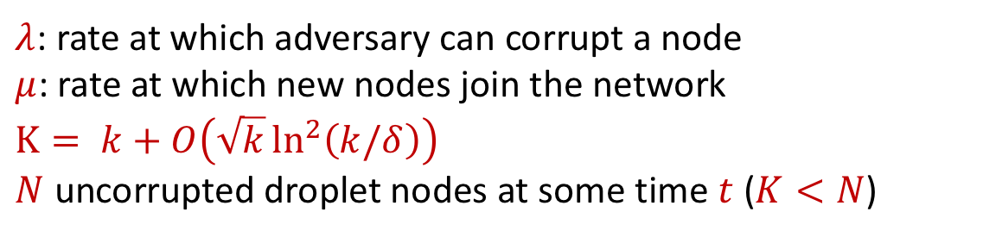
Performance Analysis: Adaptive Adversary
Adaptive adversary can induce decoding failure by corrupting a small subset of nodes
  For instance, corrupt if a droplet node stores a singleton
$λ$: rate at which adversary can corrupt a node
$μ$: rate at which new nodes join the network
$$K= k+O\left(\sqrt{k}\ln^{2}\left(k/δ\right)\right)$$
$N$ uncorrupted droplet nodes at some time $t$ ($K<N$)
If $λ<μ$, the probability that droplet nodes become extinct is ${\left(λ/μ\right)}^{N−K+1}$

Slide 65
Performance Metrics
Storage Savings: ratio of the total blockchain size to the size of the encoded blockchain
Bootstrap Cost: minimum number of honest droplet nodes that a bucket node needs to contact to ensure that the blockchain can be recovered with high probability
Bandwidth Overhead: overhead in terms of the amount of data that a bucket node needs to download for recovering the blockchain with high probability
Computation Cost: average number of arithmetic operations associated with the encoder and the decoder

