Slide 1
A Lucas Critique to
the Difficulty Adjustment Algorithm
of the Bitcoin System
@Scaling Bitcoin
September 2019
Yoshinori Hashimoto (BUIDL, Ltd.)
Shunya Noda (University of British Columbia)
Kyohei Okumura (The University of Tokyo)
Notes:
Hello everyone! Thanks for having me here today! I will talk about our research project , A Lucas Critique to the Difficulty Adjustment Algorithm of the Bitcoin System.

Slide 2





BUIDL as a blockchain service provider
Consulting & Development
Research & Development
Notes:
My name is Yoshinori Hashimoto, working at BUIDL as a researcher. BUIDL is a cryptocurrency startup company in Japan.

Slide 3






Shunya Noda
UBC Econ
Kyohei Okumura
U Tokyo Econ
(Ph.D. Student)
Yoshinori Hashimoto
BUIDL, Ltd.
(Researcher)
Notes:
As a part of my company research, we released this academic paper collaborating with Professor Shunya Noda at University of British Columbia, and Kyohei Okumura at University of Tokyo. Now let’s move on to the details.

Slide 4
Design Issue of the Bitcoin System
The Bitcoin community agreed to aim at generating blocks every 10 minutes (on average).
Need to adjust the “difficulty target”.
Difficulty Adjustment Algorithm (DAA)
How should we design it?
Notes:
As all of you know, the Bitcoin community agreed to aim at generating blocks every 10 minutes. To achieve this, we adjust the difficulty target by using a difficulty adjustment algorithm, DAA. Our paper studies the design of DAA.

Slide 5
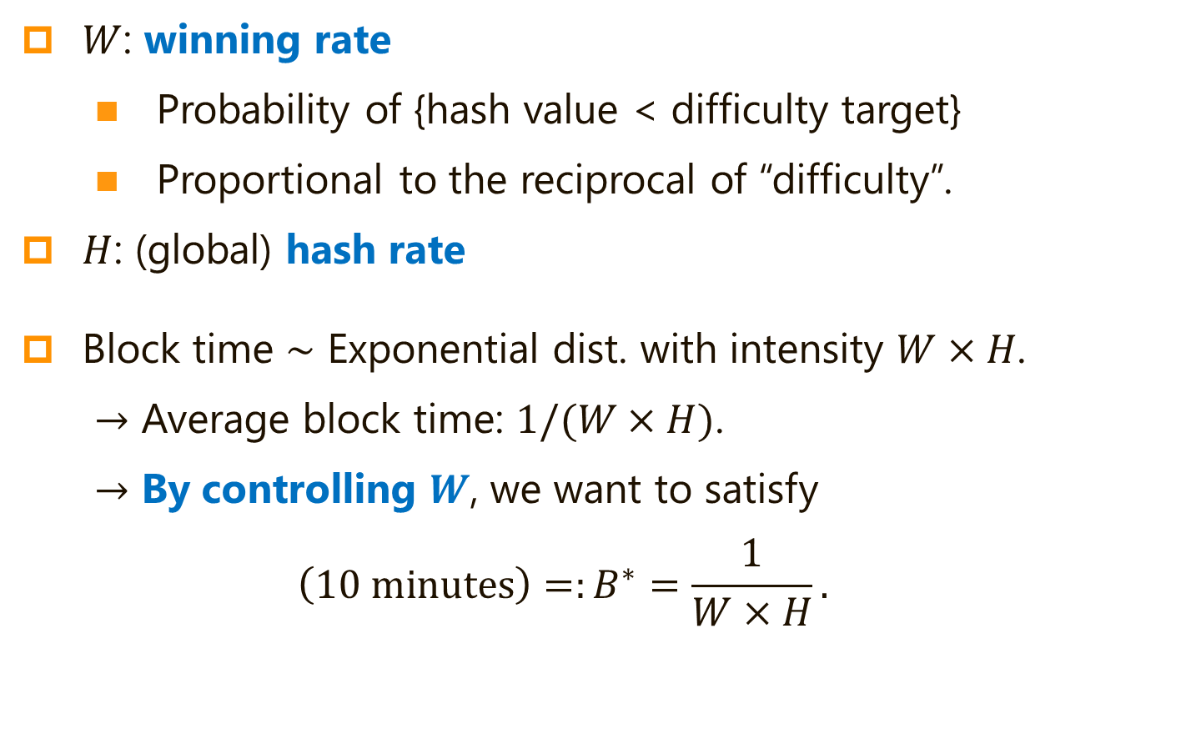
Policy Goal
$W$: winning rate
Probability of {hash value < difficulty target}
Proportional to the reciprocal of “difficulty”.
$H$: (global) hash rate
Block time $∼$ Exponential dist. with intensity $W×H$.
$→$ Average block time: $1/(W×H)$.
$→$ By controlling $W$, we want to satisfy
$$\left(10 minutes\right)=:B^{∗}=\frac{1}{W×H}.$$
Notes:
First, I am going to explain our terminology. W is the winning rate. It is the probability that a hash value is smaller than the difficulty target. H is the hash rate. The total number of hash attempts per unit time taken in the world. After some calculations, we can show that the average block time is one over W times H. So, we want to satisfy 10 minutes equals one over W times H.

Slide 6
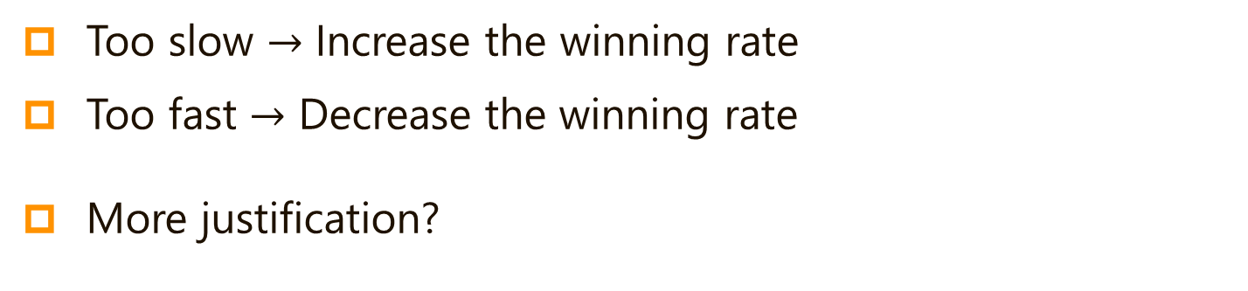


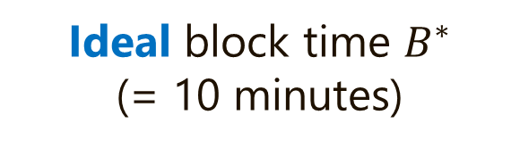

Current Bitcoin DAA
Periodic adjustment (every 2016 blocks $≈$ 2 weeks)
Average block time in previous 2016 blocks
$$W\left(New\right)$$
=
$$×$$
$$W\left(Old\right)$$
Ideal block time $B^{∗}$
(= 10 minutes)
Too slow $→$ Increase the winning rate
Too fast $→$ Decrease the winning rate
More justification?
Notes:
As you know, the current Bitcoin DAA adjusts the winning rate every 2016 blocks, using the following formula. Basically, it compares the average block time in previous 2016 blocks and the ideal block time, 10 minutes, and multiply this factor to the old winning rate. If block generation was too slow, the winning rate is increased. Then, block generation is accelerated. And so on. This is a naive explanation of the structure of Bitcoin DAA, but there is a better justification.

Slide 7
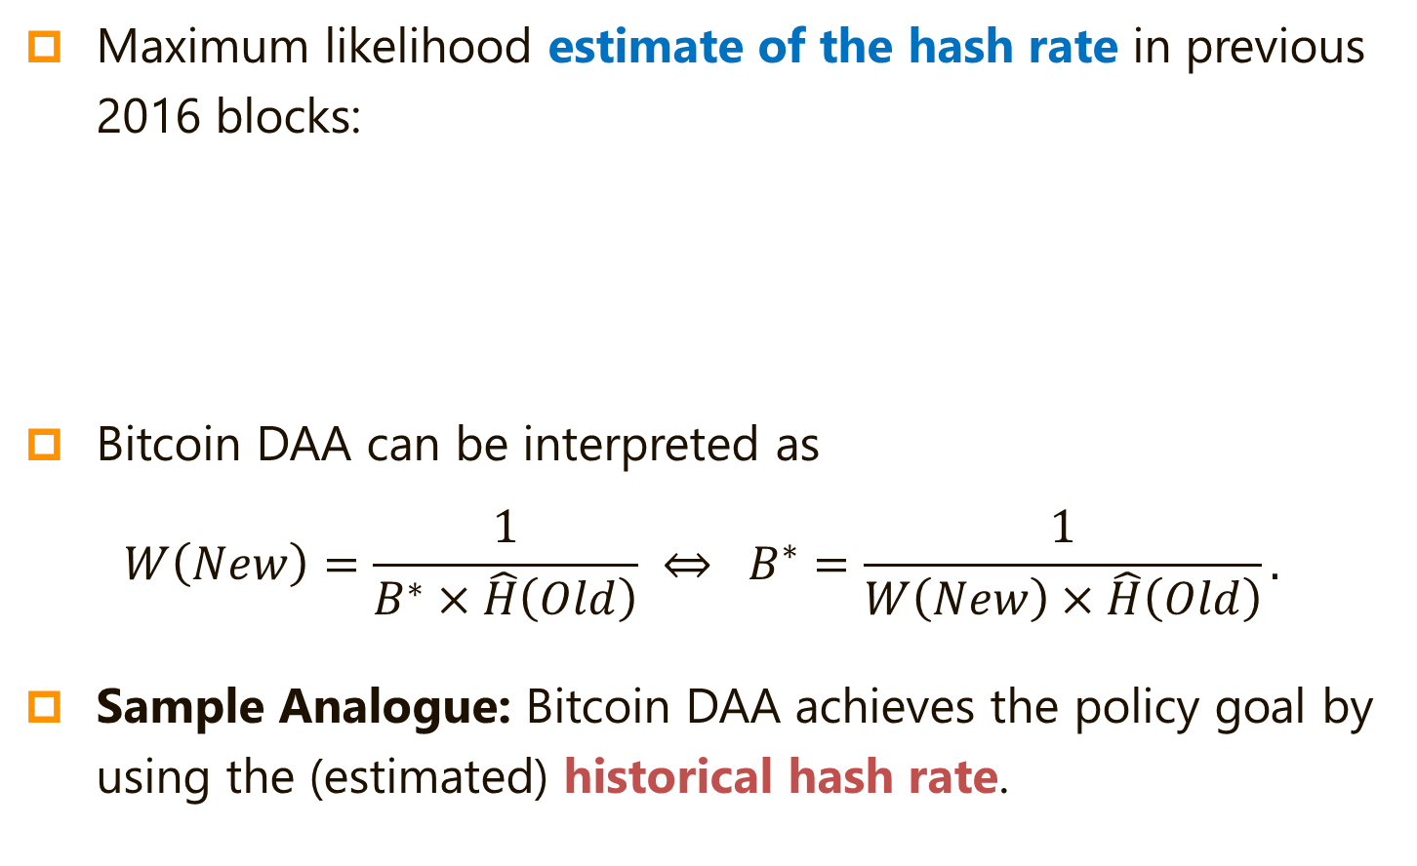



Sample Analogue
Maximum likelihood estimate of the hash rate in previous 2016 blocks:
Bitcoin DAA can be interpreted as
$$W\left(New\right)=\frac{1}{B^{∗}×\hat{H}\left(Old\right)} ⇔ B^{∗}=\frac{1}{W\left(New\right)×\hat{H}\left(Old\right)}.$$
Sample Analogue: Bitcoin DAA achieves the policy goal by using the (estimated) historical hash rate.
-1
Average block time in previous 2016 blocks
$$\hat{H}\left(Old\right)$$
=
$$×$$
$$W\left(Old\right)$$
Notes:
If the hash rate were directly observable, it would be easy to pick an ideal winning rate. However, the hash rate is not observable. Still, we can compute an estimator of the hash rate, instead. After some algebra, we can show that an efficient estimator of the hash rate is given by this formula. Substituting this into the Bitcoin DAA formula, we have this formula. This means that Bitcoin DAA attempts to achieve a sample analogue of the policy goal equation. Since the hash rate is not observable, we estimate the historical hash rate, and substitute it into the policy goal equation.

Slide 8
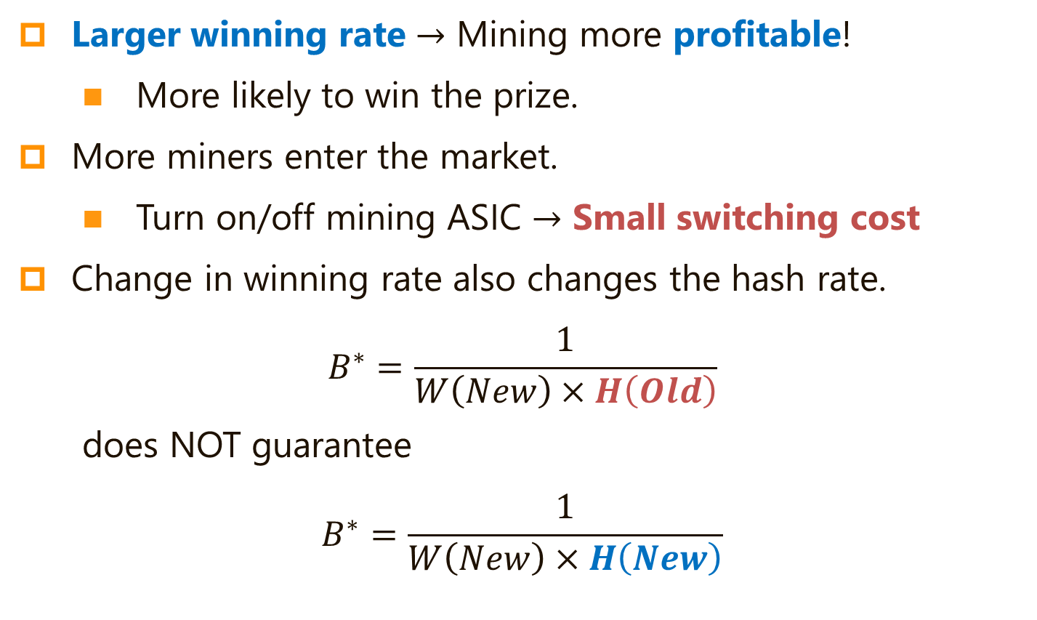
Miners’ Incentive
Larger winning rate $→$ Mining more profitable!
More likely to win the prize.
More miners enter the market.
Turn on/off mining ASIC $→$ Small switching cost
Change in winning rate also changes the hash rate.
$$B^{∗}=\frac{1}{W\left(New\right)×H\left(Old\right)}$$
does NOT guarantee
$$B^{∗}=\frac{1}{W\left(New\right)×H\left(New\right)}$$
Notes:
But this procedure dismisses one very important feature. If we change the winning rate, miners profitability will also change! If we increase the winning rate, it is easier to get the mining reward. So, more hash power will be provided. This increases the global hash rate. We also note that, for miners, it is easy to adjust the hash rate. They can do it just by turning on and off the switch of mining ASIC machines. After we change the winning rate, the hash rate will also be changed. So, this formula does not mean that an ideal block arrival rate is also achieved with the updated hash rate.

Slide 9

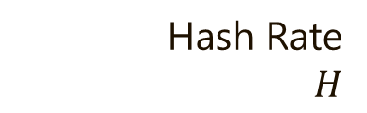
Hash Rate
$H$
0
Winning Rate $W$
Notes:
Let me visualize the behavior of Bitcoin DAA. The horizontal axis is the winning rate, and the vertical axis is the hash rate.

Slide 10
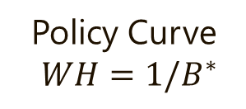
Hash Rate
$H$
Policy Curve
$WH=1/B^{∗}$
0
Winning Rate $W$
Notes:
If the profile of the winning rate and the hash rate is on this line, the average block time becomes 10 minutes. The policy curve is decreasing in the winning rate, because the product of H and W is constant.

Slide 11
Hash Rate
$H$
Supply Curve
(Hash rate is increasing in winning rate)
Policy Curve
$WH=1/B^{∗}$
0
Winning Rate $W$
Notes:
The hash supply function looks like this. The hash supply is increasing in the winning rate, because more hash power is supplied when mining is more profitable.

Slide 12

Hash Rate
$H$
Supply Curve
(Hash rate is increasing in winning rate)
Policy Curve
$WH=1/B^{∗}$
0
$$W^{∗}$$
Winning Rate $W$
Notes:
Ideally, we want to choose this winning rate (W star). If we choose this winning rate,

Slide 13

Hash Rate
$H$
Supply Curve
(Hash rate is increasing in winning rate)
$H^{∗}$
Policy Curve
$WH=1/B^{∗}$
0
$$W^{∗}$$
Winning Rate $W$
Notes:
Miners will supply this hash rate, and it is on the policy curve.

Slide 14

Hash Rate
$H$
Want to choose $W^{∗}$ to achieve this point!
$H^{∗}$
Policy Curve
$WH=1/B^{∗}$
0
$$W^{∗}$$
Winning Rate $W$
Notes:
So, our goal is to achieve this crosspoint, by choosing this winning rate (W^*).

Slide 15

Hash Rate
$H$
Supply Curve
(Hash rate is increasing in winning rate)
$H^{∗}$
Policy Curve
$WH=1/B^{∗}$
0
$$W\left(Old\right)$$
$$W^{∗}$$
Winning Rate $W$
Notes:
However, since the situation is always changing, we cannot always achieve W star. In such a case, we start from somewhere else. Let’s say that’s here (W(Old)).

Slide 16

Hash Rate
$H$
Supply Curve
(Hash rate is increasing in winning rate)
$H^{∗}$
Policy Curve
$WH=1/B^{∗}$
$H\left(Old\right)$
0
$$W\left(Old\right)$$
$$W^{∗}$$
Winning Rate $W$
Notes:
If this winning rate (W(Old)) is taken in previous 2016 blocks, this hash rate (H(Old)) is realized, and

Slide 17
Hash Rate
$H$
Supply Curve
(Hash rate is increasing in winning rate)
$H^{∗}$
Policy Curve
$WH=1/B^{∗}$
$H\left(Old\right)$
Too slow block generation!
0
$$W\left(Old\right)$$
$$W^{∗}$$
Winning Rate $W$
Notes:
Block generation is too slow, as this point (W(Old), H(Old)) locates the bottom left of the policy curve.

Slide 18


Hash Rate
$H$
Supply Curve
(Hash rate is increasing in winning rate)
$$W\left(New\right)=\frac{1}{\hat{H}\left(Old\right)×B^{∗}}≈\frac{1}{H\left(Old\right)×B^{∗}}$$
$H^{∗}$
Policy Curve
$WH=1/B^{∗}$
$H\left(Old\right)$
0
$$W\left(Old\right)$$
$$W^{∗}$$
$$W\left(New\right)$$
Winning Rate $W$
Notes:
So, Bitcoin DAA will increase the winning rate to speed up block generation.
As I explained, the Bitcoin DAA chooses the winning rate so that an ideal block generation time is realized along with the historical hash rate. In this graph, it means that the new hash rate is this point. Together with H(Old), this W(New) achieves the policy goal.

Slide 19

Hash Rate
$H$
Supply Curve
(Hash rate is increasing in winning rate)
$$W\left(New\right)=\frac{1}{\hat{H}\left(Old\right)×B^{∗}}≈\frac{1}{H\left(Old\right)×B^{∗}}$$
$$H\left(New\right)$$
$H^{∗}$
Policy Curve
$WH=1/B^{∗}$
$H\left(Old\right)$
0
$$W\left(Old\right)$$
$$W^{∗}$$
$$W\left(New\right)$$
Winning Rate $W$
Notes:
But this adjustment dismisses miners’ reaction! Since mining became more profitable, more hash power is provided from now! In the next 2016 blocks, we will generate blocks too fast.

Slide 20

Hash Rate
$H$
Supply Curve
(Hash rate is increasing in winning rate)
$$H\left(New\right)$$
Overshoot.
Fails to select the ideal winning rate ($W^{∗}$).
$H^{∗}$
Policy Curve
$WH=1/B^{∗}$
$H\left(Old\right)$
0
$$W\left(Old\right)$$
$$W^{∗}$$
$$W\left(New\right)$$
Winning Rate $W$
Notes:
Bitcoin DAA always over shoots. It fails to select the ideal winning rate, W^*.

Slide 21
Hash Rate
$H$
0
Winning Rate $W$
Notes:
This is not the end of the story. The Bitcoin DAA does this adjustment again and again, and then, the winning rate evolves in this manner.

Slide 22
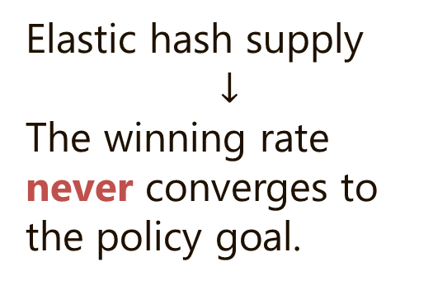
Hash Rate
$H$
Elastic hash supply
$$↓$$
The winning rate never converges to the policy goal.
0
Winning Rate $W$
Notes:
Even in the long run, the winning rate does not get closer to the ideal level. Instead, the winning rate oscillates and diverges.

Slide 23
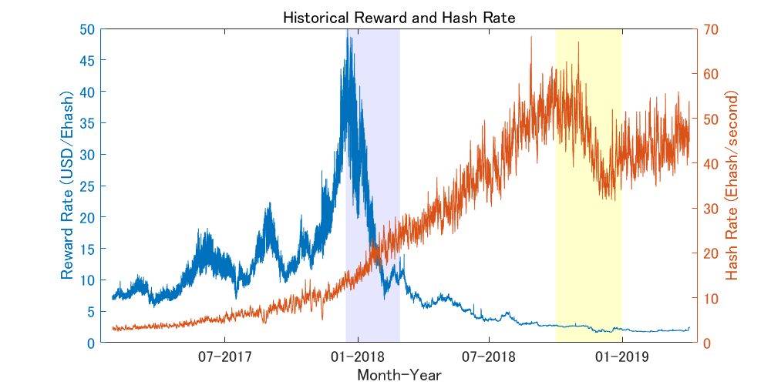
Simulation
Replicate the situation of late 2018.
Per hash reward attained the historical minimum.
Notes:
In the paper, we also give some simulation results. We replicate the situation of late 2018. At that time, per hash reward attained the historical minimum, and the hash supply became very elastic.

Slide 24
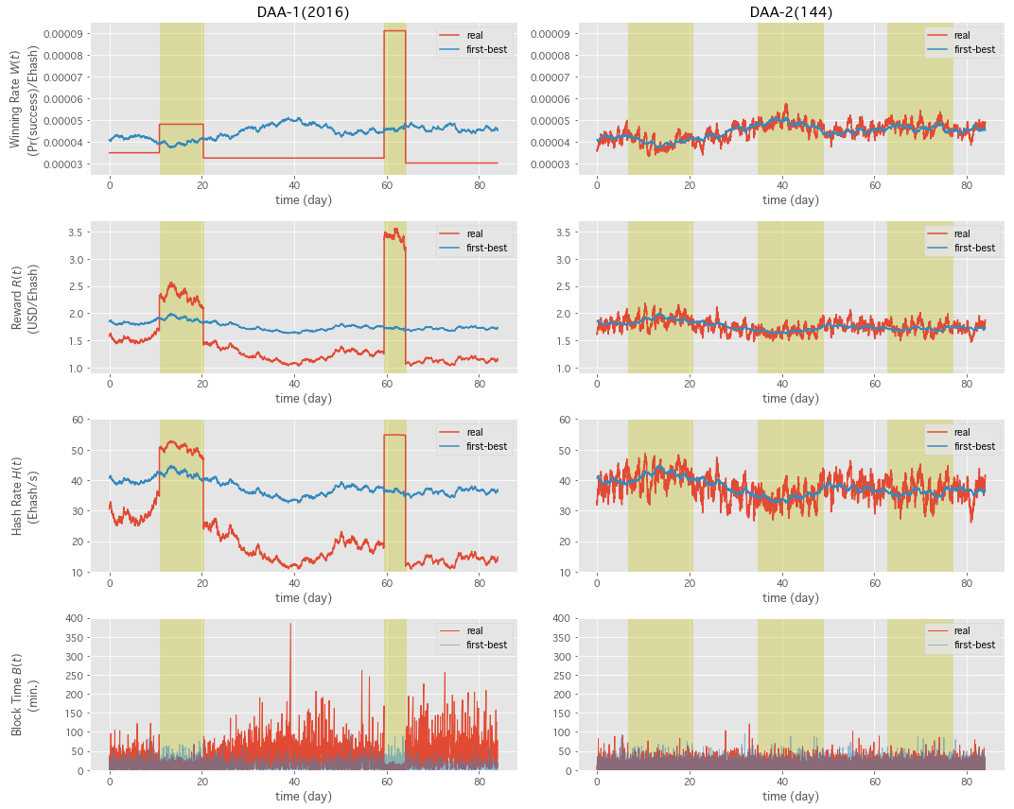
Blue line: Ideal
Red line: Under Bitcoin DAA
Bitcoin DAA fails to “trace” the ideal outcome.
Block time is highly unstable.
We were about to face a crisis in November 2018!
Notes:
This is our simulation result. The blue line is ideal adjustment, and the red line the behavior of Bitcoin DAA. I skip the details, but as you can see, Bitcoin DAA does not trace the ideal adjustment, at all!

Slide 25
In contrast, the DAA of Bitcoin Cash is shown to be very robust.
(See the paper)
Notes:
In the paper, we also study an alternative DAA. Bitcoin Cash. We show that Bitcoin Cash DAA is stable both theoretically and empirically. Unlike Bitcoin DAA, Bitcoin Cash DAA nicely traces the ideal values.

Slide 26
Policy Suggestion:
(1) We must upgrade Bitcoin DAA.
(2) The current DAA of the Bitcoin Cash system is a good candidate for it.
Notes:
Given these results, we have two policy suggestions. First, we must upgrade Bitcoin DAA, as it is very unstable. Second, Bitcoin Cash DAA is a good candidate for it, while there may exist an even better one.

Slide 27

Thank you!
Original paper download link:
https://ssrn.com/abstract=3410460
Notes:
Thank you for listening! If you are interested, please read our paper.
Any questions?

Slide 28
Alternative: Bcash DAA
Bitcoin Cash (Bcash) is another blockchain platform.
Hardforked from Bitcoin $→$ Share many structures.
Bcash updates the winning rate continually (every period).
Look at the total block time of previous 144 blocks.
$$W\left(t+1\right)=\frac{\sum_{s=t−144+1}^{t}{B\left(s\right)}}{B^{∗}⋅\sum_{s=t−144+1}^{t}{\frac{1}{W\left(s\right)}}}.$$
$B∼Exp\left(WH\right)$ $→$ If $W$ and $H$ were constant, this DAA also achieves $W=1/B^{∗}H$.
Replace DAA equation $→$ Obtain economy under new DAA.

Slide 29
Intuition (Bitcoin DAA)
$$H$$
Supply Curve
$H=Φ\left(WMS\right)$
Updated
$H\left(n+1\right)$
During the period of observation, an identical winning rate $W\left(n\right)$ is used.
DAA estimates $H\left(n\right)≠H^{∗}$.
$H^{∗}$
Data point
Policy Curve
$WH=1/B^{∗}$
$H\left(n\right)$
0
$$W\left(n\right)$$
$$W^{∗}$$
$$W\left(n+1\right)$$
$$W$$

Slide 30
Intuition (Bitcoin cash DAA)
$$H$$
Supply Curve
$H=Φ\left(WMS\right)$
Updated point is closer to the steady state.
$W\left(t\right)$ is updated every period.
Historical hash rate fluctuates around $H^{∗}$.
Take average $→$ Closer to $H^{∗}$!
Data points vary!!
$H^{∗}$
Policy Curve
$WH=1/B^{∗}$
0
$$W^{∗}$$
$$W$$

Slide 31
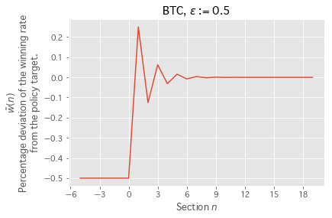
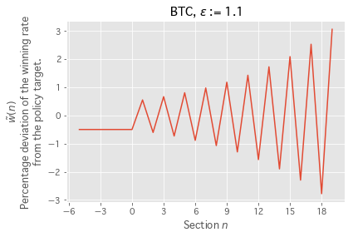

Local (In)Stability (Bitcoin DAA)
Theorem 1:
Under the Bitcoin DAA, $\tilde{w}\left(n\right)→0$ iff $ε<1$.
Where $ε≔Φ^{′}\left(W^{∗}MS\right)W^{∗}MS/Φ\left(W^{∗}MS\right)$
If $ε>1$, the winning rate oscillates and diverges.

Slide 32
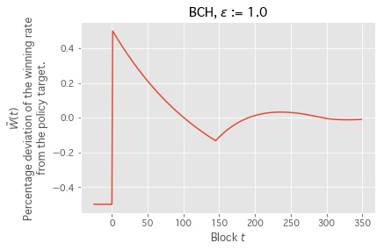
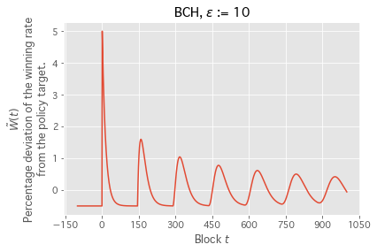
Local Stability (Bitcoin cash DAA)
Theorem 2:
Under the Bcash DAA, $\tilde{W}\left(t\right)→0$ iff $ε<144$.
Proof: Evaluate eigenvalues of the characteristic equation.
Much weaker than the hypothesis of Theorem 1.

