Slide 1
A Survey of Progress in Succinct Zero-Knowledge Proofs
Towards Trustless SNARKs
Ben Fisch
Stanford, Findora

Slide 2
Talk Goals
Survey some recent developments
  Towards SNARKs without trusted setup
Unified view of underlying paradigms/techniques
Emergence of polynomial commitment schemes as a key tool
Announcement: of a new trustless polynomial commitment scheme → New trustless SNARK

Slide 3
SNARKs
SNARK = “Succinct non-interactive argument of knowledge”

Slide 4




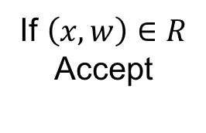
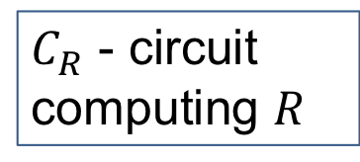
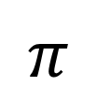


SNARKs
Setup$\left(1^{λ}\right)→pp$
$C_{R}$ - circuit computing $R$
Inputs:
$$\left(x, w\right)∈R$$
$$x$$
If $\left(x, w\right)∈R$
Accept
$$π$$
Prover
Verifier
Succinctness:
$$\left|π\right|<polylog \left(\left|C_{R}\right|\right)$$

Slide 5
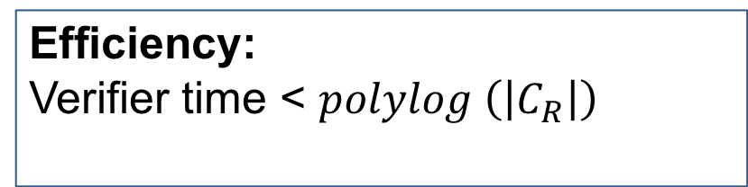
SNARKs
Setup$\left(1^{λ}\right)→pp$
$C_{R}$ - circuit computing $R$
Inputs:
$$\left(x, w\right)∈R$$
$$x$$
If $\left(x, w\right)∈R$
Accept
$$π$$
Prover
Verifier
Efficiency:
Verifier time < $polylog \left(\left|C_{R}\right|\right)$

Slide 6
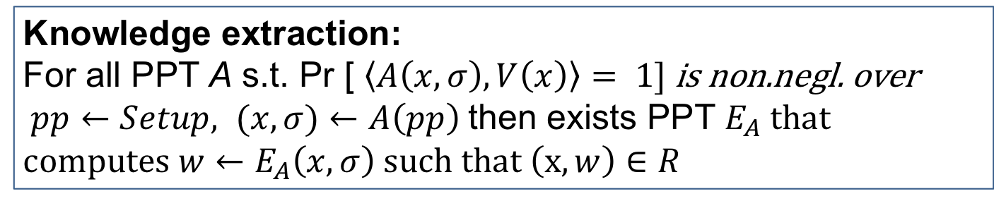
SNARKs
Setup$\left(1^{λ}\right)→pp$
$C_{R}$ - circuit computing $R$
Inputs:
$$\left(x, w\right)∈R$$
$$x$$
If $\left(x, w\right)∈R$
Accept
$$π$$
Prover
Verifier
Knowledge extraction:
For all PPT A s.t. Pr [ $\left\langle A\left(x, σ\right), V\left(x\right)\right\rangle = 1]$ is non.negl. over
$pp←Setup, (x,σ)←A\left(pp\right)$ then exists PPT $E_{A}$ that c$omputes {w←E}_{A}\left(x, σ\right) such that \left(x,w\right)∈R$

Slide 7
ZK-SNARKs
Setup$\left(1^{λ}\right)→pp$
$C_{R}$ - circuit computing $R$
Inputs:
$$\left(x, w\right)∈R$$
$$x$$
If $\left(x, w\right)∈R$
Accept
$$π$$
Prover
Verifier
Doesn’t reveal anything about witness w

Slide 8

... with transparent setup …
Setup$\left(1^{λ}\right)→pp$
No secrets
$C_{R}$ - circuit computing $R$
Inputs:
$$\left(x, w\right)∈R$$
$$x$$
If $\left(x, w\right)∈R$
Accept
$$π$$
Prover
Verifier
Publicly verifiable setup

Slide 9
Genesis…

Slide 10

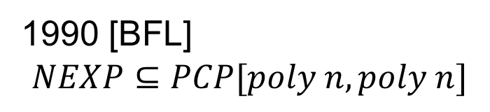
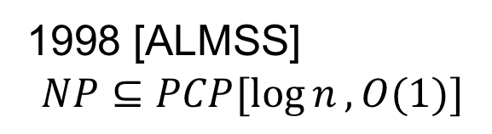
Genesis…
1990 [BFL]
$$NEXP⊆PCP[poly n, poly n]$$
1998 [ALMSS]
$$NP⊆PCP[\log{n}, O(1)]$$
PCP Theorem

Slide 11
PCP Theorem
Any NP statement with proof size n, can be transformed to length poly n probabilistically checkable proof
Verifier with random access only needs to read O(1) locations in the PCP proof, log n bits of randomness

Slide 12
CS Proofs
[Kilian’92, Micali’00]
“Computationally sound” proofs
Prover commits to PCP proof in Merkle tree
Verifier makes O(1) random queries to proof, receives Merkle proofs authenticating answers
Made non-interactive with Fiat-Shamir (hashing)

Slide 13
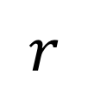
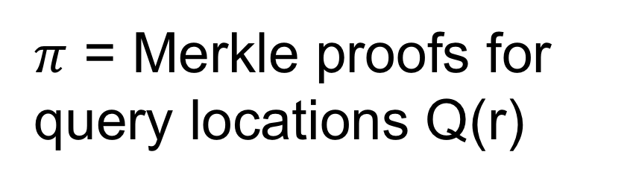
CS Proofs
Commits to locations of long proof
T = Merkle tree root
$$r$$
$π$ = Merkle proofs for query locations Q(r)

Slide 14
CS Proofs
Commits to locations of long proof
T = Merkle tree root
r = Hash(T,x)
$π$ = Merkle proofs for query locations Q(r)

Slide 15
Cryptographic compilation
e.g. Merkle trees,
Fiat-Shamir + Random Oracle Hash
Information theoretic proof system
SNARK

Slide 16
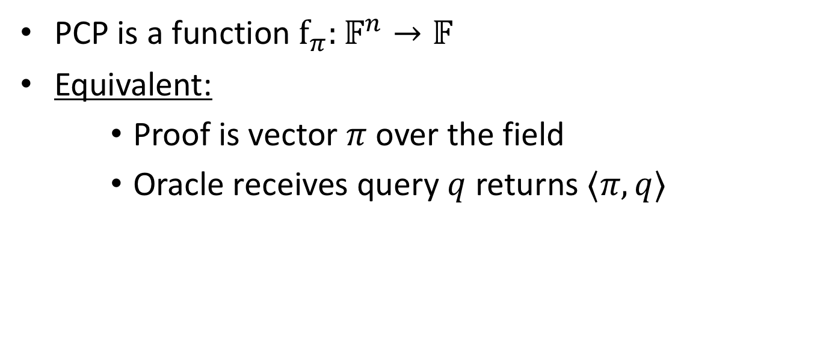
Linear PCP
PCP is a function $f_{π}:𝔽^{n}→𝔽$
Equivalent:
    Proof is vector $π$ over the field
    Oracle receives query $q$ returns $⟨π, q⟩$

Slide 17
Ishai, Kushilevitz, Ostrovksy ‘07
Cryptographic compiler:
Linear homomorphic encryption
4-move linear PCP based on Hadamard code
SNARK
Quadratic proving time
Linear verification time

Slide 18
QAPs
Gennaro, Gentry, Parno, Raykova 2013 (building on Groth ’10).
Quadratic Arithmetic Program instantiation of linear PCP
Developed further in many follow up works: PGHR13, Lipmaa13, BCIOP13, BCTV14, CFHKKNPZ15, Groth16

Slide 19
QAPs (GGPR)
Cryptographic compiler:
Linear-only encoding
[BCIOP’13]
QAP based linear PCP
SNARK
N log n proving time
Constant verification time
Notes:
Bitansky et. Al.

Slide 20
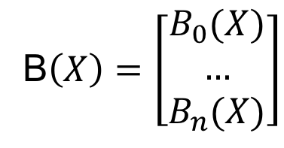
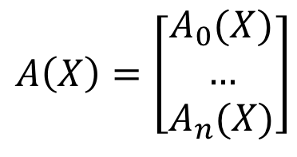
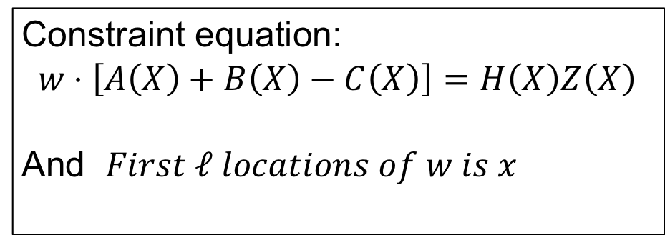
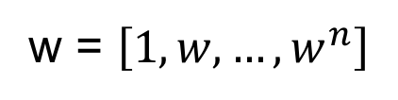
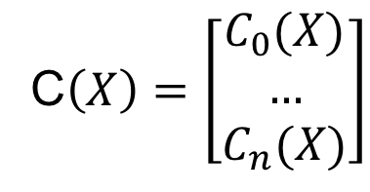
R1CS Example
Rank 1 constraint system [BCGTV13]
$$A\left(X\right)=\left[\begin{matrix}A_{0}(X) \\ … \\ A_{n}(X)\end{matrix}\right]$$
B$\left(X\right)=\left[\begin{matrix}B_{0}(X) \\ … \\ B_{n}(X)\end{matrix}\right]$
C$\left(X\right)=\left[\begin{matrix}C_{0}(X) \\ … \\ C_{n}(X)\end{matrix}\right]$
w = $\left[1,w,…,w^{n}\right]$
Constraint equation:
$$w⋅\left[A\left(X\right)+B\left(X\right)−C\left(X\right)\right]=H\left(X\right)Z\left(X\right)$$
And $First ℓ locations of w is x$

Slide 21
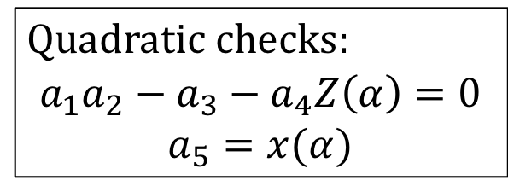
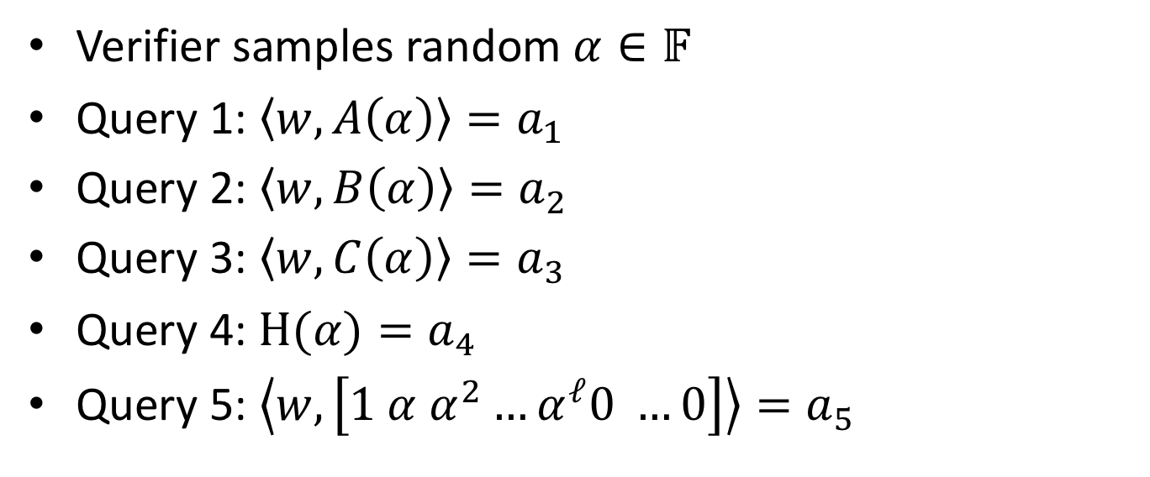
R1CS Linear PCP
Verifier samples random $α∈𝔽$
Query 1: $\left\langle w, A\left(α\right)\right\rangle =a_{1}$
Query 2: $\left\langle w, B\left(α\right)\right\rangle =a_{2}$
Query 3: $\left\langle w, C\left(α\right)\right\rangle =a_{3}$
Query 4: $H(α)=a_{4}$
Query 5: $\left\langle w, \left[1 α α^{2}…α^{ℓ}0 …0\right]\right\rangle =a_{5}$
Quadratic checks:
$$a_{1}a_{2}−a_{3}−a_{4}Z\left(α\right)=0$$
$$a_{5}=x(α)$$

Slide 22
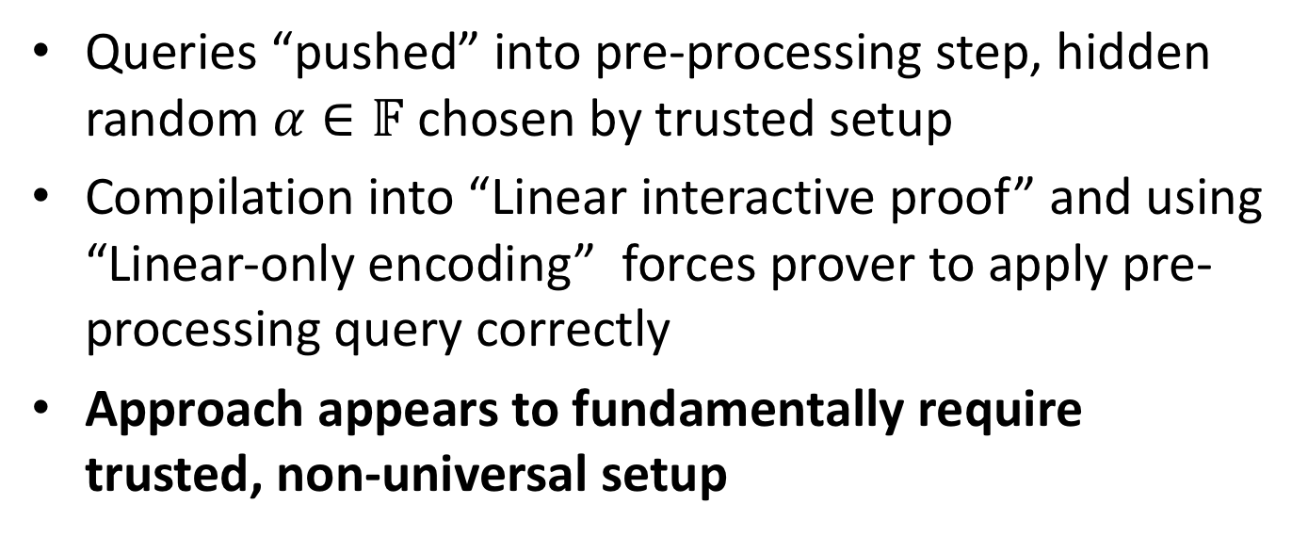
R1CS Preprocessing SNARK
Queries “pushed” into pre-processing step, hidden random $α∈𝔽$ chosen by trusted setup
Compilation into “Linear interactive proof” and using “Linear-only encoding” forces prover to apply pre-processing query correctly
Approach appears to fundamentally require trusted, non-universal setup

Slide 23
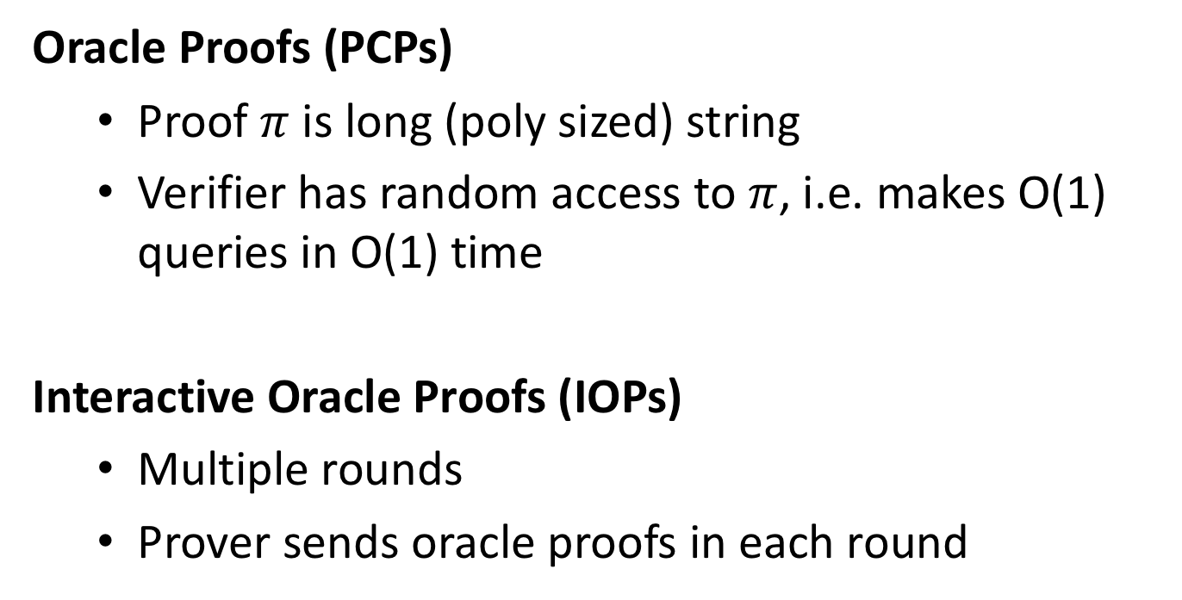
Interactive Oracle Proofs
[BCS16, RRR16]
Oracle Proofs (PCPs)
  Proof $π$ is long (poly sized) string
  Verifier has random access to $π$, i.e. makes O(1) queries in O(1) time
Interactive Oracle Proofs (IOPs)
  Multiple rounds
  Prover sends oracle proofs in each round

Slide 24
IOPs Efficiency
Multiple rounds allows for great efficiency gains over classical PCPs
BCGV16, BCFGRS17, BBCGHPRSTV17, BBHR18
Light-weight compilation (Merkle trees, hash functions) compared to linear PCP

Slide 25
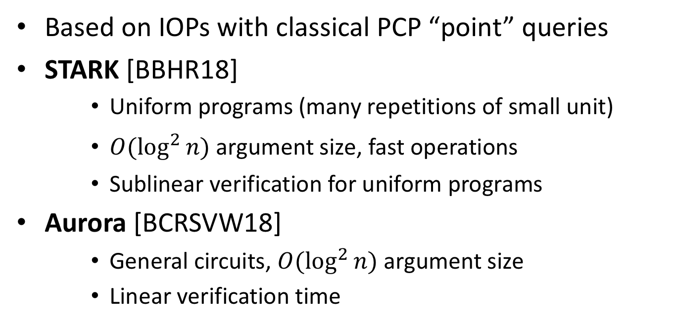
STARK, Aurora
Based on IOPs with classical PCP “point” queries
STARK [BBHR18]
    Uniform programs (many repetitions of small unit)
    $O(\log^{2}{n)}$ argument size, fast operations
    Sublinear verification for uniform programs
Aurora [BCRSVW18]
    General circuits, $O(\log^{2}{n)}$ argument size
    Linear verification time

Slide 26
Interactive linear PCPs?
What can be gained from linear PCPs with multiple rounds?
Linear IOPs (each round send linear PCP oracle, linear queries to prior oracles sent)

Slide 27
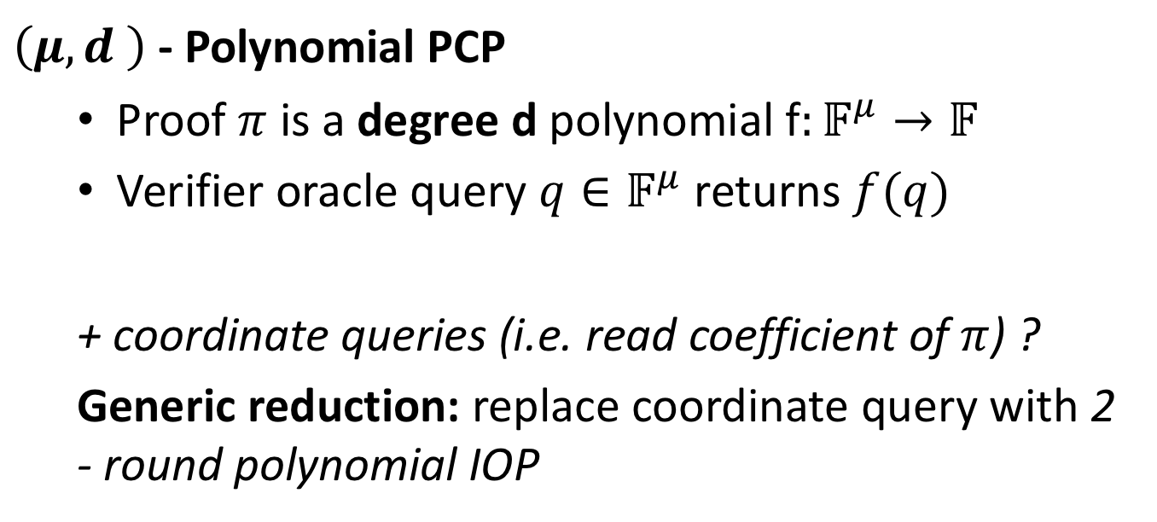
Polynomial IOPs
$\left(μ,d \right)$- Polynomial PCP
  Proof $π$ is a degree d polynomial f$:𝔽^{μ}→𝔽$
  Verifier oracle query $q∈𝔽^{μ}$ returns $f(q)$
  + coordinate queries (i.e. read coefficient of $π$) ?
  Generic reduction: replace coordinate query with 2 - round polynomial IOP
Notes:
Linear query is monomials derived from q

Slide 28


Polynomial IOPs
Point PCPs (short)
$$⊆$$
Polynomial PCPs
$$⊂$$
Linear
PCPs
Notes:
Linear query is monomials derived from q

Slide 29
Polynomial IOP Compilation
Cryptographic compilers
Polynomial IOPs
Public coin
Polynomial commitment
(Doubly-efficient) Interactive Proof
Fiat Shamir
SNARK

Slide 30
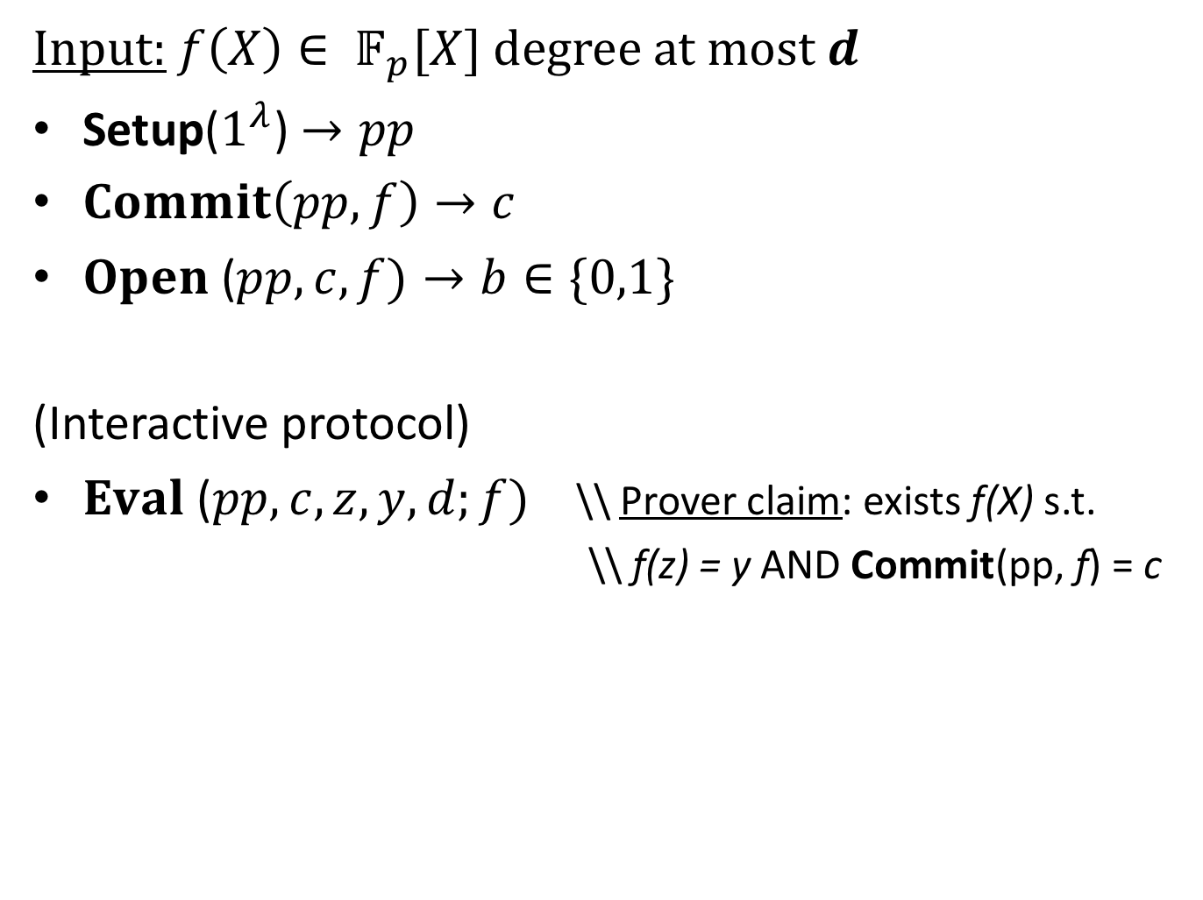
Polynomial Commitment [KZG’10]
Input: $f\left(X\right)∈ 𝔽_{p}[X]$ degree at most $d$
Setup($1^{λ}$) $→pp$
$Commit\left(pp,f\right)→c$
$Open$ ($pp, c, f)→b∈\{0,1\}$
(Interactive protocol)
$Eval$ ($pp, c, z, y,d;f)$ \\ Prover claim: exists f(X) s.t.
  \\ f(z) = y AND Commit(pp, f) = c

Slide 31

Efficiency: Succinctness
Input: $f\left(X\right)∈ 𝔽_{p}[X]$ degree at most $d$
Setup($1^{λ}$) $→pp$
$Commit\left(pp,f\right)→c$
$Open$ ($pp, c, f)→b∈\{0,1\}$
(Interactive protocol)
$Eval$ ($pp, c, z, y,d;f)$ \\ Prover claim: exists f(X) s.t.
  \\ f(z) = y AND Commit(pp, f) = c
|c| << f(X)
ideally O($λ$)
Communication sublinear in |f(X)|
Notes:
|f(X)| is size of representation of poynomial, e.g. coefficient vector length

Slide 32
Security: Binding / Knowledge
Input: $f\left(X\right)∈ 𝔽_{p}[X]$ degree at most $d$
Setup($1^{λ}$) $→pp$
$Commit\left(pp,f\right)→c$
$Open$ ($pp, c, f)→b∈\{0,1\}$
(Interactive protocol)
$Eval$ ($pp, c, z, y,d;f)$ \\ Prover claim: exists f(X) s.t.
  \\ f(z) = y AND Commit(pp, f) = c
Standard commitment binding
Evaluation Binding / Argument of Knowledge

Slide 33

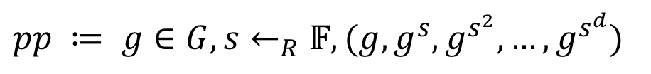
Transparent Setup
Input: $f\left(X\right)∈ 𝔽_{p}[X]$ degree at most $d$
Setup($1^{λ}$) $→pp$
Previous construction by Kate et. al. from Bilinear Groups had a trusted setup:
No secrets / publicly verifiable
$pp ≔ g∈G, s←_{R}𝔽, (g, g^{s},g^{s^{2}},…,g^{s^{d}})$
Secret

Slide 34
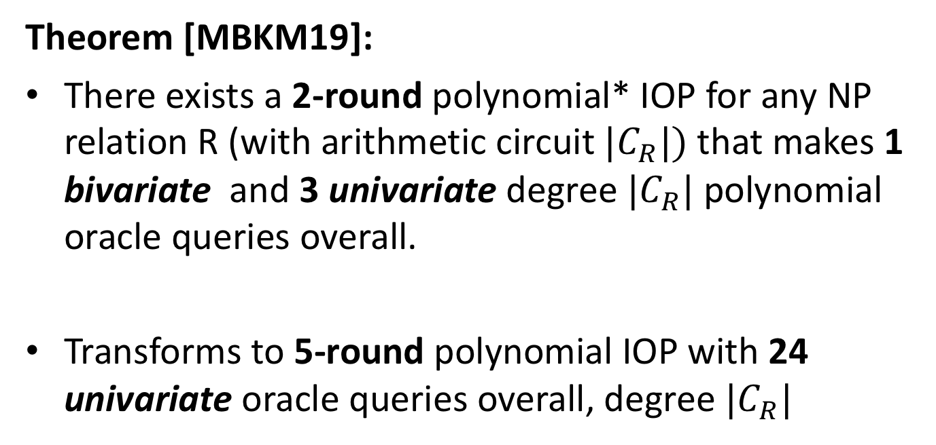
Sonic: Polynomial IOP for NP
Theorem [MBKM19]:
There exists a 2-round polynomial* IOP for any NP relation R (with arithmetic circuit ${|C}_{R}|)$that makes 1 bivariate and 3 univariate degree ${|C}_{R}|$polynomial oracle queries overall.
Transforms to 5-round polynomial IOP with 24 univariate oracle queries overall, degree ${|C}_{R}|$
Notes:
**Not really…assuming the IOP prover is restricted to sending Laurent polynomials that have no constant term. Or allowing coefficient queries for free.
Using our transformation for general coefficient queries, adds 1 round, three queries, but can be done in parallel (overall rounds remain the same)
Preprocessing: 4M oracles
Total number of online oracles is 4M + 2 = 14
Total number queries = 7M + 3 = 24 (batching removes 4 queries)

Slide 35
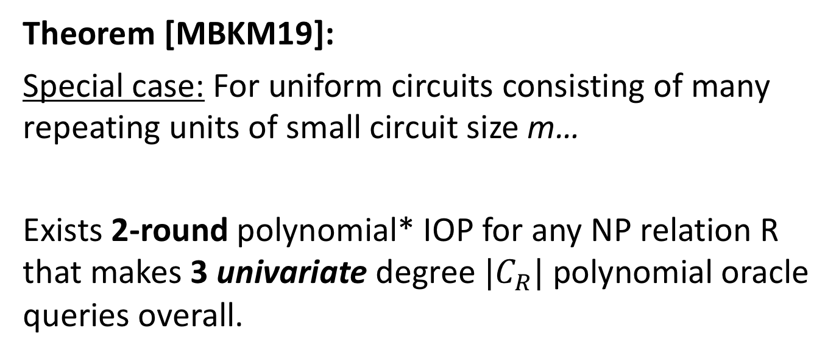
Sonic: Uniform Circuits
Theorem [MBKM19]:
Special case: For uniform circuits consisting of many repeating units of small circuit size m…
Exists 2-round polynomial* IOP for any NP relation R that makes 3 univariate degree ${|C}_{R}|$polynomial oracle queries overall.
Notes:
Total # oracles = 2

Slide 36
Sonic: Universal Setup
Applying polynomial commitments of Kate, Zaverucha, and Goldberg
Single trusted setup for all circuits
Linear time (publicly verifiable) pre-processing per circuit

Slide 37

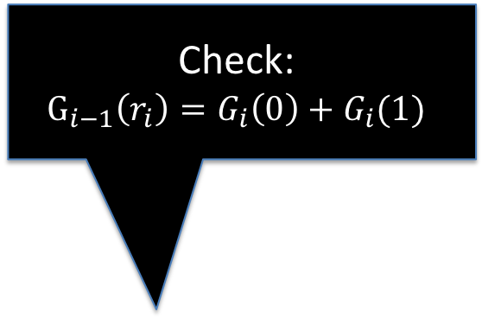
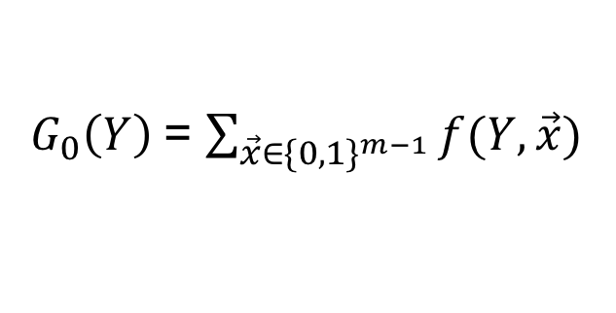

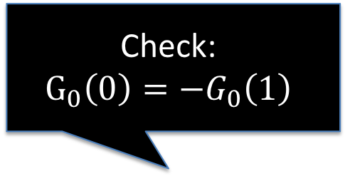
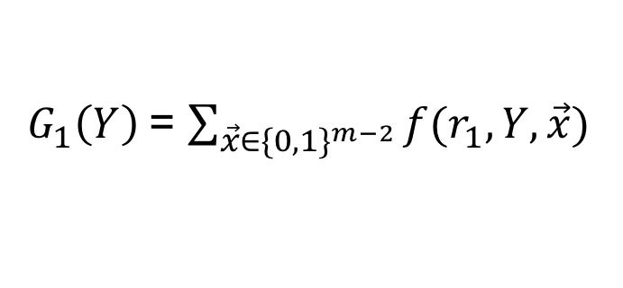
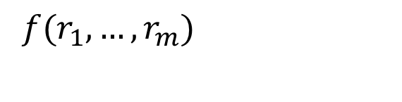

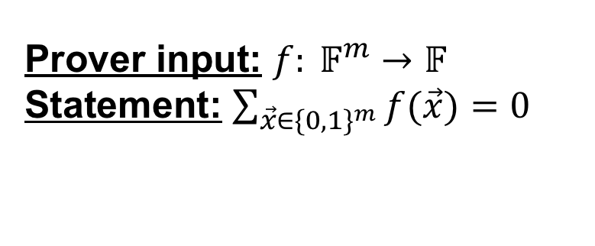

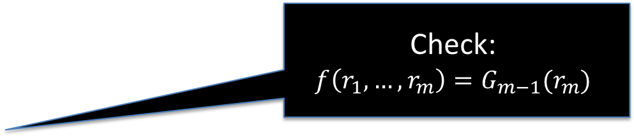
Sum-Check [LFKN’90]
Prover input: $f: 𝔽^{m}→𝔽$
Statement: $\sum_{\vec{x}∈\{0,1\}^{m}}{f(\vec{x}})=0$
Check:
$$G_{0}\left(0\right)=−G_{0}\left(1\right)$$
Check:
$$G_{i−1}\left(r_{i}\right)=G_{i}\left(0\right)+G_{i}(1)$$
$G_{0}\left(Y\right)$= $\sum_{\vec{x}∈\{0,1\}^{m−1}}{f(Y,\vec{x}})$
$$r_{1}$$
$G_{1}\left(Y\right)$= $\sum_{\vec{x}∈\{0,1\}^{m−2}}{f(r_{1},Y,\vec{x}})$
. . .
$$r_{i}$$
Check:
$$f\left(r_{1},…,r_{m}\right)=G_{m−1}(r_{m})$$
$G_{i}\left(Y\right)$= $\sum_{\vec{x}∈\{0,1\}^{m−i−1}}{f(r_{1},…,r_{i},Y,\vec{x}})$
. . .
$$r_{m}$$
$f(r_{1},…,r_{m})$

Slide 38
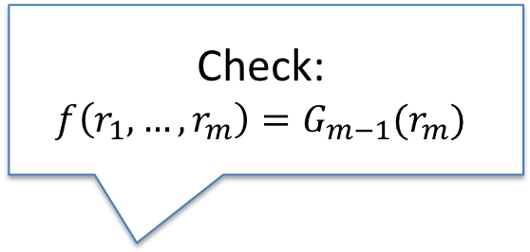
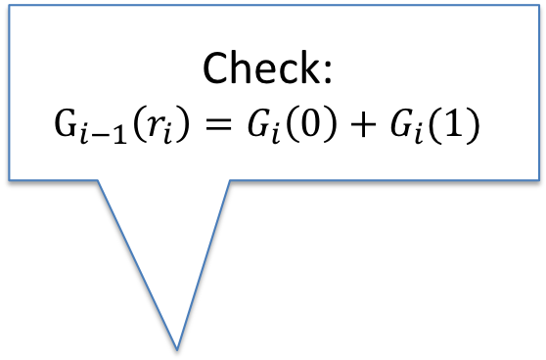
Sum-Check [LFKN’90]
Prover input: $f: 𝔽^{m}→𝔽$
Statement: $\sum_{\vec{x}∈\{0,1\}^{m}}{f(\vec{x}})=0$
Check:
$$G_{i−1}\left(r_{i}\right)=G_{i}\left(0\right)+G_{i}(1)$$
$G_{0}\left(Y\right)$= $\sum_{\vec{x}∈\{0,1\}^{m−1}}{f(Y,\vec{x}})$
Oracle queries
$$r_{1}$$
$G_{1}\left(Y\right)$= $\sum_{\vec{x}∈\{0,1\}^{m−2}}{f(r_{1},Y,\vec{x}})$
. . .
$$r_{i}$$
Check:
$$f\left(r_{1},…,r_{m}\right)=G_{m−1}(r_{m})$$
$G_{i}\left(Y\right)$= $\sum_{\vec{x}∈\{0,1\}^{m−i−1}}{f(r_{1},…,r_{i},Y,\vec{x}})$
Polynomial PCP oracles
. . .
$$r_{m}$$
$f(r_{1},…,r_{m})$

Slide 39
GKR Interactive Proof
Outputs
Output gates (layer 0)
Layer 1 Gates
. . .
. . .
Layer d Gates
Inputs

Slide 40
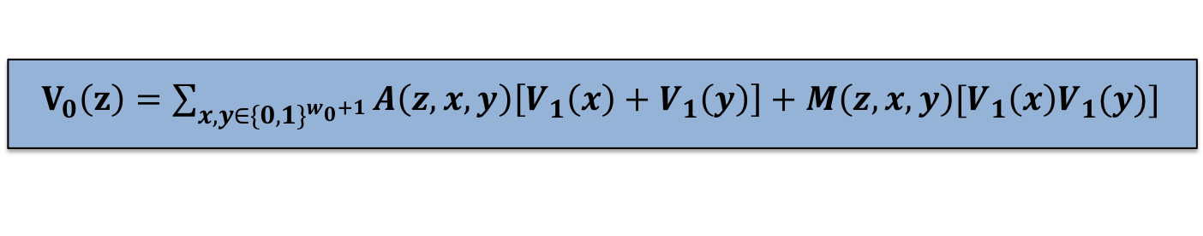
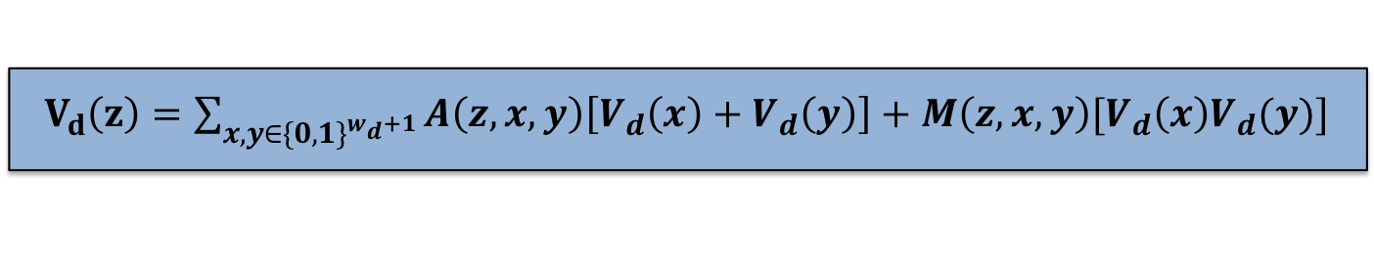
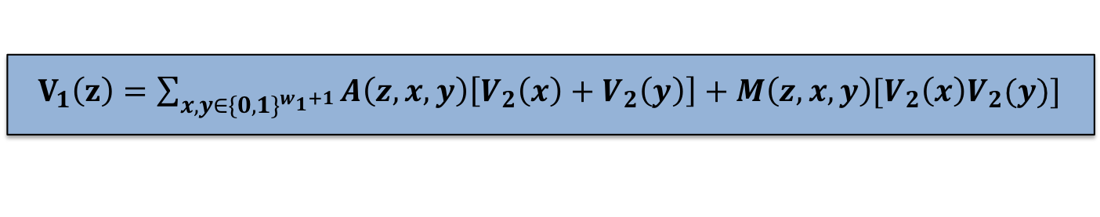
GKR Interactive Proof
Outputs
“Multilinear extension”
$V_{0}\left(z\right)=\sum_{x,y∈\{0,1\}^{w_{0}+1}}{A\left(z,x,y\right)\left[V_{1}\left(x\right)+V_{1}\left(y\right)\right]+M\left(z,x,y\right)[V_{1}\left(x\right)V_{1}(y)}]$
Output gates (layer 0)
Degree 1
2 log|C| variables
Layer 1 Gates
$V_{1}\left(z\right)=\sum_{x,y∈\{0,1\}^{w_{1}+1}}{A\left(z,x,y\right)\left[V_{2}\left(x\right)+V_{2}\left(y\right)\right]+M\left(z,x,y\right)[V_{2}\left(x\right)V_{2}(y)}]$
. . .
. . .
$V_{d}\left(z\right)=\sum_{x,y∈\{0,1\}^{w_{d}+1}}{A\left(z,x,y\right)\left[V_{d}\left(x\right)+V_{d}\left(y\right)\right]+M\left(z,x,y\right)[V_{d}\left(x\right)V_{d}(y)}]$
Layer d Gates
Inputs
Notes:
Recursive sum-check

Slide 41

GKR Interactive Proof
Outputs
$V_{0}\left(z\right)=\sum_{x,y∈\{0,1\}^{w_{0}+1}}{A\left(z,x,y\right)\left[V_{1}\left(x\right)+V_{1}\left(y\right)\right]+M\left(z,x,y\right)[V_{1}\left(x\right)V_{1}(y)}]$
Output gates (layer 0)
Verifier sends random z
Sum-check $V_{0}\left(z\right)−→Eval V_{0}(\vec{r})$
Prover claims $V_{1}\left(\vec{r}\right)=y_{1}, V_{2}\left(\vec{r}\right)=y_{2}$
Verifier sends random $α$
Recurse sum-check on:
$V_{1}\left(\vec{r}\right)+αV_{1}\left(\vec{r}\right)−y_{1}−αy_{2}=0$
Layer 1 Gates
$V_{1}\left(z\right)=\sum_{x,y∈\{0,1\}^{w_{1}+1}}{A\left(z,x,y\right)\left[V_{2}\left(x\right)+V_{2}\left(y\right)\right]+M\left(z,x,y\right)[V_{2}\left(x\right)V_{2}(y)}]$
. . .
. . .
$V_{d}\left(z\right)=\sum_{x,y∈\{0,1\}^{w_{d}+1}}{A\left(z,x,y\right)\left[V_{d}\left(x\right)+V_{d}\left(y\right)\right]+M\left(z,x,y\right)[V_{d}\left(x\right)V_{d}(y)}]$
Layer d Gates
Inputs
Notes:
Recursive sum-check

Slide 42
GKR as “Polynomial IOP”
O(d log |C|) rounds
Queries are on low degree polynomials,
  i.e. can be “read” entirely to evaluate (don’t require oracle access)

Slide 43
Libra [XZZPS’19]
Improvements to GKR
Reduce GKR prover time from quasi-linear to linear
ZK via small random masking polynomials
    Improvement of CFS’17
    1 extra degree 1, O(log |C|)-variate polynomial oracle per level
Compiled with hiding multivariate polynomial commitment
Trusted setup
[ZGKPP’17]

Slide 44
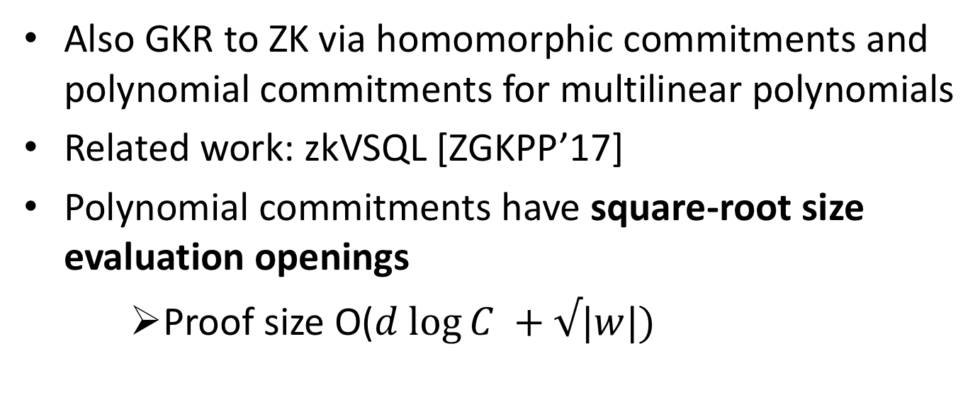
Hyrax [WTsTW’17]
Also GKR to ZK via homomorphic commitments and polynomial commitments for multilinear polynomials
Related work: zkVSQL [ZGKPP’17]
Polynomial commitments have square-root size evaluation openings
    Proof size O($d log⁡C +√|w|)$
No trusted setup
Notes:
W is size of witness

Slide 45
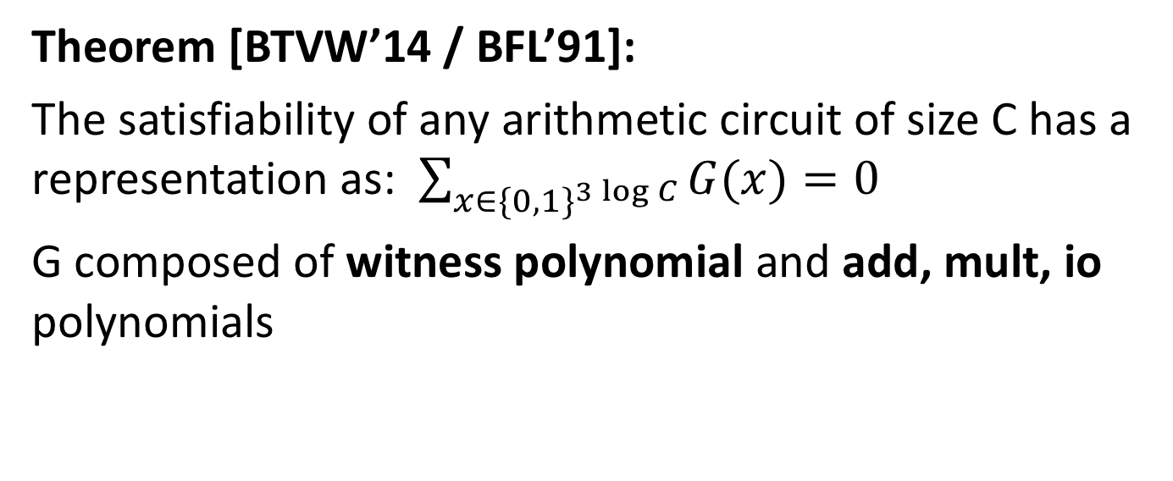
Spartan / Clover / BFL
Theorem [BTVW’14 / BFL’91]:
The satisfiability of any arithmetic circuit of size C has a representation as: $\sum_{x∈\{0,1\}^{3\log{C}}}{G(x)}=0$
G composed of witness polynomial and add, mult, io polynomials
log C variables, degree 1
3 log C variables, degree 1
Notes:
BFLS / BFL gave multilinear polynomial representation of Boolean formula satisfiability
Clover adapts this to arithmetic circuit
Clover suggested applying polynomial commitments, Spartan made this proposal more concrete
Represent C satisfiability as Sum over Boolean hypercube of multilinear polynomial on 3 log C variables, degree 3
Sum-check protocol → 3 log C rounds, 4 field elements sent in each round
At end query polynomial oracle on random assignment to the 3s variables
- Part of this is an s-variate degree 1 query to polynomial “Z” encoding the witness
- Another part is 3 independent 3s-variate degree 1 polynomials (add/mult/io) that verifier can locally verify at worst linear time, but better for say homogenous circuits

Slide 46
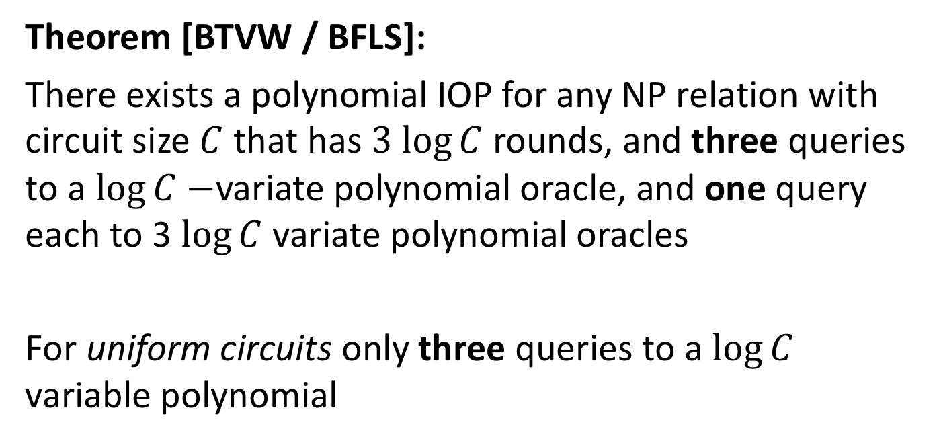
Spartan / Clover / BFLS
Theorem [BTVW / BFLS]:
There exists a polynomial IOP for any NP relation with circuit size $C$that has $3 log⁡C$rounds, and three queries to a $\log{C}−$variate polynomial oracle, and one query each to 3 $\log{C}$ variate polynomial oracles
For uniform circuits only three queries to a $\log{C}$ variable polynomial
Notes:
BFLS / BFL gave multilinear polynomial representation of Boolean formula satisfiability
Clover adapts this to arithmetic circuit
Clover suggested applying polynomial commitments, Spartan made this proposal more concrete
Represent C satisfiability as Sum over Boolean hypercube of multilinear polynomial on 3 log C variables, degree 3
Sum-check protocol → 3 log C rounds, 4 field elements sent in each round
At end query polynomial oracle on random assignment to the 3s variables
- Part of this is an s-variate degree 1 query to polynomial “Z” encoding the witness
- Another part is 3 independent 3s-variate degree 1 polynomials (add/mult/io) that verifier can locally verify at worst linear time, but better for say homogenous circuits

Slide 47
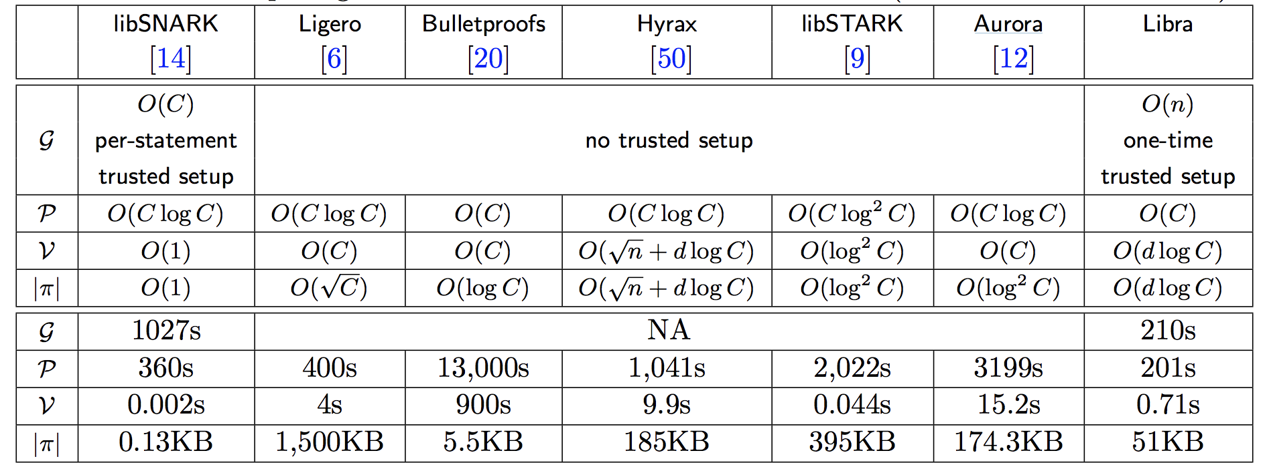
Recent Comparison
Implementation comparison in [XZZPS’19]

Slide 48
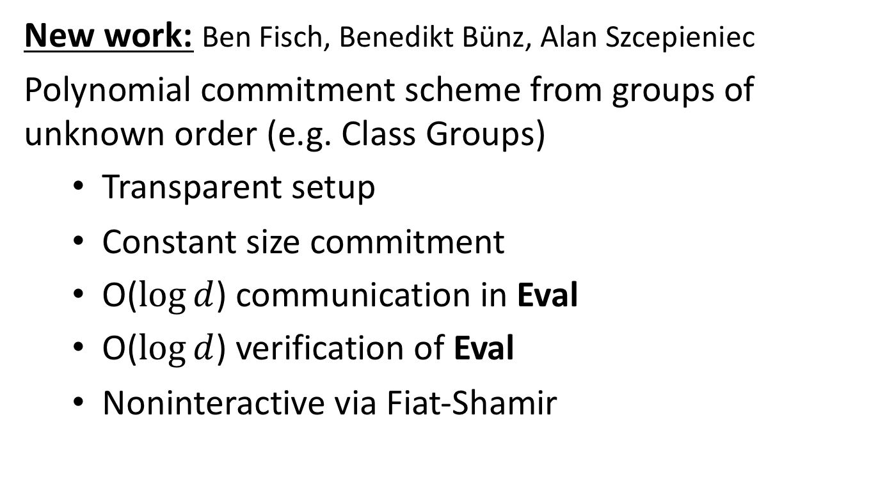
Transparent Setup Poly Commit!
New work: Ben Fisch, Benedikt Bünz, Alan Szcepieniec
Polynomial commitment scheme from groups of unknown order (e.g. Class Groups)
  Transparent setup
  Constant size commitment
  O($log⁡d$) communication in Eval
  O($log⁡d$) verification of Eval
  Noninteractive via Fiat-Shamir

Slide 49
Supersonic
Applying new polynomial commitment to Sonic polynomial IOP …
Trustless setup SNARK with log n proof size and log n verfication , quasi-linear prover time + preprocessing
24kB proof size for million gate circuits (optimizations possible)

Slide 50
Alan’s talk at Starkware Sessions
See Alan speak about more details on the new result next week!

Slide 51
Conclusion
Notes:
Lots of details and performance optimizations left out; also room for improvement. Recent work using accumulators and SNARKs to compress proof sizes further. Filecoin implementation and ongoing work.

