Slide 1

Proof-of-Verification for Proof-of-Work:
Miners Must Verify the Signatures on Bitcoin Transactions
Presentation at Scaling Bitcoin Workshop 2019 in Tel Aviv
2018年6月25日
Kanta MATSUURA
(Institute of Industrial Science,
The University of Tokyo)

Slide 2
Introduction

Slide 3
Revisit a technical origin of Bitcoin from the viewpoint of digital evidence
Resolution～Day
SRH_{n-1}
SRH_{n}
Super Root Hash
Resolution is very limited.
Verification/validation is assumed to be very infrequent.
Root Hash_{n}
H₁
H₂
Y₁=H(H(x₁), H(x₂))
Y₁
Y₂
Y₃
Y₄
H(x₁)
H(x₂)
H(x₃)
H(x₄)
H(x₅)
H(x₆)
H(x₇)
H(x₈)
S. Haber, W.S. Stornetta, "How to time-stamp a digital document," Journal of Cryptology, vol.3, no.2, pp.99-111, 1991.
A. Buldas et. al.: ``Time-Stamping with Binary Linking Schemes,'‘ Proc. CRYPTO '98, LNCS 1462, pp.486-501, 1998.

Slide 4

Digital Publicizing of SRH
Resolution～Second
Embedded in digital TV (data)
SRH_{n-1}
SRH_{n}
Resolution is better.
Verification/validation is assumed to be infrequent.
Root Hash of the requests
Tsutomu Morigaki, Kanta Matsuura, Osamu Sudo: ``An Analysis of Detailed Electronic Time-Stamping Using Digital TV'', Proceedings of the 2004 IEEE International Conference on e-Technology, e-Commerce, and e-Service (EEE04), pp.277-284, 2004.

Slide 5
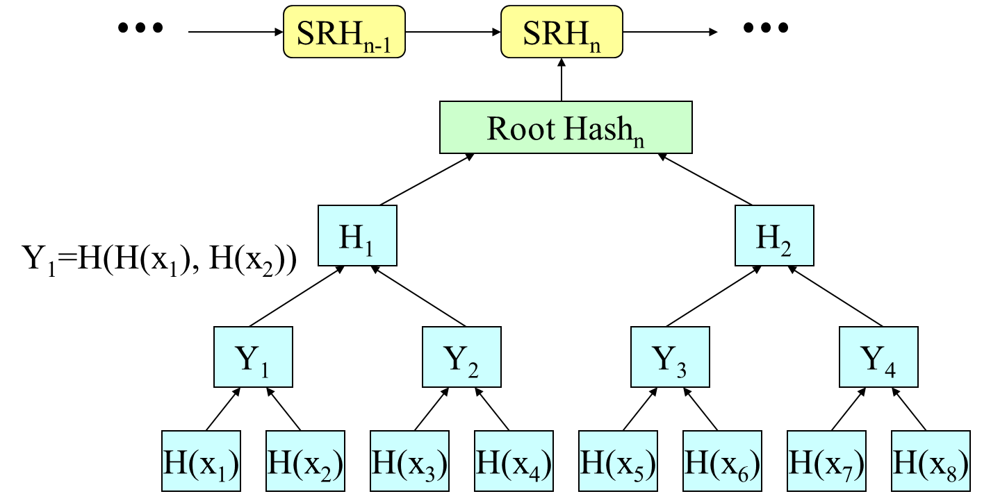
Avoiding TTP
S. Nakamoto. Bitcoin: A Peer-to-Peer Electronic Cash System. http://bitcoin.org/bitcoin.pdf, 2008.
Witness-based digital publicizing
  Incentive is needed.
  An answer is to give a reward.
Public verifiability in a P2P network
  Append-only database is (ideally) replicated at ledger nodes.
  Each transaction is digitally signed by the current owner of the coin.
  The payee is identified by the hashed value of his public key (the idea proposed by Chaum in 1981).
Resolution～Minute
“Verifiability” does not ensure that someone has really verified it.
However,
Reward

Slide 6

A research question
I can
verify.
I really
verified.
≠
Are we (any nodes) certain that another node has really verified the transactions to be included in the block of the current concern?
In this talk, we focus on the verification of the signatures on transactions.
  In order to fully verify the transaction, a node must also confirm that it is not an attempt of double-spending. This aspect is not explicitly considered here. However, it is worth noting that a node must visit the input transactions and confirm the public key corresponds to the recipient of the inputs in order to fully verify the signature.

Slide 7

Possible stories of the problem
Rushing miners may skip the verification so that they are in a better position in the competition of getting rewards.
  Signature verification is much more computationally expensive than hashing.
  The risk may get more significant if scalability innovation dramatically increases the number of transactions in a block.
Colluding nodes may skip the verification for the purpose of attacks.
Number of transactions in a block
Comp. cost of sig. verification
Coefficient controlled by the target value in PoW
X
Comp. cost of one hashing
X
>>
>>
Comp. cost
of one
hashing

Slide 8
Possible stories of the problem
Rushing miners may skip the verification so that they are in a better position in the competition of getting rewards.
  Signature verification is much more computationally expensive than hashing.
  The risk may get more significant if scalability innovation dramatically increases the number of transactions in a block.
Colluding nodes may skip the verification to allow some attacks.
Number of transactions in a block
Comp. cost of sig. verification
Coefficient controlled by the target value in PoW
X
Comp. cost of one hashing
X
>>
Many implementation issues
Comp. cost
of one
hashing

Slide 9
Proposal

Slide 10
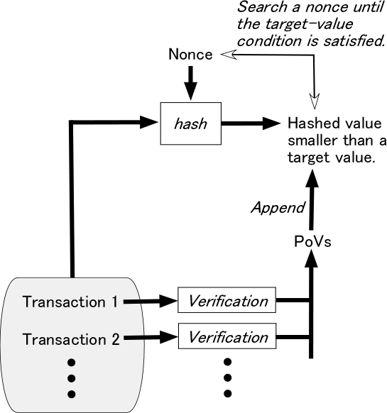
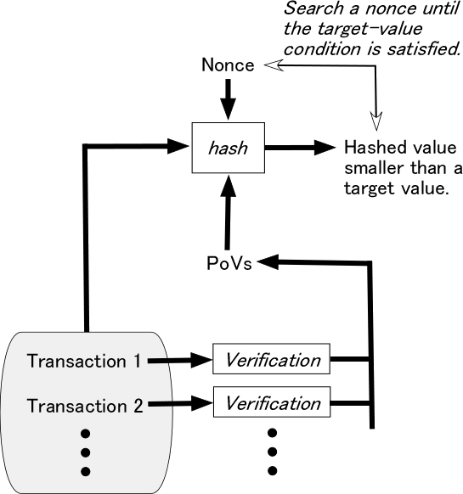
PoV: Proof-of-Verification
Explicit PoV
Implicit PoV
Anyone can verify
In theory, there are a wide variety of implementation options.

Slide 11
Schnorr’s digital signature scheme (1/2)
Employs a subgroup of order q in Z*_{p} where p is a large prime. By using a secure hash function h: {0, 1}* → Z_{q}, the scheme is described as follows.
Key generation
  Generate a generator g of the multiplicative group Z*_{p}.
  Select a random integer x such that 1 < x < p－1.
  Compute y = g^{x} mod p.
  Let (p, g, y) be the public key, and let x be the private key.
C.P. Schnorr. “Efficient signature generation by smart cards,” Journal of Cryptology, Vol.4, pp.161-174, 1991.

Slide 12
Schnorr’s digital signature scheme (2/2)
Proof-of-Verification
Signature generation for a message m.
  Select a random integer k such that 1≦k≦qｰ1.
  Compute r = g^{k} mod p, e=h(m,r), and s = xe + k mod q.
  The signature for m is the pair (s, e).
Signature verification
  Compute v = g^{s}y^{ｰe} mod p and e'=h(m,v).
  Accept the signature if and only if e' = e.
Computationally most expensive (and cannot be pre-computed)
K. Matsuura, H. Imai: ``Protection of Authenticated Key-Agreement Protocol against a Denial-of-Service Attack'', Proceedings of 1998 International Symposium on Information Theory and Its Applications (ISITA'98), pp.466-470, 1998.
K. Matsuura, H. Imai: Modified aggressive modes of Internet Key Exchange resistant against Denial-of-Service attacks. IEICE Trans. Info. Sys., Vol.E83-D (5), pp.972-979, 2000.

Slide 13
Evaluation & Discussion

Slide 14
Applicability
In many of digital signature schemes (e.g. DSA) based on the hardness of discrete logarithm (DL) problem (including the EC-based implementation), we can find such parameter(s) that can be a PoV.
This applies also to DL-based multi-signatures.
For example, in the case of a simple Schnorr multi-signature [1], g^{s} mod p (or its hashed value) can be a PoV.
Likewise, in the case of compact multi-signatures for smaller blockchains [2, 3], g^{s} mod p (or its hashed value) can be a PoV.
The same PoV mechanism can be considered for many of the PoW-based altcoins where DL-based (multi-)signatures can be used.
[1] G. Maxwell, et al. “Simple Schnorr multi-signatures with applications to Bitcoin.” Designs, Codes and Cryptography, Vol.87, Issue 9, pp.2139-2164, 2019.
[2] D. Boneh, et al. “Compact multi-signatures for smaller blockchains.” Scaling Bitcoin 2018.
[3] D. Boneh, et al. “Compact multi-signatures for smaller blockchains.” Proc. Asiacrypt2018, LNCS 11273, pp.435-464, Springer, 2018.

Slide 15
Computational cost for honest nodes (1/2)
Nodes who generate transactions
  No changes. The PoV mechanism is just naturally embedded.
Nodes who generate a block
  A proportional increase of component hashing (proportional to the number of the TXO’s) but much smaller than the total PoW hashing.
    Implicit PoV
    Explicit PoV
Small
Comparable size

Slide 16
Input of k bits (k>m)
Pad (0’s of d bits)
M₁
M₂
・ ・ ・
M_{n－1}
Segment of
m－t－1 bits
0’s
M₁
h*: (Z₂)^{m}→(Z₂)^{t},
where m>t+1
g₁
M₂
Binary
representation
1
g₂
M₃
1
M_{n}
1
g_{n}
(d)₂
1
0
Merkle-Damgard construction
≡ Output of h

Slide 17
Computational cost for honest nodes (2/2)
Nodes who are considering whether they agree to the newly reported block
  If they are not interested in signature verification but interested only in the verification of the nonce, the use of the implicit PoV increases the computational cost; the nodes must verify the signatures to compute
  before verifying the validity of the nonce.
  SPV (simplified payment verification) nodes who do not verify the signatures cannot verify the validity of the nonce if the implicit PoV is used.

Slide 18
Communication overhead
No changes in the case of the implicit PoV.
Marginal increase (just one hash) in the case of the explicit PoV.
Notes
  Miners in a pool would need additional internal communication to share the PoVs computed by another node in the same pool, depending on the implementation.
  The order of the PoVs of different transactions in the same block can be controlled in the same way as in the hash-tree aggregation of transactions. Therefore, the use of PoVs would not cause significant overhead of such control mechanisms.

Slide 19
If we accept larger communication overhead,
We may consider individually verifiable explicit PoV.
This time, I would just verify PoV₂.
Outside the block

Slide 20
Concluding remarks

Slide 21
Summary
I can
do.
I really
did.
≠
Dishonest nodes may skip the verification of the signatures on transactions. Such behaviors may allow malicious transactions to be included in a new block, and reduce the security.
This talk is a proposal of efficient Proof-of-Verification (PoV) to avoid such behaviors; the PoV mechanism is naturally embedded in the DL-based signature schemes.
  Communication overhead is marginal, and computational cost (of additional hashing) is proportional to the number of transactions.
  There are many implementation options. We can consider at least explicit PoV and implicit PoV.
Why don’t we introduce a field to accommodate the explicit PoV?

Slide 22


Future works
Collaborators welcome.
Advanced experimental evaluation.
  Experiments so far are not really interesting (and hence, omitted in today’s talk); they are just to confirm that the deployment of PoV under current parameters does not do significant harm to the performance of honest nodes.
Advanced theoretical evaluation.
  Related to the security model of SPV.
  Tradeoff between the proportional cost of PoV and the value of PoV.
Proof-of-full-Verification.
  Extending PoV so that we can verify someone else has confirmed there are no double-spending.
  Extending PoV so that we can verify someone else has done anti-malware operations on the scripts (e.g. detection).
  Maybe more.
Why don’t we introduce a field to accommodate the explicit PoV?

Slide 23

Thank you for your attention.
Extended abstract is available at
http://kmlab.iis.u-tokyo.ac.jp/papers/scaling19-matsuura-final.pdf

