Slide 1


A Tale of Two Trees: One Writes, and Other Reads
Optimized Oblivious Accesses to Large-Scale Blockchains
Duc V. Le, Adil Ahmad, Mohsen Minaei, Aniket Kate (Purdue University), Lizzy Hurtado (National University of Colombia), Byoungyoung Lee (Seoul National University)
le52@purdue.edu, aniket@purdue.edu
Link to the paper:

Slide 2
Motivation
Bitcoin data has become too large to store in resource-constrained devices like mobile phones(~239GB)
Current solution: BIP37 + Nakamoto’s idea = Simplified Payment Verification (SPV) client
Resource-constrained clients (thin clients) have to rely on other potentially malicious full clients to obtain transaction information
Notes:
As we all know, the size of the blockchain data has become too large to store in a resource constrain devices like mobile phones.
The current solution to address the storage issue is the Simplified Payment verification client. The design of this solution comes from Nakamoto’s idea in the white paper and is later standardized in the Bitcoin improvement proposal 37
In this setting, the rc clients have to rely on the full clients. However, there is privacy implication on this approach as the full clients can be malicious

Slide 3

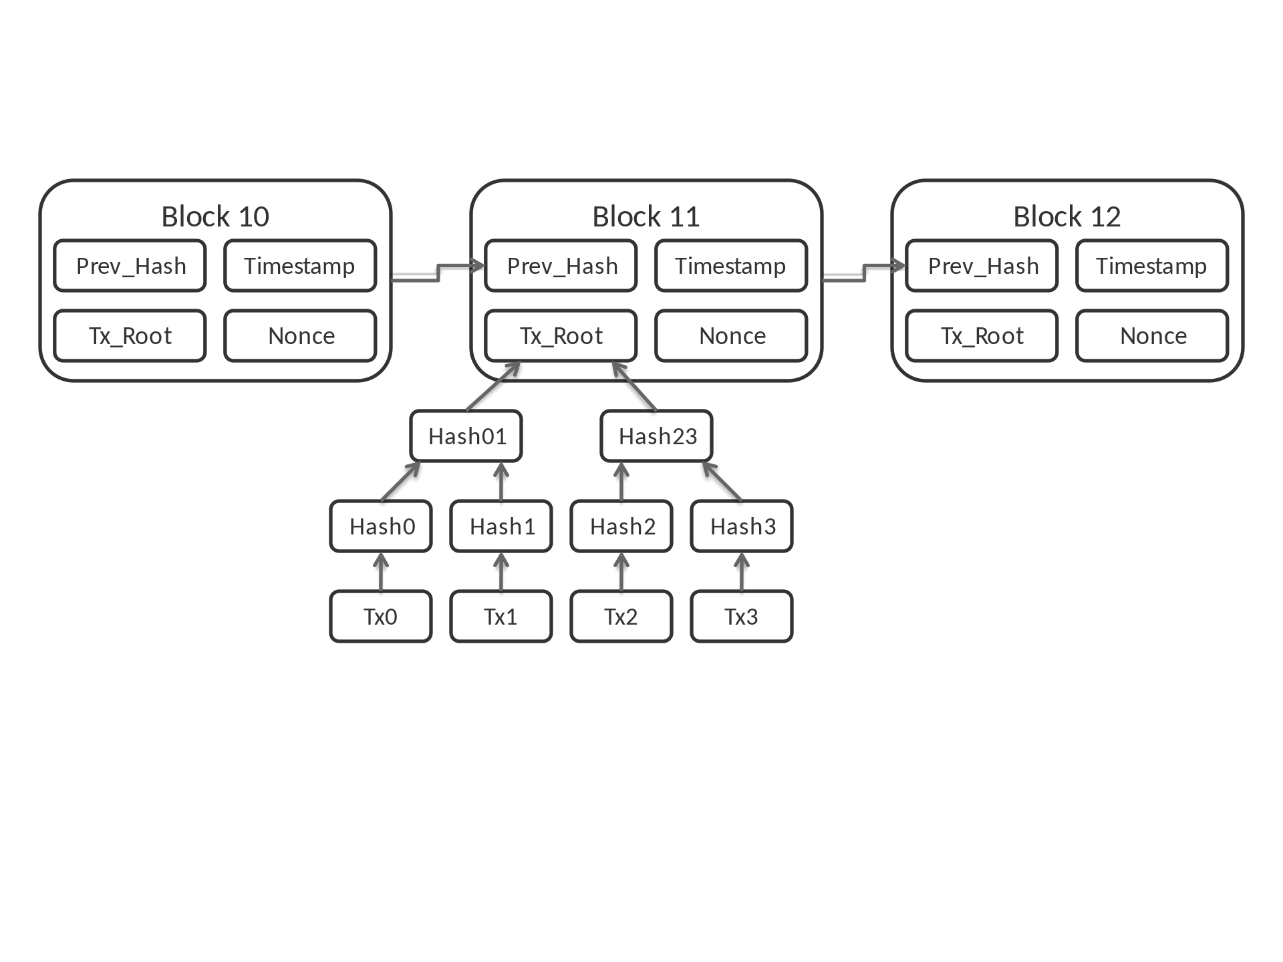
Nakamoto’s idea + BIP 37 = Current SPV client
addresses
tx
A
Bloom Filter
Full Client
Block
root
hash
hash
tx1
tx2
Notes:
The current solution relies on the use of Bloom filter.
In a simple term, Bloom filter is probabilistic memory-efficient data structure that allows users to test membership of elements that have been inserted in side the filter.
User can load addresses and transaction into the filter
Bloom filter provides a notion of efficiency and privacy

Slide 4

Motivation
Gervais et al. [1] have shown an attack on the current SPV. By looking at the filter, the adversary can correctly guess the addresses belonged to the SPV client.
Malicious Full Client
Give me all transactions of this address
[1] Arthur Gervais, Srdjan Capkun, Ghassan O. Karame, and Damian Gruber. On the privacy provisions of bloom filters in lightweight bitcoin clients. In ACSAC 2014

Slide 5
Solutions
We need a full client that offers private access to the thin client.
Malicious Full Client
Request
Response
What did he just fetch?

Slide 6
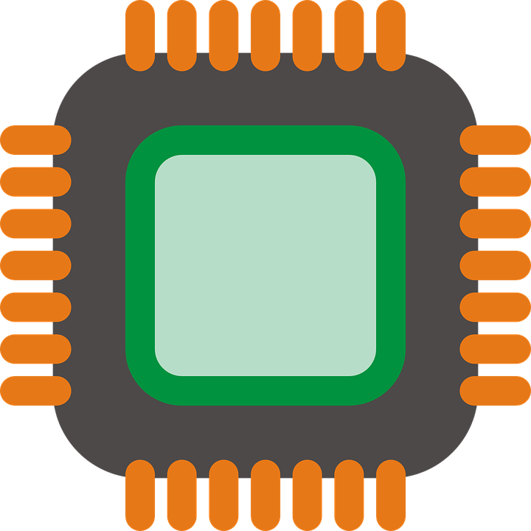

Generic Solutions
Using Private Information Retrieval techniques:
  Pure cryptographic approaches are not scalable.
  ORAM + Trusted Hardware = generic PIR solution.
Trusted hardware
ORAM Database of
Encrypted Entries
ORAM Client
tls/ssl channel
Malicious server environment
Notes:
Well studied problem in crypto community known as Private Information Retrieval
To our limited understanding, pure cryptographic approaches of PIR are not practical. In term of performance and bandwidth overhead
Trusted hardware resides on the server side the client can trust.
It secures the communication channel between the client and hardware
And use ORAM to hide access patterns on the encrypted database
The encrypted database here is the blockchain data

Slide 7
Oblivious RAM [1]
Cryptographic primitive that hides access pattern on encrypted data of a program.
Tree-based ORAM schemes: Path ORAM [2] and Circuit ORAM [3]
[1] O. Goldreich. Towards a theory of software protection and simulation by oblivious rams. In Proceedings of the Nineteenth Annual ACM Symposium on Theory of Computing, STOC ’87.
[2] Emil Stefanov, Marten van Dijk, Elaine Shi, Christopher Fletcher, Ling Ren, Xiangyao Yu, and Srinivas Devadas.
Path oram: An extremely simple oblivious ram protocol. CCS ’13.
[3] Xiao Wang, Hubert Chan, and Elaine Shi. Circuit oram: On tightness of the goldreich-ostrovsky lower bound. In Proceedings of the CCS ’15.
Notes:
Explain more about oram

Slide 8
Tree-based ORAM schemes
Path-ORAM example.
Client
Position map
Server
Block | Path
Id 1 | 1
Id 2 | 2
Id 3 | 4
Id 4
1
3
Stash
Read path 3
evict
1
2
3
4
Notes:
To understand how tree-based
Server stores all encrypted ORAM block data in a tree structure
On the client side,

Slide 9
Tree-based ORAM scheme
All the logics/data structures implemented in the client side are known as ORAM controllers
A Tree-based ORAM access can be generalized a combination of 2 operations, readpath and eviction.
Idea: Use ORAM to hide the access pattern of the thin client on the blockchain data
Notes:
All logics and data structures used on the client side are known as the ORAM controller
Tree based oram access can be generalized as a combination of readpath and eviction.
Different schemes offer different eviction strategy.
Take away ideas here are:
One can use ORAM to hide the access pattern of the thin client on the blockchain data

Slide 10
Trusted Execution Environment (TEE)
Intel SGX:
  Attestation Mechanism that allows SPV client to remotely authenticate the SGX.
  Set aside trusted memory regions known as enclave for code isolation. SGX processor makes sure no other program can access this memory region.
  Idea:
    implement ORAM controllers inside an enclave
    use ORAM controller to store and encrypt blockchain data in ORAM structure
    the intel SGX performs ORAM access on behalf of the Client.
Notes:
One instantiation of TEE is Intel SGX
Code isolation
Cpu with secret keys
Set a side a subset of RAM known as PRM at boottime

Slide 11
Untrusted memory
Enclave
Server
Client
Block | Path
 | 1
 | 2
 | 4
3
Stash
ORAM controller
4
1
2
3
Notes:
Now going back to the example:
Used to client and server.
ORAM tree can be stored and encrypted outside in the untrusted memory reason.
Even though, the program reside on the full client, the server cannot access those data structures.

Slide 12
Challenges
Combining ORAM and TEE as solution for blockchain introduces several challenges:
  ORAM storage blowup
  Lack of concurrency
  Mapping between address and ORAM block id
  Several limitations of Intel SGX such as limited secure memory
Notes:
In the following slides, I will explain it in more detailed.
And how our work addressed these challenges

Slide 13
Challenge 1: ORAM Storage overhead
Using ORAM incurs a constant storage blowup: 8x for Path-ORAM, 4x for Circuit ORAM.
Storing Bitcoin Blockchain into ORAM tree results 2TB of blockchain data in a tree structure.
Notes:
-One challenge of using oram is the constant storage blowup
-

Slide 14
Solution for Storage blow up
Securing oblivious accesses to the Unspent Transaction Outputs (UTXOs) set is sufficient
transaction
transaction
input
output
input
output
input
output
output
output
transaction
input
output
output
output
Notes:
As thing client, knowing those utxos is enough to determine balance and form new transactions

Slide 15
Solution for Storage blow up
Intuition: the SGX should obliviously and securely update UTXOs set, and provides thin clients with oblivious access to this database.
The size of the UTXO database is around 2.8GB. Therefore, the size of the ORAM tree is ~24GB for Path ORAM and ~12GB for Circuit ORAM.

Slide 16
Challenge 2: traditional ORAMs lack of concurrency
Concurrency
Client 1
Client 2
TEE
Untrusted Memory
Oram access
ReadPath
ORAM Tree
Eviction
Notes:
As stated before, oram access contains two operations: read, and eviction where eviction cause writing on the oram tree
This is a blocking operation which prevents other client from performing ORAM access

Slide 17

Challenge 2:
The Bitcoin network generates new block every 10 minute
New block can generate thousands ORAM update requests.
Bitcoin Network
Client 2
TEE
Untrusted Memory
Bitcoin Block
Oram accesses
ORAM Tree
Notes:
In our setting, the problem becomes more prominent. Because:
….
Blocking all requests from the client

Slide 18
Solution for Concurrency
Introduces 2 ORAM trees: read-once tree and original tree to allow non-blocking eviction.
Read Tree
ReadPath
Synchronizes every block interval
ORAM Access
Original Tree
Evict
Notes:
Emphasis this step

Slide 19
Solution for Concurrency
Security
  For each address, the rational SPV client should only request once during an interval of 10 minutes.
  The system synchronizes 2 trees every 10 minutes.
Efficiency:
  Improve latency from the perspective of the thin clients

Slide 20
Challenge 3: Trusted memory region is limited
The size of the trusted memory region (PRM) is limited to ~96MB [1] (allocating more memory is possible, performance will suffer)
Naïve use of ORAM will quickly cause the PRM to run out of memory.
[1] Sergei Arnautov, Bohdan Trach, Franz Gregor, Thomas Knauth, Andre Martin, Christian Priebe, Joshua Lind, Divya Muthukumaran, Dan O’Keeffe, Mark L. Stillwell, David Goltzsche, Dave Eyers, Rüdiger Kapitza, Peter Pietzuch, and Christof Fetzer. SCONE: Secure linux containers with intel SGX. (OSDI 16).
Notes:
Explain better
Recall that the enclave storing the position map and the stash
Bring the picture

Slide 21
Solution for limited trusted memory region
Using recursive ORAM construction. Storing the position map into another ORAM structure in the untrusted memory region.
enclave
Untrusted memory
Block | Path
 | 1
 | 2
 | 4
Block | Path
 | 1
 | 2
3

Slide 22
Challenge 4: Bitcoin Address and ORAM ID mapping
How the SGX knows how to translate Bitcoin Address into ORAM block.
Naïve approach 1: address = ORAM bid => Position map will be huge.
Naïve approach 2: deterministic hashing address into ORAM block => adversary can overflow a block

Slide 23
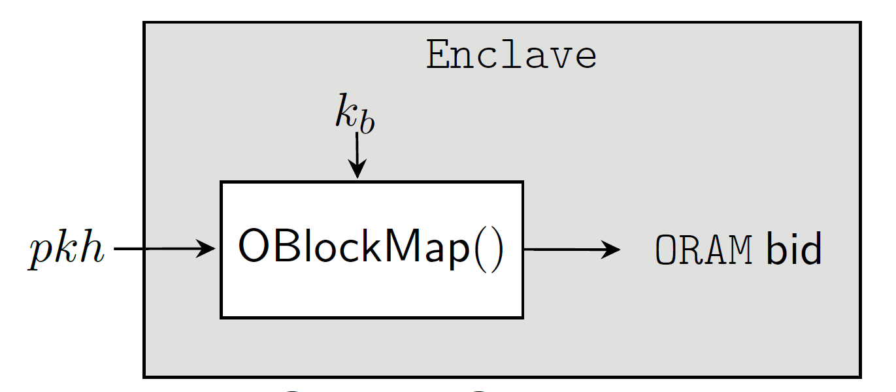
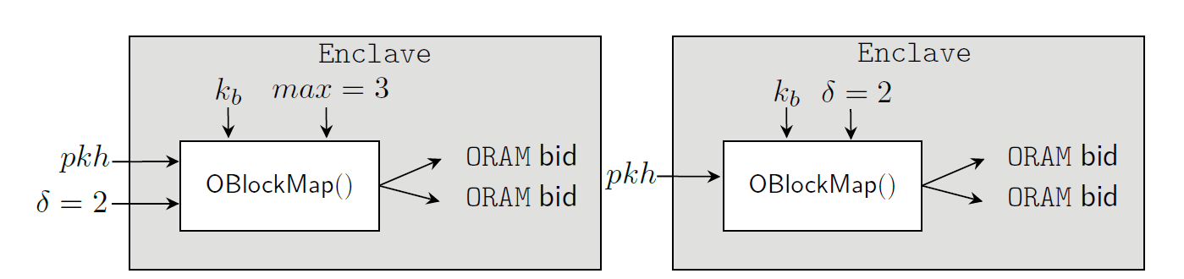
Solution for Address-ORAM block ID mapping
Using PRF OBlockMap() to map Bitcoin address into ORAM block ID where the secret key is generated by the SGX.
Notes:
In the paper, we define different mappings to allow trade off between performance and storage overhead

Slide 24
Problems
Introduce collisions: This is a standard max load analysis. One can show the ORAM block will have less than certain number of UTXOs with overwhelm probability
Some addresses have more output than others.
Notes:
Each Oram block will have less than certain number of utxo with overwhelm probability

Slide 25
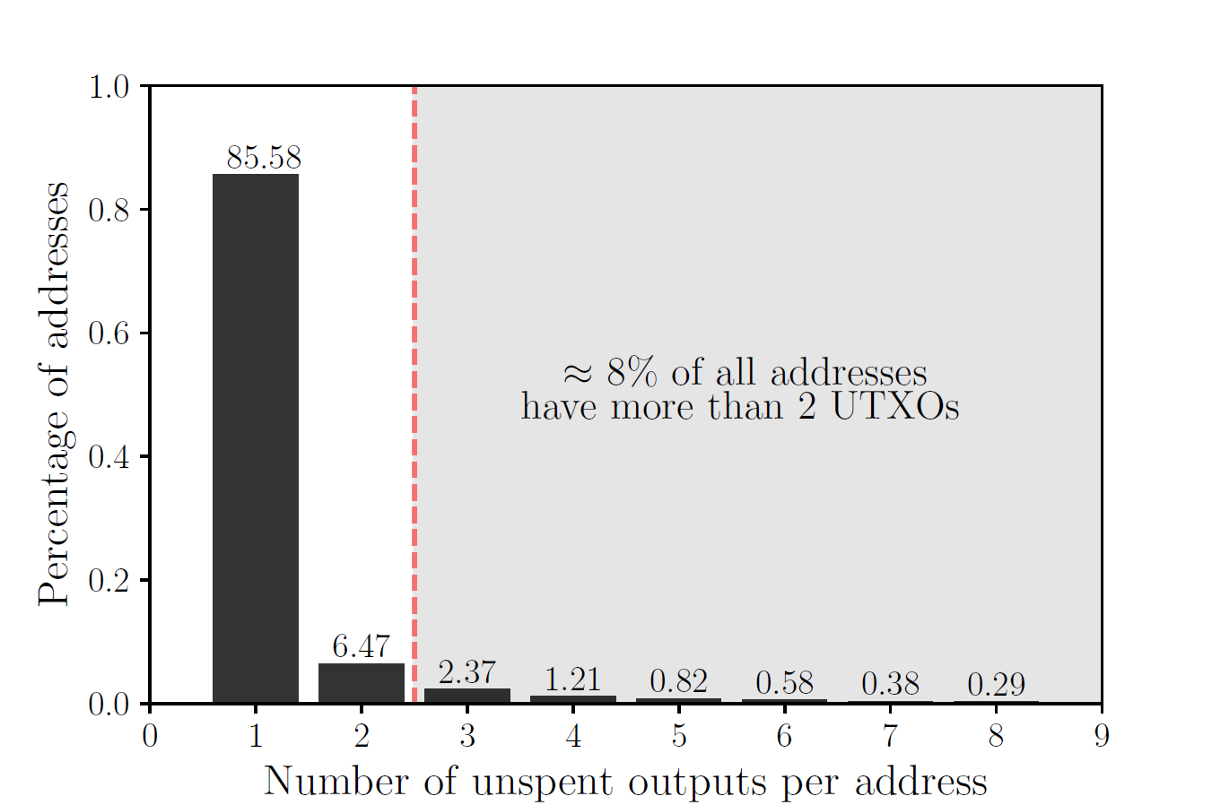
Output/Address distribution
Notes:
We find that 92% addresses have less than 2 utxo.
So the system designer can decide a threshold for the number of output each address can have

Slide 26
Several side-channel attacks against Intel SGX
Built on top of the implementations of Oblivate and Zerotrace.
Our system inherited standard secure operations from both libraries.
Their implementations use an oblivious access wrapper by using the x86 instruction cmov.
From the perspective of an attacker (which can only observe access-patterns), this is the same as reading or modifying every byte in memory.

Slide 27
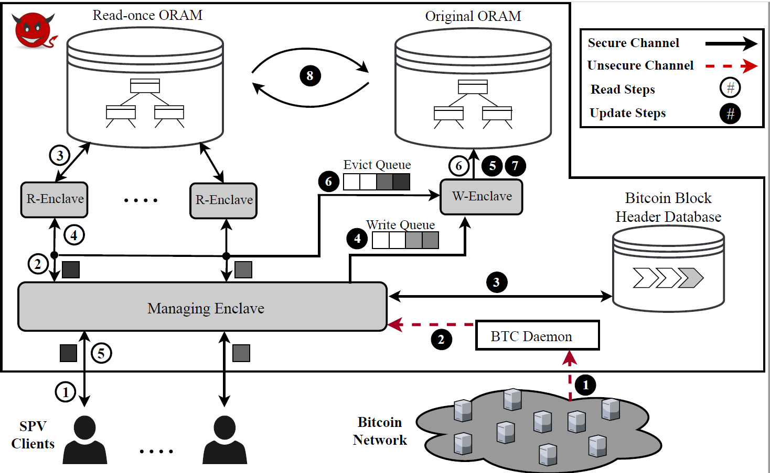
Putting things together
Notes:
If read request comes in burst, this allow to amortize the cost of evictions over the block interval .

Slide 28
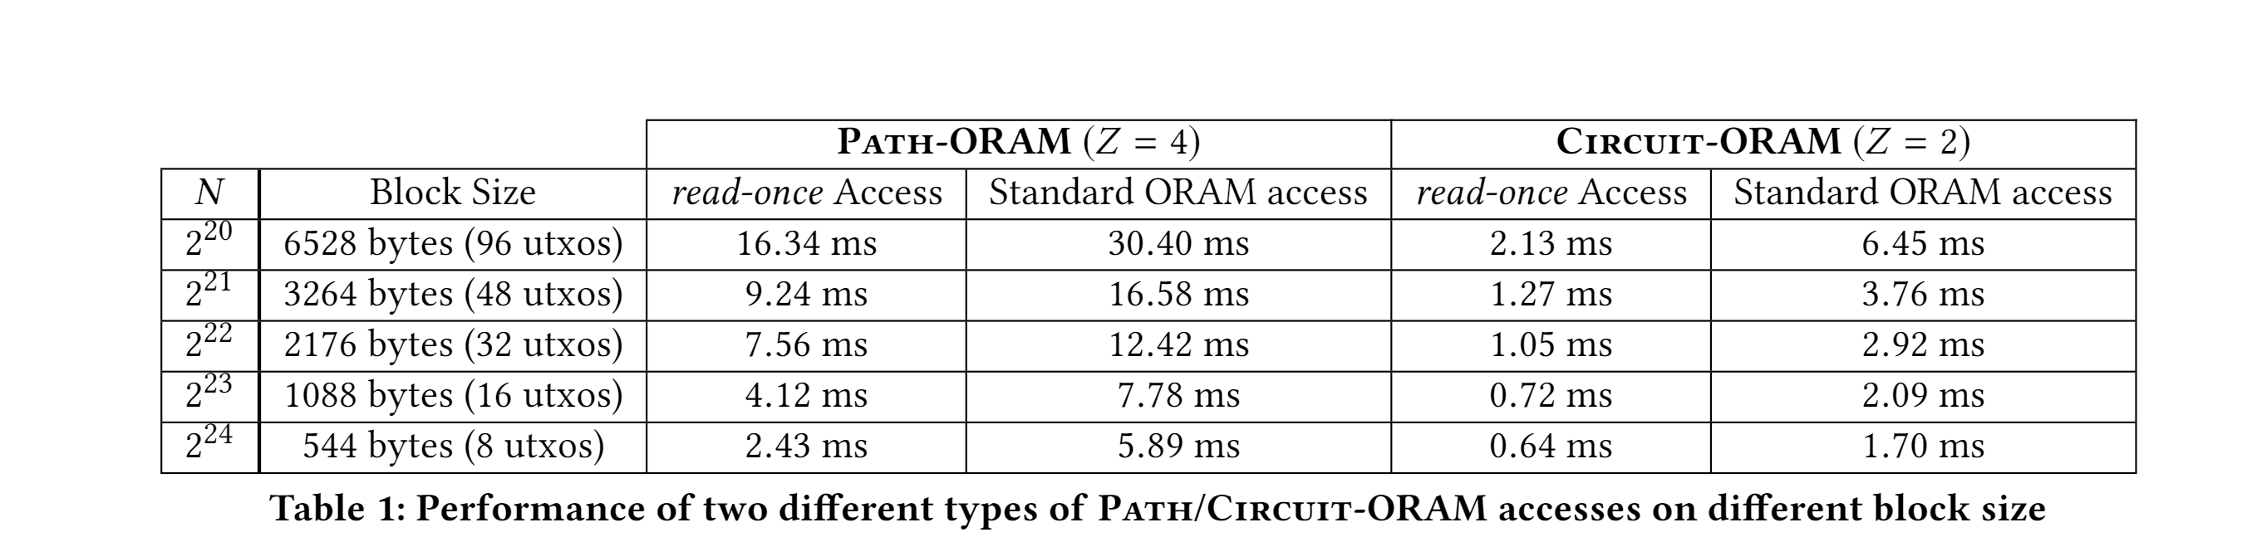
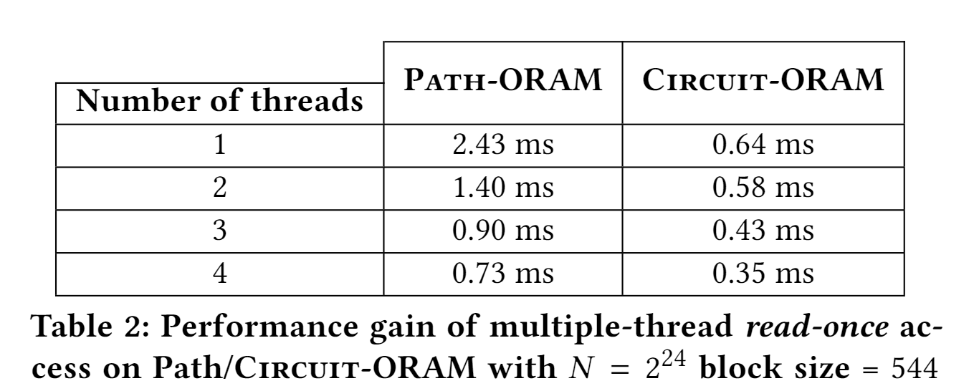
Evaluation

Slide 29
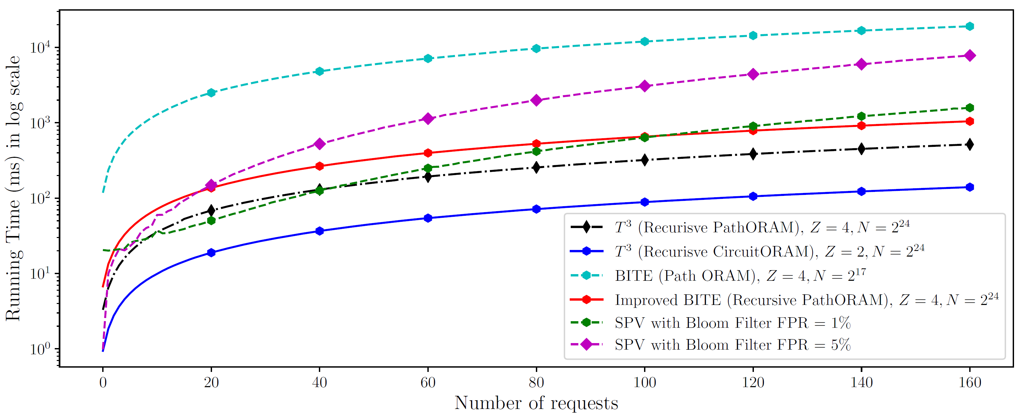
Evaluation
Notes:
Explain which one is ours.
We compare the prototype performance with other solutions including the current spv client with bloom filter
And
Bite system which uses ORAM as it is

Slide 30
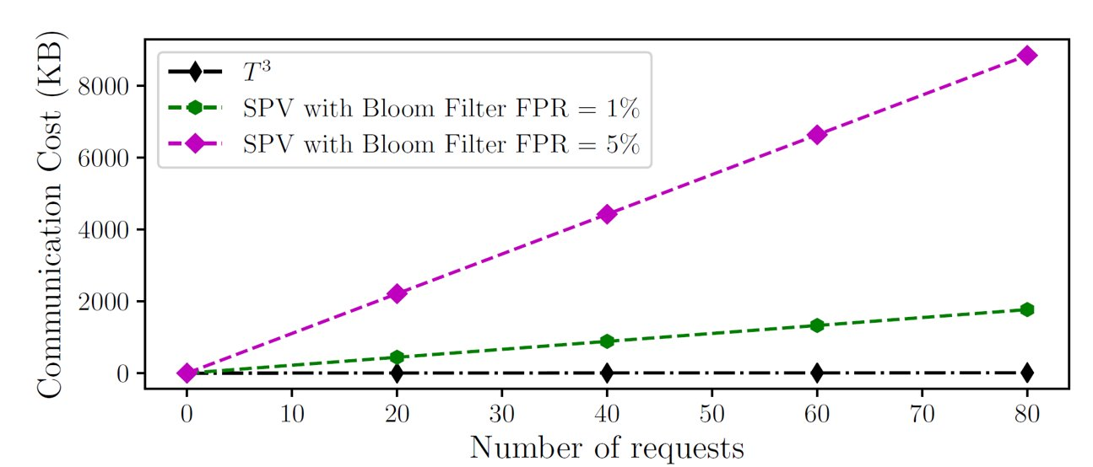
Bandwidth overhead
Notes:
We showed that the bandwidth overhead is much lower compare to the current solution of SPV client.
The reason is because
Mobile phone uses less data

Slide 31
Conclusion
We developed a system design that supports a large-scale oblivious search on UTXOs while efficiently maintains the state of the Bitcoin UTXO set via an oblivious update protocol.
We addressed several challenges of naïve use of ORAM and TEE for blockchain setting.
Notes:
Use conclusion from the paper
2-3

Slide 32
Thank you!
Email: le52@purdue.edu
Link to paper:
Notes:
Thank you for listening, and I am ready to answer any question you may help

