Slide 1





BackPackers: A New Network Paradigm
for High-Performance Blockchains
Thang N. Dinh
Fractal Platform Inc., USA
Virginia Commonwealth University, USA
Joint work with Phuc Thai, Hong-Sheng Zhou, Fan Lei, and Jonathan Katz
FRACTAL

Slide 2

Blockchain issues
Low throughput:
  Bitcoin ~ 7 txs/s
  Ethereum ~ 15 txs/s
  …
  VISA ~ 10,000 txs/s
High latency (i.e., confirmation time):
  Bitcoin/Ethereum ~ 1 hour
  VISA ~ 7 seconds

Slide 3
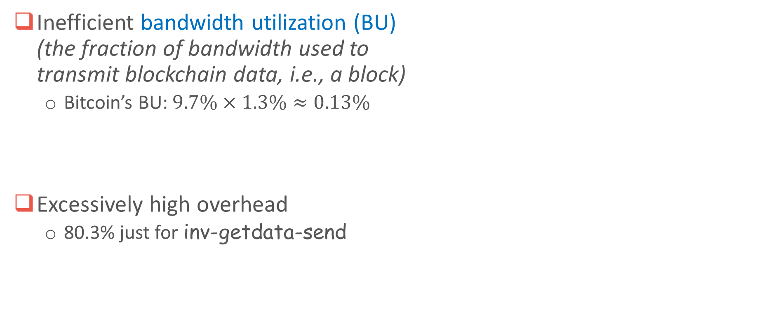
Case study: Bitcoin’s network activity
Inefficient bandwidth utilization (BU)
(the fraction of bandwidth used to
transmit blockchain data, i.e., a block)
  Bitcoin’s BU: $9.7\%×1.3\%≈0.13\%$
Excessively high overhead
  80.3% just for inv-getdata-send
Block
9.7%
Txs
10%
Overhead
80.3%
Used bandwidth
1.3%
Unused bandwidth 98.7%
(Avg.) block interval: 10 min,
block size: 2MB, avg. connection: 32

Slide 4
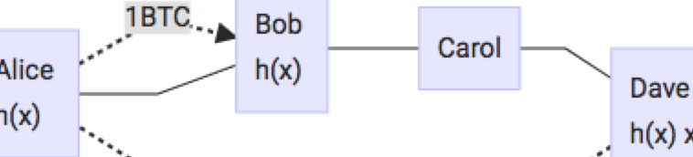
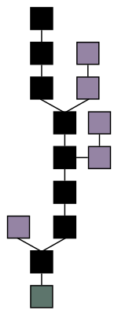
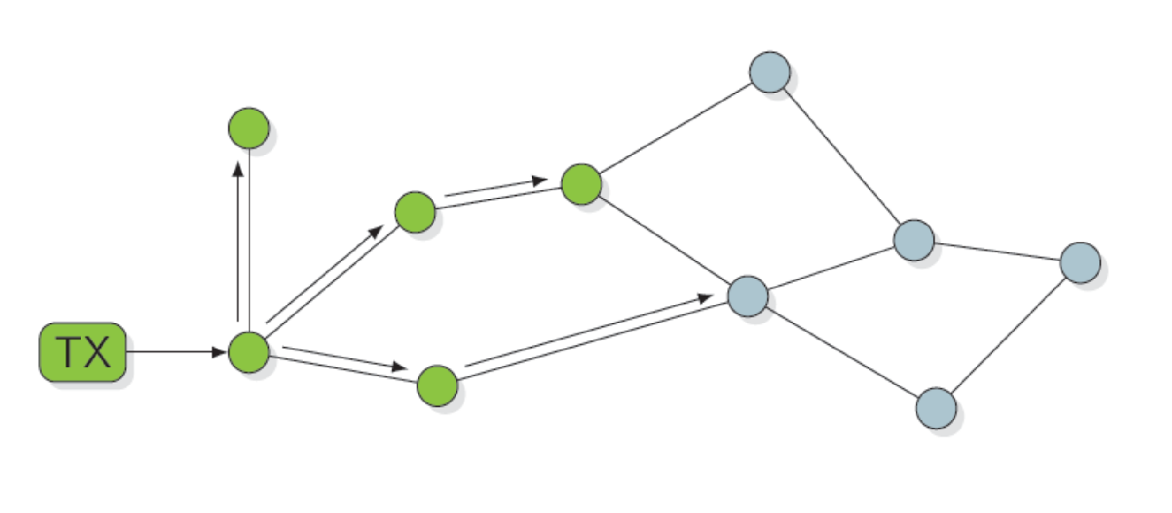
Scaling proposals
Layer-2 (off-chain)
  Payment channels: Lightning/Raiden network
  Pegged sidechains, Plasma
Layer-1 (consensus layer)
  Bitcoin-NG
  DAG-based: SPECTRE, Phantom, Conflux, Prism
  BFT protocols, Sharding
Layer-0 (networking layer)
  Bitcoin Compact (BIP 152)
  FIBRE, Falcon, bloXroute
  Few and far between!

Slide 5
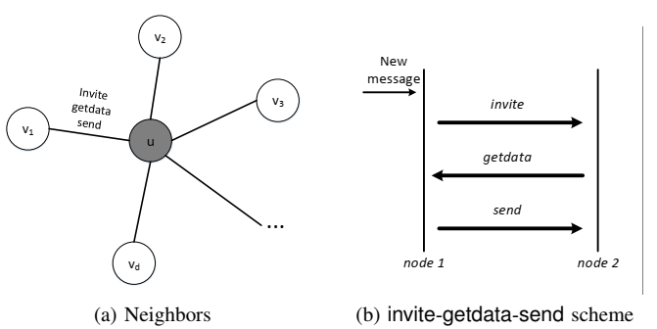
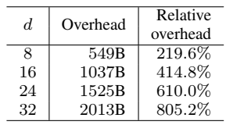
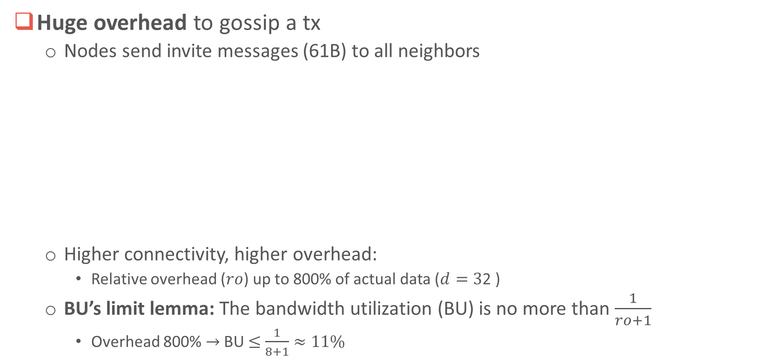
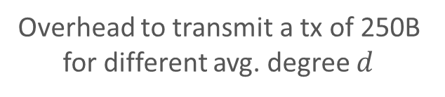
Performance bottleneck I: tx relay
Huge overhead to gossip a tx
  Nodes send invite messages (61B) to all neighbors
  Higher connectivity, higher overhead:
    Relative overhead ($ro$) up to 800% of actual data ($d=3$2 )
  BU’s limit lemma: The bandwidth utilization (BU) is no more than $\frac{1}{ro+1}$
    Overhead 800% $→$ BU $≤$ $\frac{1}{8+1}≈11\%$
Overhead to transmit a tx of 250B
for different avg. degree $d$

Slide 6
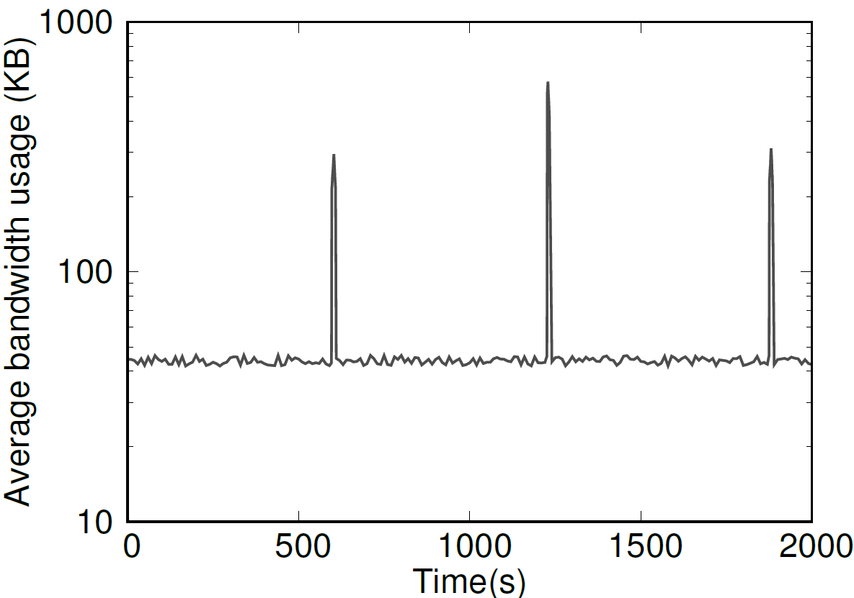
Performance bottleneck II: inefficient scheduling
Intermittent transmission
  Traffic spikes when new
  block created, and otherwise unused
Unbalanced load
  A few nodes deliver most of
  the blocks
Bottleneck at source
  Block producer may have low
  upload bandwidth
5.5% of nodes propagate
blocks to 85% of nodes

Slide 7






BackPacker: data first, ordering later
Consensus = agreement on tx order
…
…
…
$${tx}_{i−1}$$
$${tx}_{i}$$
$${tx}_{i+1}$$
…
$${tx}_{i−1}$$
$${tx}_{i}$$
$${tx}_{i+1}$$
Agreement on set of txs
Agreement on ordering of txs
+
Optimize throughput
Optimize block-propagation time

Slide 8
Design overview
Introduce new entities called packers
  Receive transactions from users
  Periodically create pseudoblocks with signed sets of transactions
  Can be incentivized to participate (outside the scope of this talk)
Packers broadcast pseudoblocks to miners (and other packers)
  Lower overhead; invite-request-get per pseudoblock, rather than per tx!
Miners solve puzzles on blocks as before
  Blocks include pseudoblocks rather than txs
After solving a puzzle, broadcast meta-block rather the block
  Meta-block identifies which pseudoblocks are included, and their order
  Important that pseudoblocks have been propagated already

Slide 9
Results
Nodes’ bandwidth: 20 Mbps Nodes’ bandwidth: 100 Mbps
Protocol | Throughput (tps) | Bandwidth utilization | Propagation time (s)
Bitcoin | 197 | 1.9% | 8.9
Bitcoin-c | 423 | 4.0% | 3.5
Bitcoin-NG | 331 | 3.2% | 5.3
Conflux | 340 | 3.2% | 9.5
Prism | 382 | 3.6% | 5.6
BackPacker | 7542 | 71.9% | 0.8
Protocol | Throughput (tps) | Bandwidth utilization | Propagation time (s)
Bitcoin | 712 | 1.4% | 7.4
Bitcoin-c | 1142 | 2.2% | 3.4
Bitcoin-NG | 1754 | 3.3% | 3.7
Conflux | 953 | 1.8% | 7.7
Prism | 2032 | 3.9% | 4.2
BackPacker | 38,010 | 72.5% | 0.8
Throughput:
More than 10x higher than the others
Achieve up to 70% optimality
~Visa-scale (40k tps) for good network
Block-propagation time:
<1s
Optimal propagation time
Independent of throughput/load.
Notes:
Notes:
+ At 100Mbps, Bitcoin, Bitcoin-compact, Conflux throughput are limited by block size 2MB

Slide 10

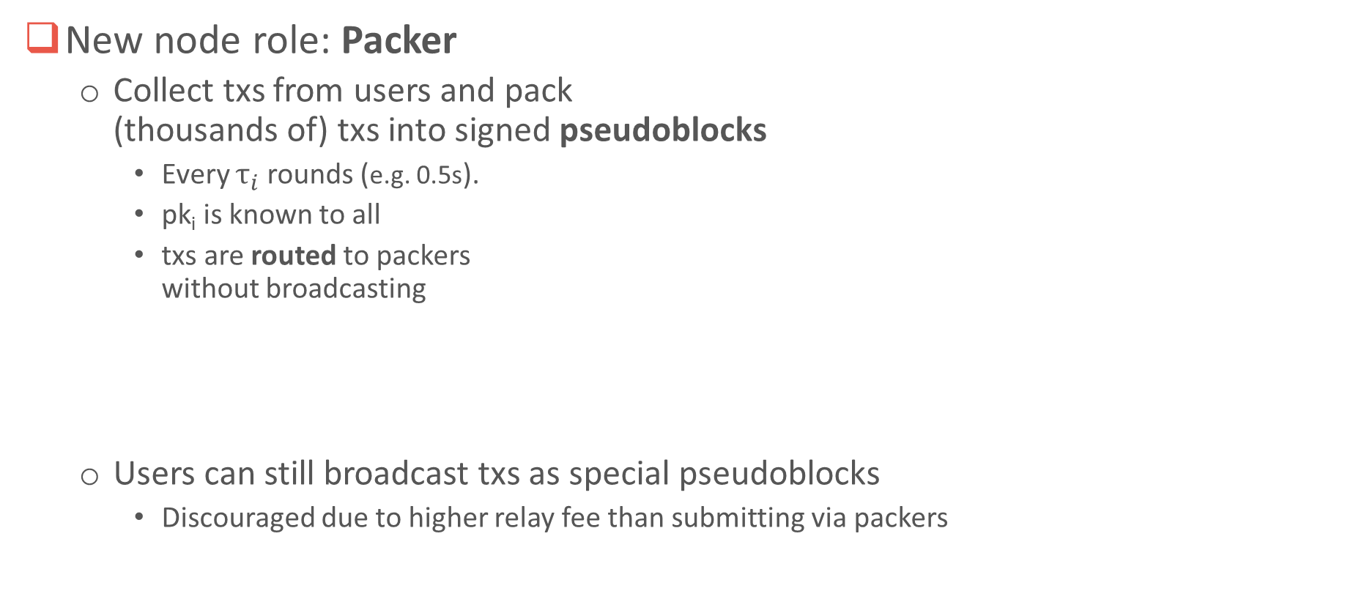






Packers and pseudoblocks (Txs batching)
New node role: Packer
  Collect txs from users and pack
  (thousands of) txs into signed pseudoblocks
    Every $τ_{i}$ rounds (e.g. 0.5s).
    pk_{i} is known to all
    txs are routed to packers
    without broadcasting
  Users can still broadcast txs as special pseudoblocks
    Discouraged due to higher relay fee than submitting via packers
round/timestamp
seq. #
signature
Packer
$$({pk}_{i}, {sk}_{i})$$
$$s, r, σ$$
$$…$$
$$…$$
$$TXs$$
$$…$$
$$…$$
transactions
pseudoblocks
every 0.5s

Slide 11
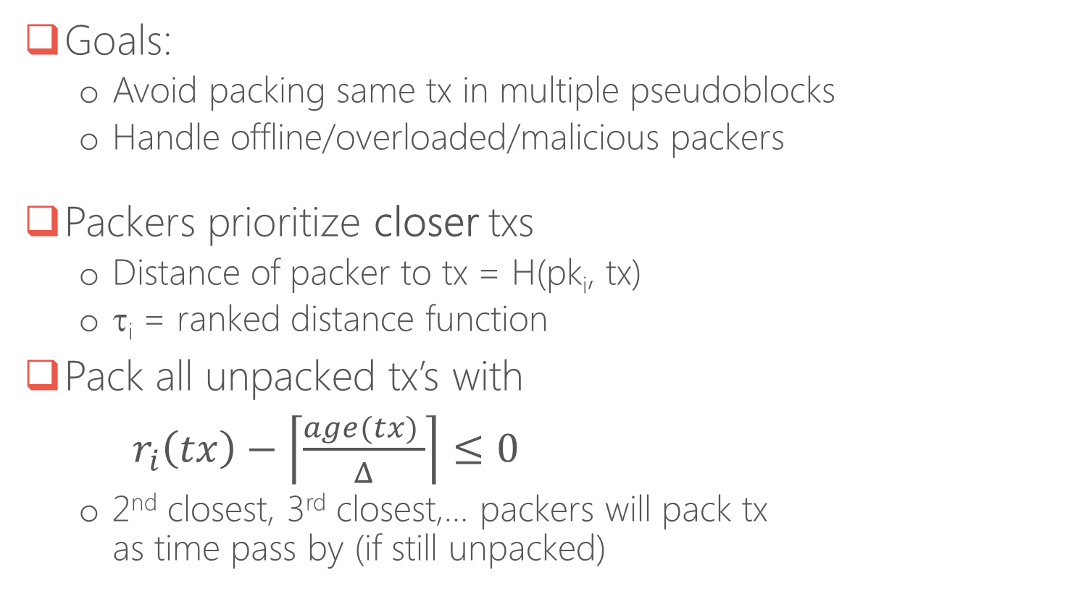
Soft spatial sharding (S3)
Assign each tx to
its closest packer
Goals:
  Avoid packing same tx in multiple pseudoblocks
  Handle offline/overloaded/malicious packers
Packers prioritize closer txs
  Distance of packer to tx = H(pk_{i}, tx)
  τ_{i} = ranked distance function
Pack all unpacked tx’s with
$r_{i}\left(tx\right)−\left\lceil \frac{age(tx) }{Δ}\right\rceil ≤0$
  2nd closest, 3rd closest,… packers will pack tx
  as time pass by (if still unpacked)
tx
a2z3uhj3l3
z8t9hav
…then 2nd closest, 3rd closest, etc.
if still unpacked
ki7gh2
a2z3uhj3l3
uhe9hef

Slide 12

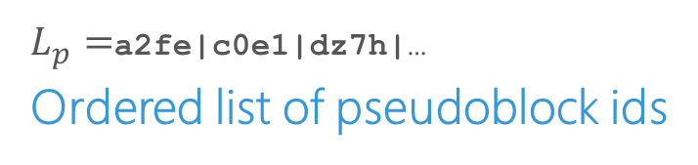


Meta-blocks
miner
Created and broadcast by block producer
pseudoblocks
c0e1
pseudoblocks
puzzle solution
a2fe
Forward
$$TXs$$
block producer
miner
$$TXs$$
…, sol
Verify sol
dz7h
$$L_{p}$$
$$TXs$$
meta-block
Linearize pseudoblocks
in $L_{p}$ $→$ (full) block
+
Validate the (full) block
$L_{p}=$a2fe|c0e1|dz7h|…
Ordered list of pseudoblock ids
Lightweight: ~3-4KB

Slide 13
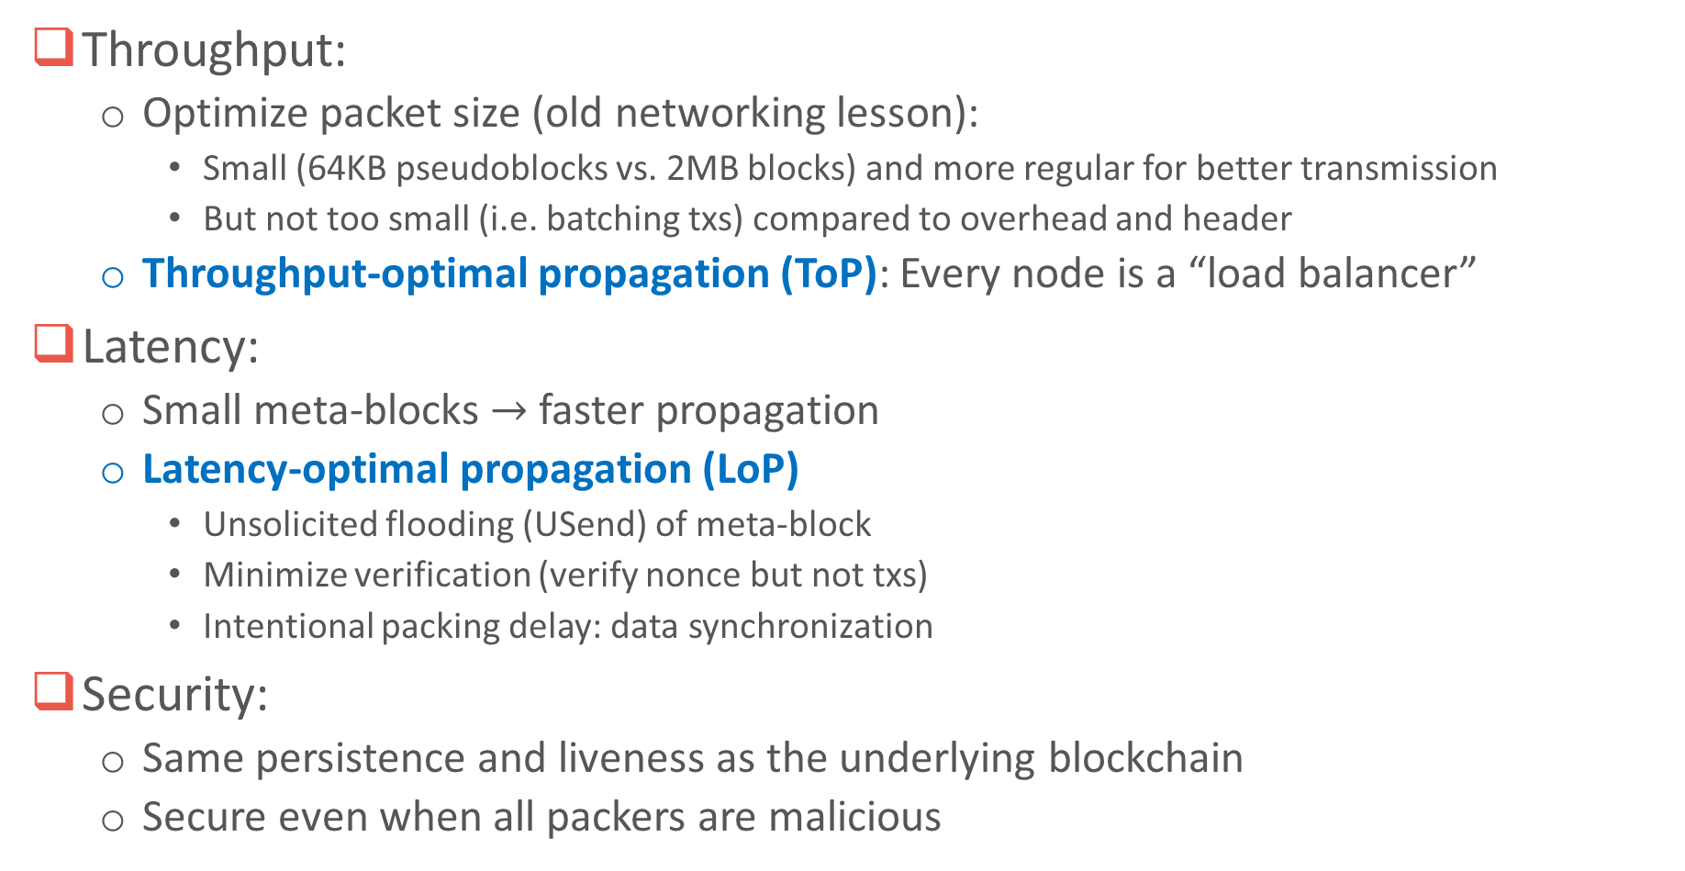
Layer-0 (network) scaling
Throughput:
  Optimize packet size (old networking lesson):
    Small (64KB pseudoblocks vs. 2MB blocks) and more regular for better transmission
    But not too small (i.e. batching txs) compared to overhead and header
  Throughput-optimal propagation (ToP): Every node is a “load balancer”
Latency:
  Small meta-blocks $→$ faster propagation
  Latency-optimal propagation (LoP)
    Unsolicited flooding (USend) of meta-block
    Minimize verification (verify nonce but not txs)
    Intentional packing delay: data synchronization
Security:
  Same persistence and liveness as the underlying blockchain
  Secure even when all packers are malicious

Slide 14

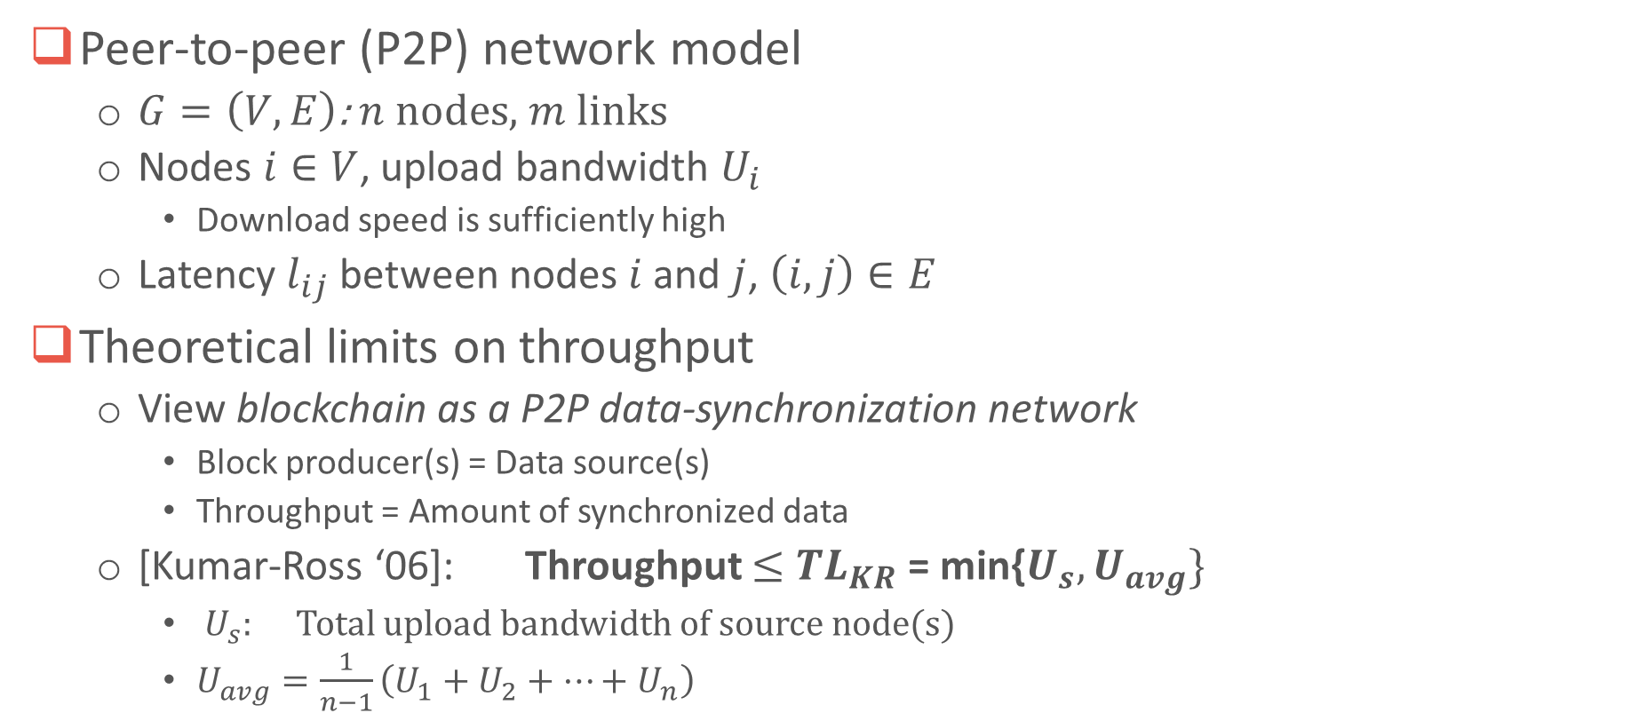





Network theoretical limits
Peer-to-peer (P2P) network model
  $G=\left(V, E\right)$: $n$ nodes, $m$ links
  Nodes $i∈V$, upload bandwidth $U_{i}$
    Download speed is sufficiently high
  Latency $l_{ij}$ between nodes $i$ and $j$, $\left(i, j\right)∈E$
Theoretical limits on throughput
  View blockchain as a P2P data-synchronization network
    Block producer(s) = Data source(s)
    Throughput = Amount of synchronized data
  [Kumar-Ross ‘06]: Throughput $≤$ ${TL}_{KR}$ = min{$U_{s}, U_{avg}\}$
    $U_{s}$: Total upload bandwidth of source node(s)
    $U_{avg}=\frac{1}{n−1}\left(U_{1}+U_{2}+…+U_{n}\right)$
$$U_{i}$$
$$i$$
$$l_{ij}$$
$$U_{j}$$
$$j$$
$$s$$

Slide 15
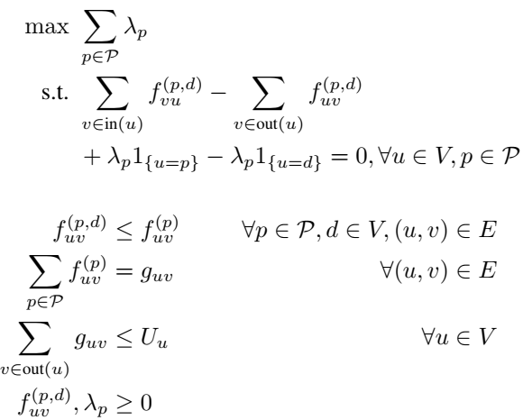

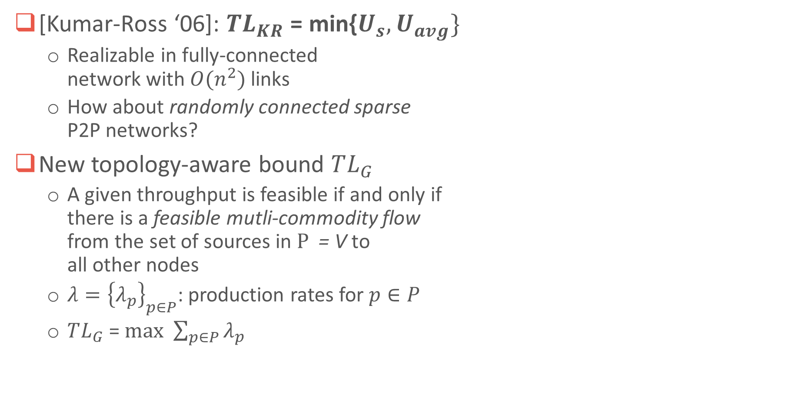




Network theoretical limits
$$U_{i}$$
$$i$$
$$l_{ij}$$
$$U_{j}$$
[Kumar-Ross ‘06]: ${TL}_{KR}$ = min{$U_{s}, U_{avg}\}$
  Realizable in fully-connected
  network with $O(n^{2})$ links
  How about randomly connected sparse
  P2P networks?
New topology-aware bound $TL_{G}$
  A given throughput is feasible if and only if
  there is a feasible mutli-commodity flow
  from the set of sources in $Ρ$ = V to
  all other nodes
  $λ={\left\{λ_{p}\right\}}_{p∈P}$: production rates for $p∈P$
  $TL_{G}$ =$max$ $\sum_{p∈P}{λ_{p}}$
$$j$$
$$s$$
$$TL_{G}=$$

Slide 16
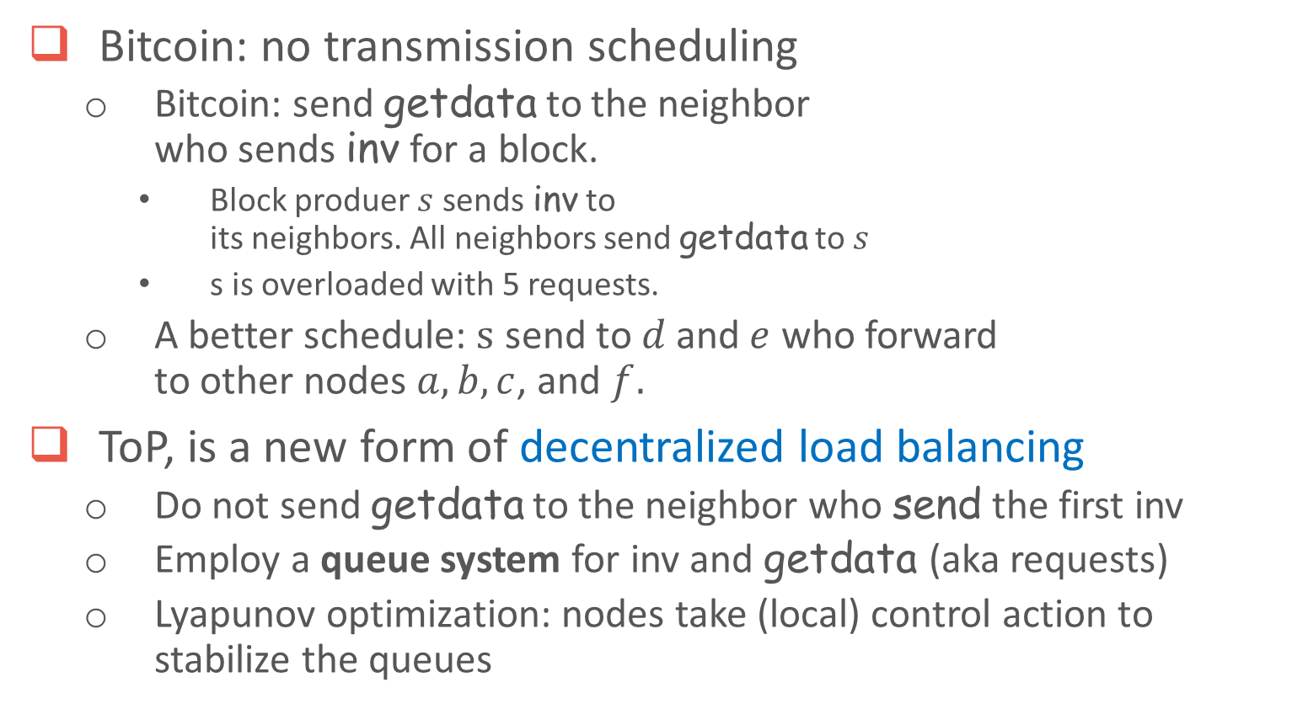



Throughput-optimal propagation (ToP)
Bitcoin: no transmission scheduling
  Bitcoin: send getdata to the neighbor
  who sends inv for a block.
    Block produer $s$ sends inv to
    its neighbors. All neighbors send getdata to $s$
    s is overloaded with 5 requests.
  A better schedule: $s$ send to $d$ and $e$ who forward
  to other nodes $a,b, c$, and $f.$
ToP, is a new form of decentralized load balancing
  Do not send getdata to the neighbor who send the first inv
  Employ a queue system for inv and getdata (aka requests)
  Lyapunov optimization: nodes take (local) control action to stabilize the queues
a
$$e$$
$$d$$
$$f$$
$$s$$
c
b

Slide 17
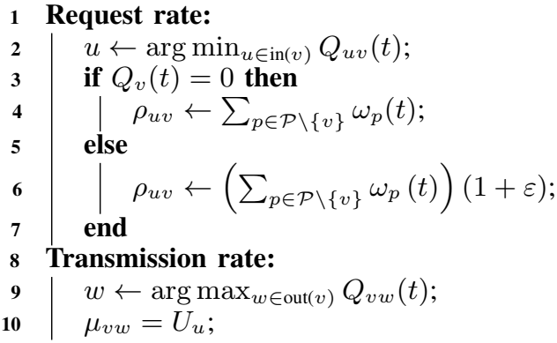
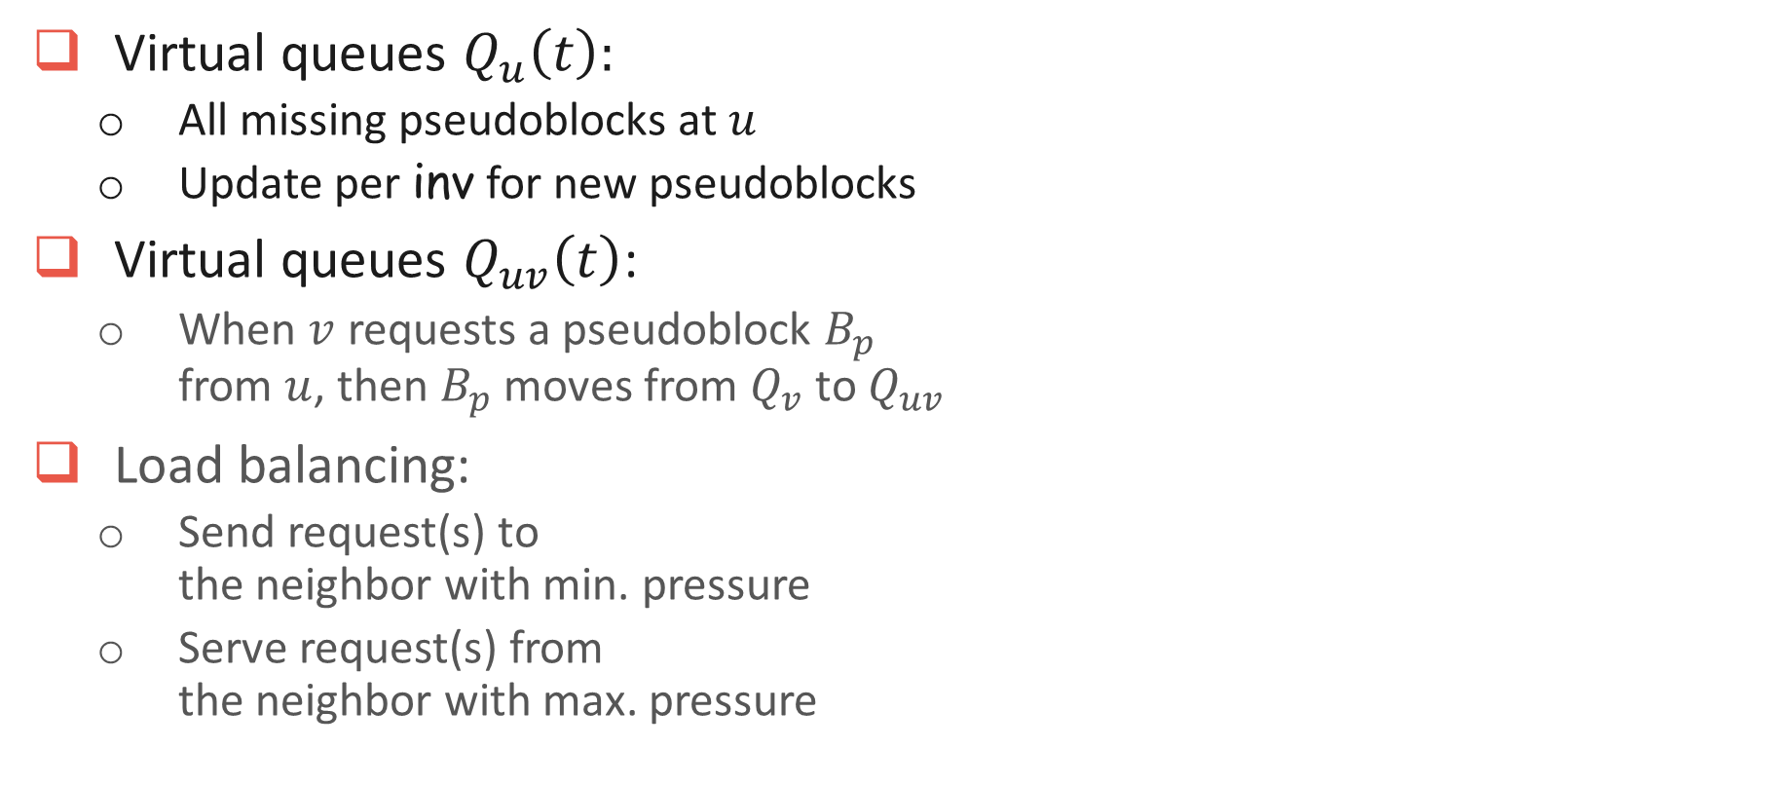
Throughput-optimal propagation (cont.)
Virtual queues $Q_{u}\left(t\right):$
  All missing pseudoblocks at $u$
  Update per inv for new pseudoblocks
Virtual queues $Q_{uv}\left(t\right)$:
  When $v$ requests a pseudoblock $B_{p}$
  from $u$, then $B_{p}$ moves from $Q_{v}$ to $Q_{uv}$
Load balancing:
  Send request(s) to
  the neighbor with min. pressure
  Serve request(s) from
  the neighbor with max. pressure
ToP scheme

Slide 18
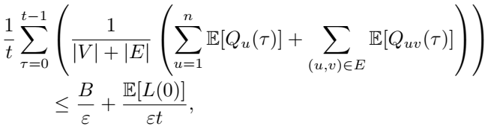
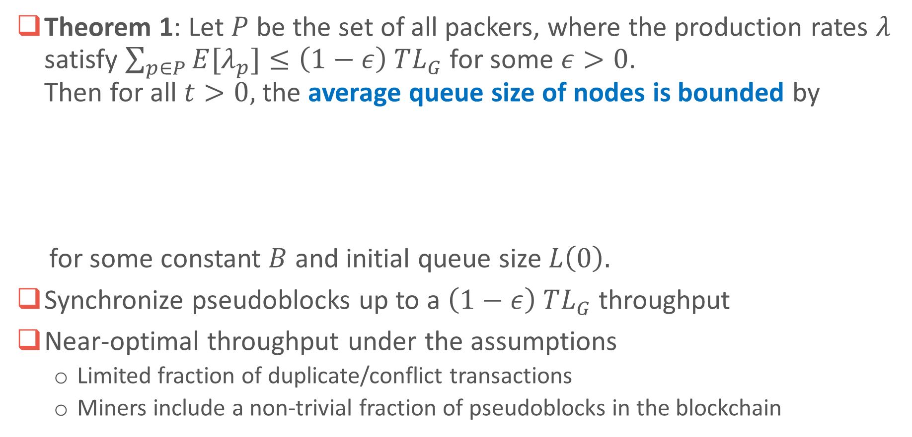
Near-optimal throughput guarantee
Theorem 1: Let $P$ be the set of all packers, where the production rates $λ$ satisfy $\sum_{p∈P}{{E[λ}_{p}]}≤\left(1−ε\right) TL_{G}$ for some $ε>0$.
Then for all $t>0,$the average queue size of nodes is bounded by
for some constant $B$ and initial queue size $L\left(0\right).$
Synchronize pseudoblocks up to a $\left(1−ε\right) TL_{G}$ throughput
Near-optimal throughput under the assumptions
  Limited fraction of duplicate/conflict transactions
  Miners include a non-trivial fraction of pseudoblocks in the blockchain
Notes:
Note:
+ Additional assumption for Theorem 1: Each miner is connected to at least one packer

Slide 19

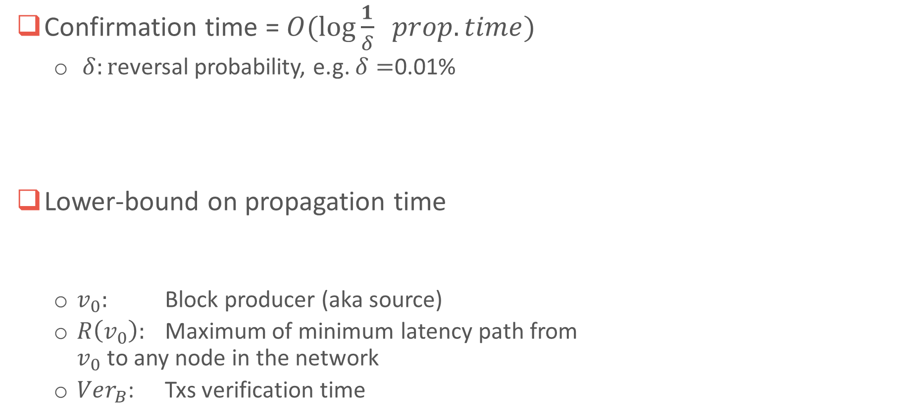
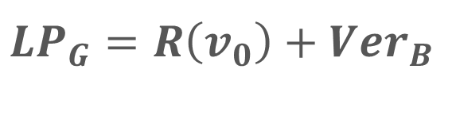
Optimal Propagation Time
Confirmation time = $O(\log{\frac{1}{δ}} prop.time)$
  $δ:r$eversal probability, e.g. $δ=$0.01%
Lower-bound on propagation time
  $v_{0}:$ Block producer (aka source)
  $R\left(v_{0}\right):$ Maximum of minimum latency path from
  $v_{0}$ to any node in the network
  $Ver_{B}$: Txs verification time
$$U_{i}$$
$$i$$
$$l_{ij}$$
$$U_{j}$$
$$j$$
$$v_{0}$$
$$LP_{G}=R\left(v_{0}\right)+Ver_{B}$$

Slide 20





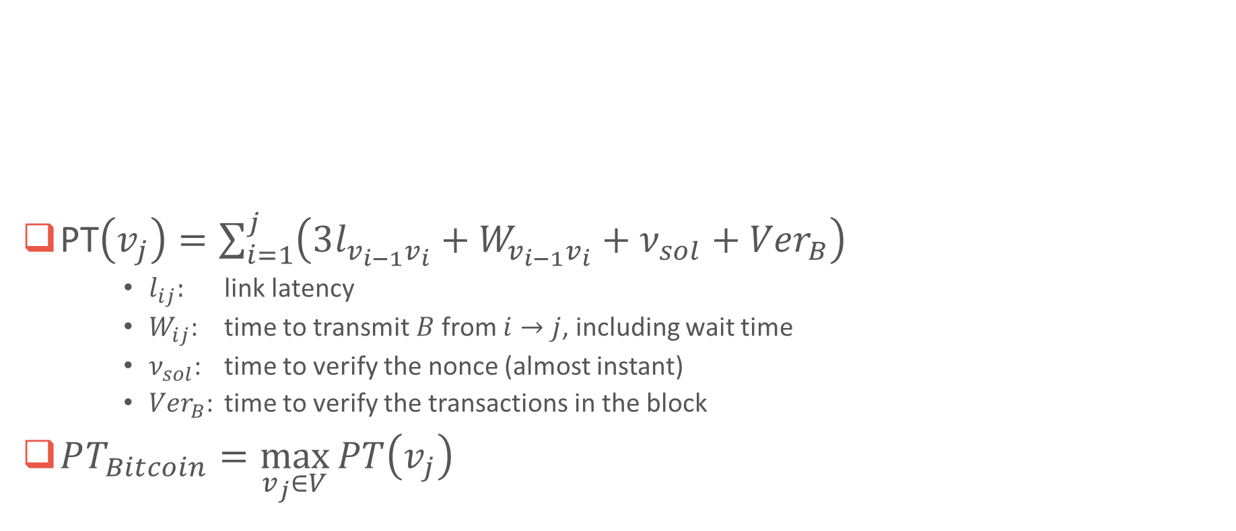









Bitcoin propagation time
new
block B
PT$\left(v_{j}\right)=\sum_{i=1}^{j}{\left(3l_{v_{i−1}v_{i}}+W_{v_{i−1}v_{i}}+ν_{sol}+{Ver}_{B}\right)}$
    $l_{ij}:$ link latency
    $W_{ij}$: time to transmit $B$from $i→j$, including wait time
    $ν_{sol}$: time to verify the nonce (almost instant)
    ${Ver}_{B}$: time to verify the transactions in the block
$PT_{Bitcoin}=\max_{v_{j}∈V}{PT\left(v_{j}\right)}$
inv
get
send
inv
get
send
verify
sol
verify
transactions
verify
sol
verify
transactions
$v_{j}$accept B
Node
$$v_{0}$$
Node
$$v_{1}$$
Node
$$v_{2}$$
…
Node
$$v_{j}$$
$$3l_{v_{0}v_{1}}$$
$$+W_{v_{0}v_{1}}$$
$$ν_{sol}$$
$${Ver}_{B}$$
$$3l_{v_{1}v_{2}}$$
$$+W_{v_{1}v_{2}}$$
$$ν_{sol}$$
$${Ver}_{B}$$
$$l_{v_{0}v_{1}}$$
$$v_{1}$$
$$v_{j}$$
$$v_{0}$$

Slide 21





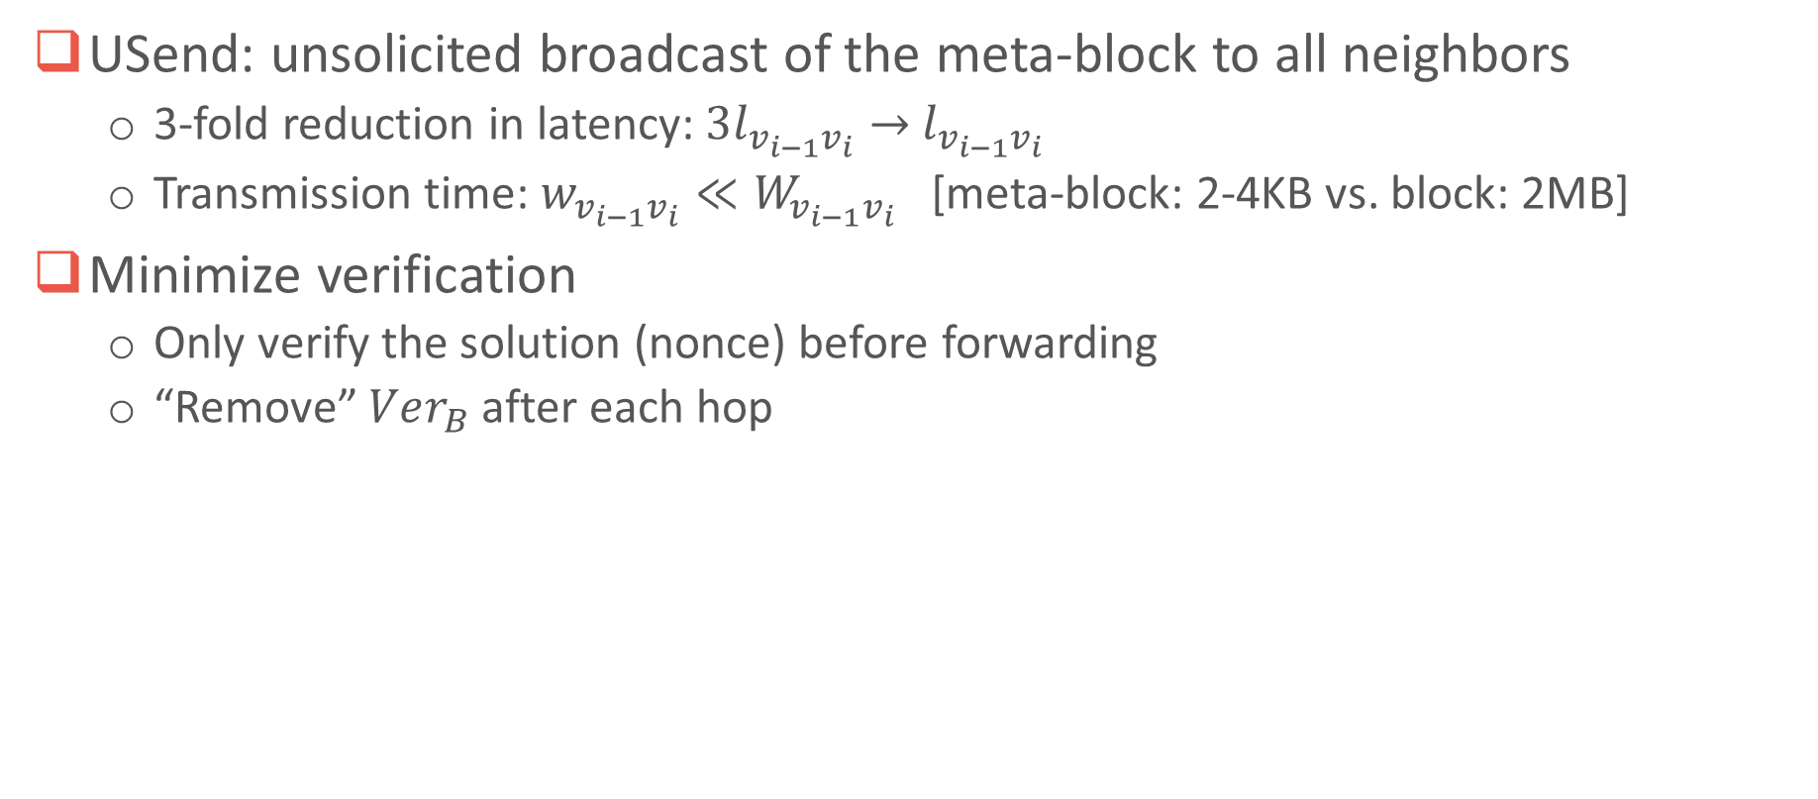









Latency-optimal propagation (LoP) scheme
USend: unsolicited broadcast of the meta-block to all neighbors
  3-fold reduction in latency: $3l_{v_{i−1}v_{i}}→$ $l_{v_{i−1}v_{i}}$
  Transmission time: $w_{v_{i−1}v_{i}}≪W_{v_{i−1}v_{i}}$ [meta-block: 2-4KB vs. block: 2MB]
Minimize verification
  Only verify the solution (nonce) before forwarding
  “Remove” $Ver_{B}$ after each hop
new meta-block $B_{m}$
USend $B_{m}$
verify
sol
USend $B_{m}$
verify
sol
Node
$$v_{0}$$
Node
$$v_{1}$$
Node
$$v_{2}$$
…
Node
$$v_{j}$$
$$l_{v_{0}v_{1} }$$
$$+w_{v_{0}v_{1}}$$
$$ν_{sol}$$
$$l_{v_{1}v_{2}}$$
$$+w_{v_{1}v_{2}}$$
$$ν_{sol}$$
Pseudo-block in $B_{m}$
received
pseudo-block in $B_{m}$
received
verify
transactions
verify
transactions
$v_{j}$accept $B_{m}$
$$Ver_{B}$$
$$Ver_{B}$$

Slide 22
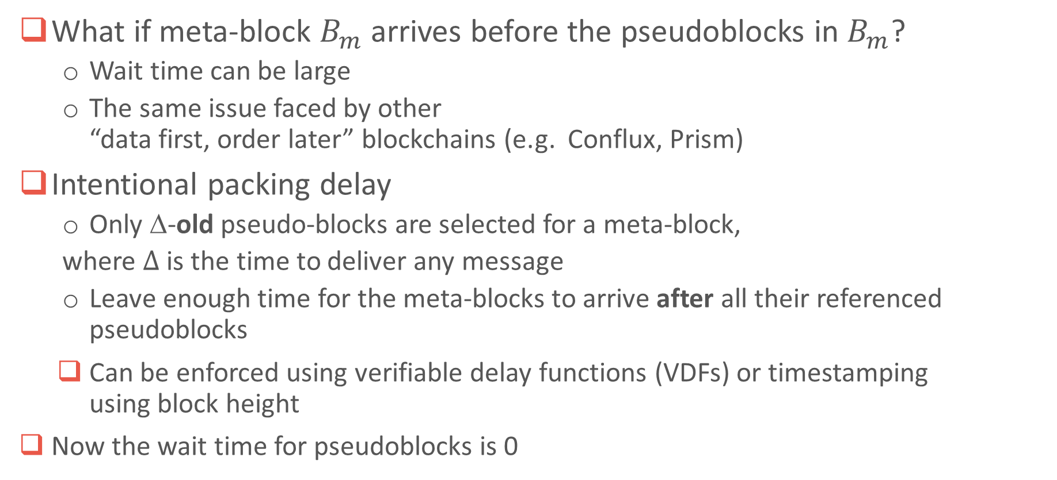
Intentional packing delay
What if meta-block $B_{m}$ arrives before the pseudoblocks in $B_{m}$?
  Wait time can be large
  The same issue faced by other
  “data first, order later” blockchains (e.g. Conflux, Prism)
Intentional packing delay
  Only Δ-old pseudo-blocks are selected for a meta-block,
  where $Δ$ is the time to deliver any message
  Leave enough time for the meta-blocks to arrive after all their referenced pseudoblocks
    Can be enforced using verifiable delay functions (VDFs) or timestamping
    using block height
  Now the wait time for pseudoblocks is 0

Slide 23






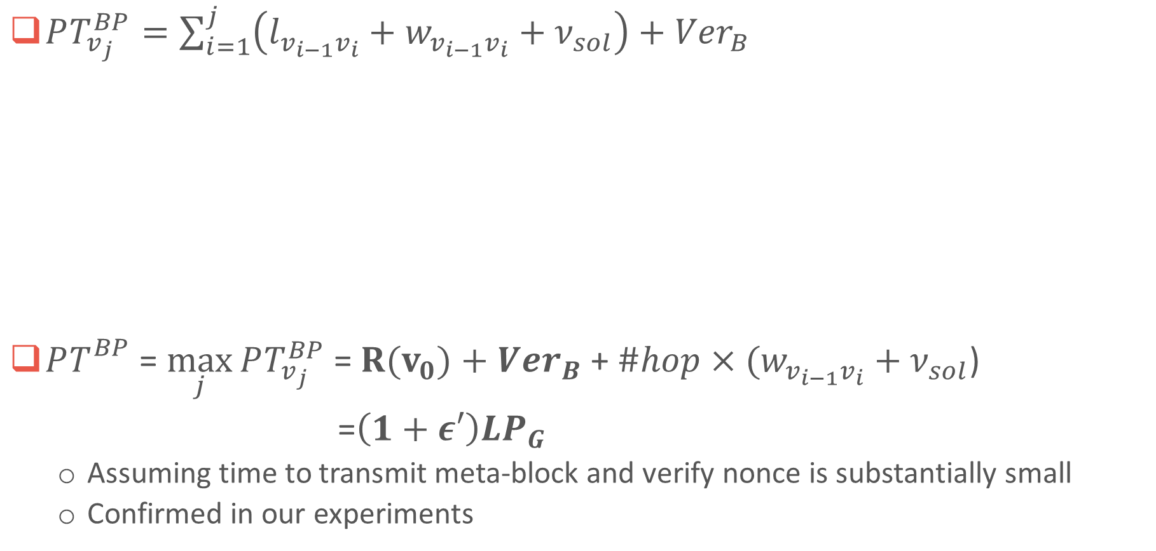








Near-optimal propagation-time guarantee
$PT_{v_{j}}^{BP}=\sum_{i=1}^{j}{\left(l_{v_{i−1}v_{i}}+w_{v_{i−1}v_{i}}+ν_{sol}\right)}+{Ver}_{B}$
$PT_{}^{BP}$ = $\max_{j}{PT_{v_{j}}^{BP}}$ = $R(v_{0})+$ ${Ver}_{B}$ + $\#hop×(w_{v_{i−1}v_{i}}+ν_{sol}$)
=$\left(1+ε′\right)LP_{G}$
  Assuming time to transmit meta-block and verify nonce is substantially small
  Confirmed in our experiments
new meta-block $B_{m}$
USend $B_{m}$
verify
sol
USend $B_{m}$
verify
sol
Node
$$v_{0}$$
Node
$$v_{1}$$
Node
$$v_{2}$$
…
Node
$$v_{j}$$
$$l_{v_{0}v_{1} }$$
$$+w_{v_{0}v_{1}}$$
$$ν_{sol}$$
$$l_{v_{1}v_{2}}$$
$$+w_{v_{1}v_{2}}$$
$$ν_{sol}$$
Pseudo-block in $B_{m}$
received
pseudo-block in $B_{m}$
received
verify
transactions
verify
transactions
$v_{j}$accept $B_{m}$
$$Ver_{B}$$
$$Ver_{B}$$

Slide 24
Experimental Studies
The “best” approach?
How to fairly compare different approaches?
  Different implementations with various levels of optimization
  Different network environments
  Different parameter settings
  Different proposals can work in tandem
Network bottlenecks in each protocol?

Slide 25
Our blockchain simulator
Large-scale (>20,000 nodes) and lightweight
Various choices for parameters
  Topology: Kademilia, Pastry, random, etc.
  Latency: Geodesic coordinate-based, uniform, etc.
  Bandwidth: Power-law, uniform, etc.
Supports powerful statistical analyses:
  Throughput, block-propagation time,
  consensus delay, confirmation time, etc.
Event-driven and modular design
to support rapid prototyping of protocols
To be available soon

Slide 26
Experiment Settings
Protocols:
  Bitcoin: Original protocol
  Bitcoin-c: Original protocol + Compact Block (BIP 152)
  Bitcoin-NG
  Conflux
  BackPackers
1000 nodes, randomly deployed across the globe
Latency ~ scaled geodic distance [2s to travel around the world]
Average bandwidth: 20Mbps
Block interval: 10s; block size: 2MB; intentional packing delay: 3s

Slide 27
Metrics
Throughput:
  Transactions per second (tps)
Block-propagation time:
  Time for 95% of nodes to receive a (full) block
Confirmation time:
  Pr[reversing a transaction] < 0.01% for adversary with 20% mining power

Slide 28
Results
Nodes’ bandwidth: 20 Mbps Nodes’ bandwidth: 100 Mbps
Protocol | Throughput (tps) | Bandwidth utilization | Propagation time (s)
Bitcoin | 197 | 1.9% | 8.9
Bitcoin-c | 423 | 4.0% | 3.5
Bitcoin-NG | 331 | 3.2% | 5.3
Conflux | 340 | 3.2% | 9.5
Prism | 382 | 3.6% | 5.6
BackPackers | 7542 | 71.9% | 0.8
Protocol | Throughput (tps) | Bandwidth utilization | Propagation time (s)
Bitcoin | 712 | 1.4% | 7.4
Bitcoin-c | 1142 | 2.2% | 3.4
Bitcoin-NG | 1754 | 3.3% | 3.7
Conflux | 953 | 1.8% | 7.7
Prism | 2032 | 3.9% | 4.2
BackPackers | 38,010 | 72.5% | 0.8
Throughput:
More than 10x higher than the others
Achieve up to 70% optimality
~Visa-scale (40k tps) for good network
Block-propagation time:
<1s
Optimal propagation time
Independent of throughput/load.
Notes:
Notes:
+ At 100Mbps, Bitcoin, Bitcoin-compact, Conflux throughput are limited by block size 2MB

Slide 29
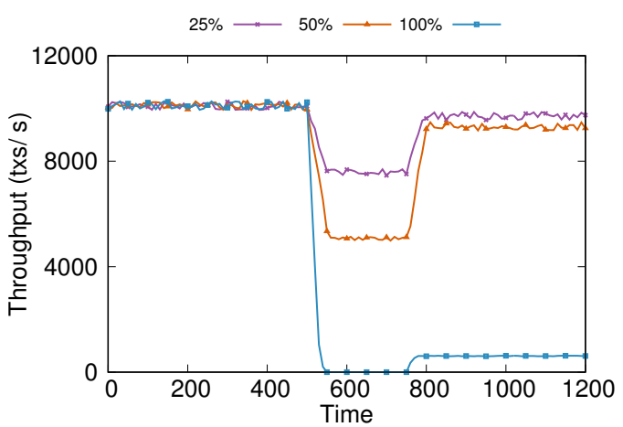
Throughput with faulty packers
Even for a large number of faulty packers, the throughput can recover quickly to a high level
When all packers are unavailable, the throughput drops to Bitcoin’s level

Slide 30
Confirmation time
Can confirm txs in under
a minute (45 seconds)!

Slide 31


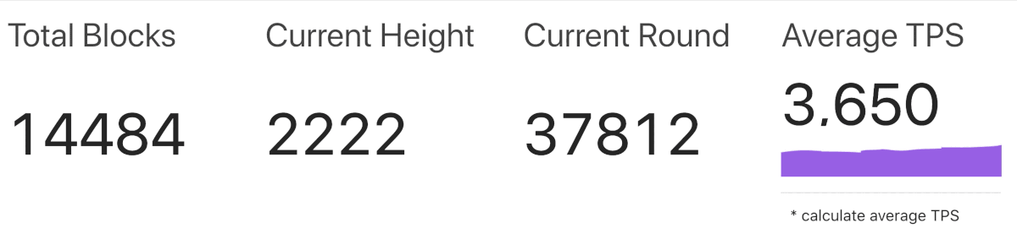
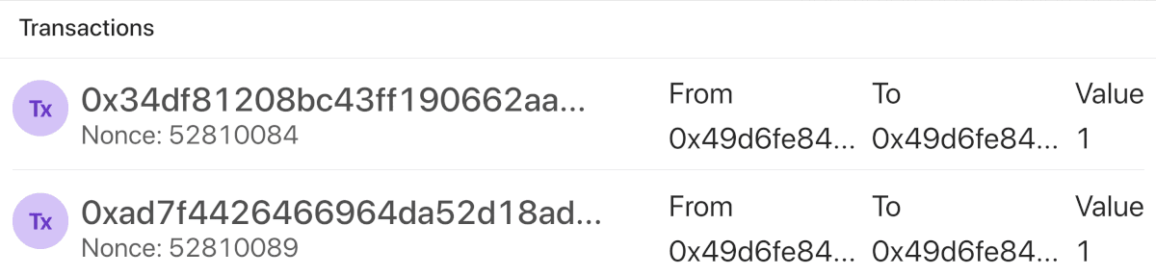
Fractal: Real-world benchmark
Fractal
  Proof-of-Stake: iChing
    Provable security properties
    Novel defense against known attacks
      Nothing-at-stakes
      Grinding
      Long-range attacks
  BackPackers
20,000 nodes
  Deployed across Asia, America,
  and Europe on AWS + Alibaba Cloud
Sustains 3,000–5,000 tps

Slide 32



Summary
Scalability: BackPackers – Layer-0 Scaling
  A. Transaction batching: Packer
  B. ToP: Near-optimal throughput (up to 70% bandwidth utilization)
  C. LoP: Near-optimal block-propagation time
    B& C are compatible with Bitcoin; A: compatibility under investigation;
Security:
  Lower fork rates (faster propagation time)
  Better decentralization:
    Lower networking bar for miners
Fractal:
  iChing (Secure Proof-of-stake) + BackPackers
  Public testnet with
  full-fledged smart contracts (WebAssembly)
Sustainable
Secure
Scalable

Slide 33
Thank you!

Slide 34
Packers Selection
Random selection:
  Among the last block producer (winning miners) after a grace period
On-chain bidding
  Nodes passing minimum requirements submit bids to become packers
  Top bidders selected as packers for next period
Hybrid

Slide 35
Soft spatial sharding (S3)
Assign each tx to
its closest packer
Goals:
  Avoid packing same tx in multiple pseudoblocks
  Handle offline/overloaded/malicious packers
Packers prioritize closer txs
  Distance of packer to tx = H(pk_{i}, tx)
  τ_{i} = ranked distance function
Pack all unpacked tx’s with
$r_{i}\left(tx\right)−\left\lceil \frac{age(tx) }{Δ}\right\rceil ≤0$
  2nd closest, 3rd closest,… packers will pack tx
  as time pass by (if still unpacked)
tx
a2z3uhj3l3
z8t9hav
…then 2nd closest, 3rd closest, etc.
if still unpacked
ki7gh2
a2z3uhj3l3
uhe9hef

Slide 36
New Congestion Control
Prioritize the propagation of data
Meta-blocks > Pseudo-blocks/Transactions
Selected pseudo-blocks > Unselected pseudo-blocks
New pricing for txs/pseudo-blocks:
    Bitcoin: Fee per byte in data (e.g. transactions)
    BackPackers: Fee per byte in data + overhead
    Incentivize transactions batching
    Increase the cost of Denial-of-service attacks

Slide 37

BackPackers as a decentralized backbone
BackPackers:
  Throughput-optimal propagation makes every node a load balancer
    Just adding powerful nodes will improve throughput
    Trust-free backbone network
Fast Internet Bitcoin Relay Engine (FIBRE): requires trust assumptions
Falcon: No block validation $⇒$may forward duplicate or invalid blocks
bloXroute: Forward encrypted blocks $⇒$ can be exploited for DoS
BackPackers
Multiple parties/companies
Proven security properties
Incentivization via fee
FIBRE, Falcon, bloXroute
Provided by a single party/company
Not proven to be secure
N/A

