Slide 1


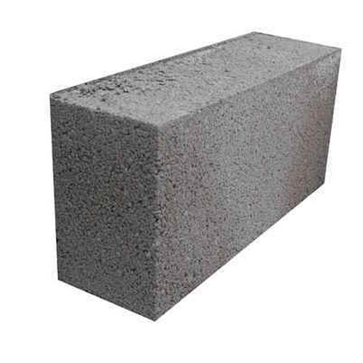
Elastic Block Caps
Meni Rosenfeld
Israeli Bitcoin Association
Scaling Bitcoin 2019 Tel Aviv “Yesod”
בס"ד

Slide 2
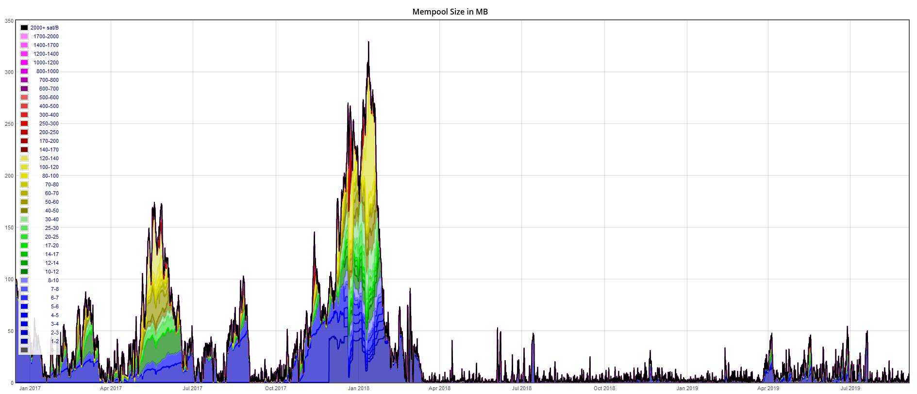
The problem: Variable fees

Slide 3
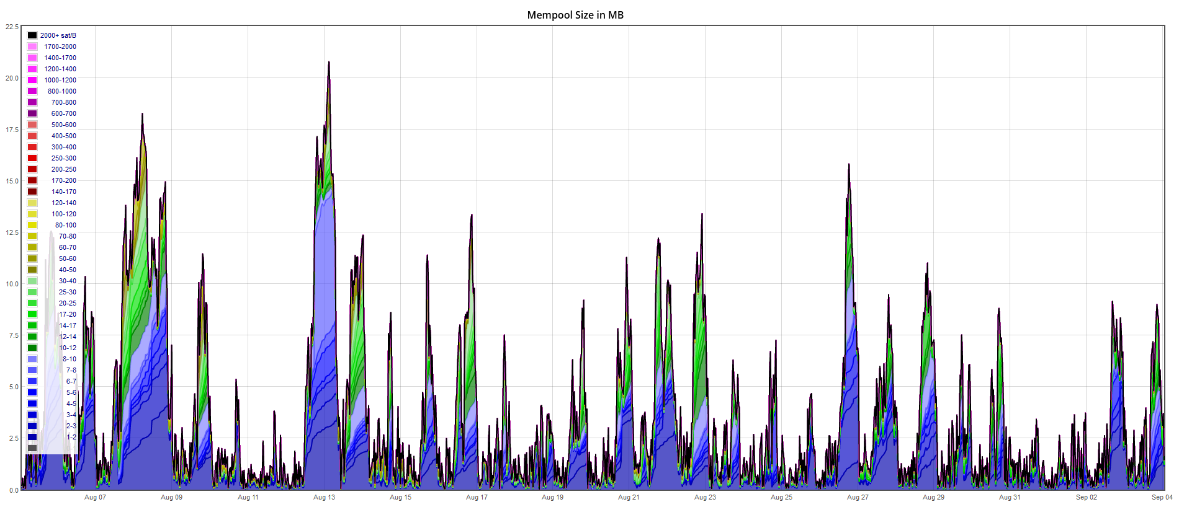
The problem: Variable fees

Slide 4
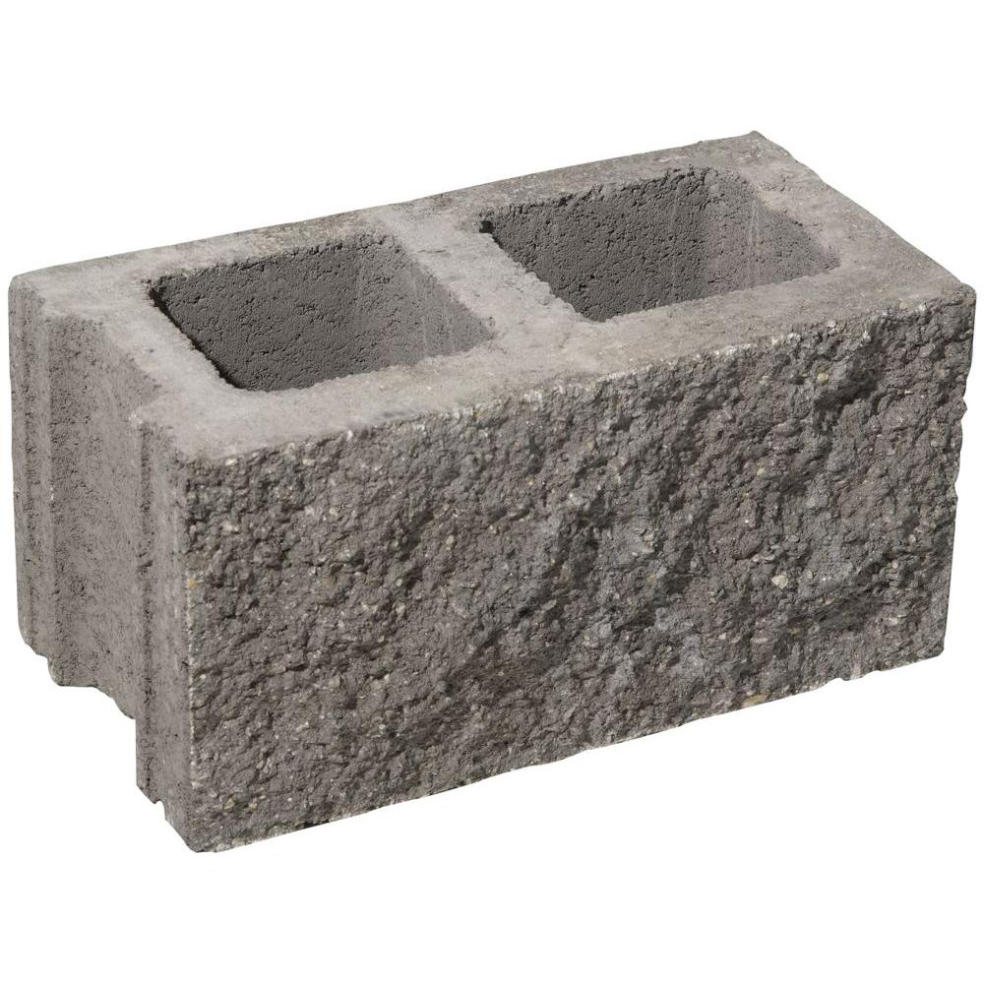

Background: Block Size limit
Easier to run a node
Higher Miner Reward
Faster propagation - Fewer orphans
Less reliance on 3rd parties
Reduced Mining Gap
Lower Fees
More network throughput
Less reliance on 3rd parties

Slide 5
Easier to run a node
Lower peak throughput
  Weaker CPU/RAM/infrastructure possible
  Less peak bandwidth
Lower average/aggregate throughput
  Less total power consumption
  Less consumed bandwidth
  Less storage
  Faster Initial Block Download

Slide 6
Mineshaft Mining Gap
Assume negligible inflation
If blocks are big enough to fit all transactions…
Then after a block is found, the mempool is empty
No gain from mining honestly
Possibility: Miners stop mining, giving more power to attackers
Possibility: Miners ignore leaf block and mine their own
  Better a chance of orphaning than 100% certainty of no reward
  Instability and more power to attackers
Actual risk to network, not just “harder to run a node”

Slide 7
Varying network load – One size doesn’t fit all
“Too big” and “too small” are relative
High load = blocks are too small. Excessive fees, low usability
Low load = blocks are too big.
  Enough room for everyone, so fees nosedive.
  Txs are included cheaply, not respecting externalities.
  Reduced miner payment and security, even though users are willing to pay.
  Mining Gap
Fees are variable
  Difficulty planning personal economic activity
  Difficulty planning network upgrades

Slide 8


Slide 9
Elastic Block Caps
Block size limit is variable
Higher limit during high load, lower limit during low load
Fees will depend on load, but not as much
Same aggregate throughput, lower fee variability

Slide 10
Related work
Similar ideas go by names such as
  Dynamic block limit
  Flexcaps
  Excess size penalty
Proposals by
  2013 - Nicolas van Saberhagen (CryptoNote, Monero)
  2015:
    Greg Maxwell aka nullc
    Mark Friedenbach aka maaku
    Meni Rosenfeld

Slide 11



What the proposal is not
Not a fire-and forget, long-term block size adjustment
Not based on voting
Not based on actual size of previous blocks
Elastic, not Plastic

Slide 12
Network load metrics
#Transactions not a reliable load metric
A trillion floating transactions at 0.1 sat/vB is spam, not load
Load is when users are actually willing to pay and still can’t get in
Good load metric = Block inclusion threshold = Minimal block feerate

Slide 13
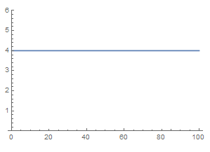
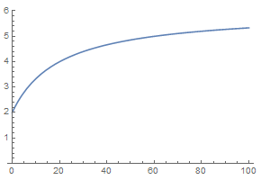
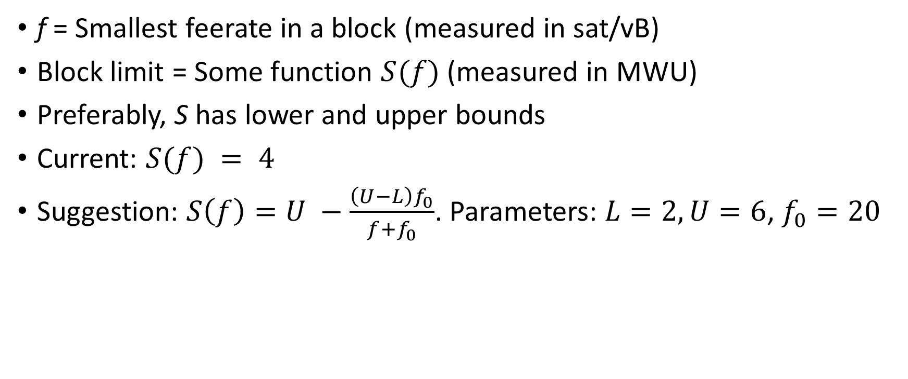
Elastic Block Cap
f = Smallest feerate in a block (measured in sat/vB)
Block limit = Some function $S(f)$ (measured in MWU)
Preferably, S has lower and upper bounds
Current: $S(f) = 4$
Suggestion: $S\left(f\right)=U −\frac{\left(U−L\right)f_{0}}{f+f_{0}}$. Parameters: $L=2, U=6$, $f_{0}=20$

Slide 14

Gameability
No benefit from lower-than-min fake tx
No benefit from higher-than-min fake tx
No benefit from out-of-band payments
Reverse out-of-band payment – miner pays user?
No freedom for miner to insert his own txs
  Mitigation – use 0.1% quantile instead of minimum

Slide 15
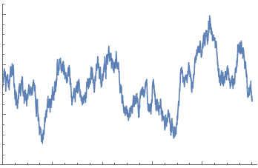
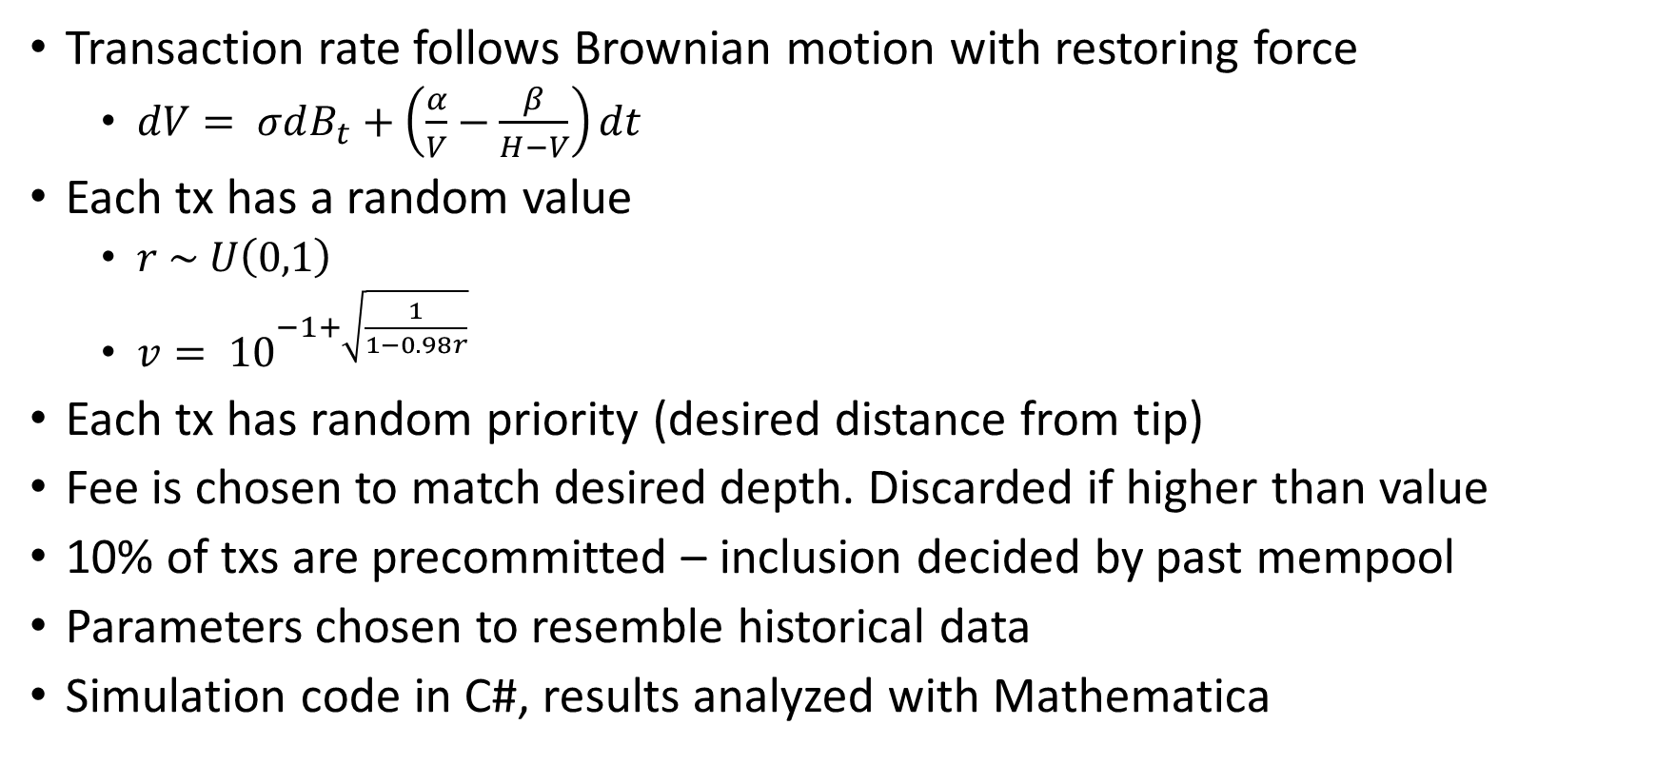
Simulation methodology
Transaction rate follows Brownian motion with restoring force
  $dV= σdB_{t}+\left(\frac{α}{V}−\frac{β}{H−V}\right)dt$
Each tx has a random value
  $r \sim U\left(0,1\right)$
  $v= {10}^{−1+\sqrt{\frac{1}{1−0.98r}}}$
Each tx has random priority (desired distance from tip)
Fee is chosen to match desired depth. Discarded if higher than value
10% of txs are precommitted – inclusion decided by past mempool
Parameters chosen to resemble historical data
Simulation code in C#, results analyzed with Mathematica

Slide 16
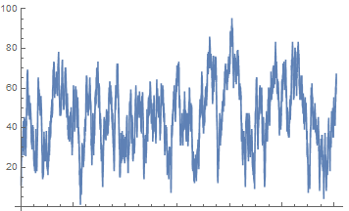
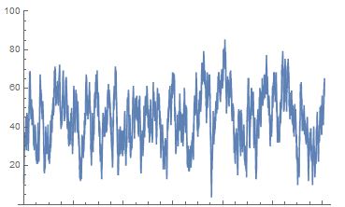

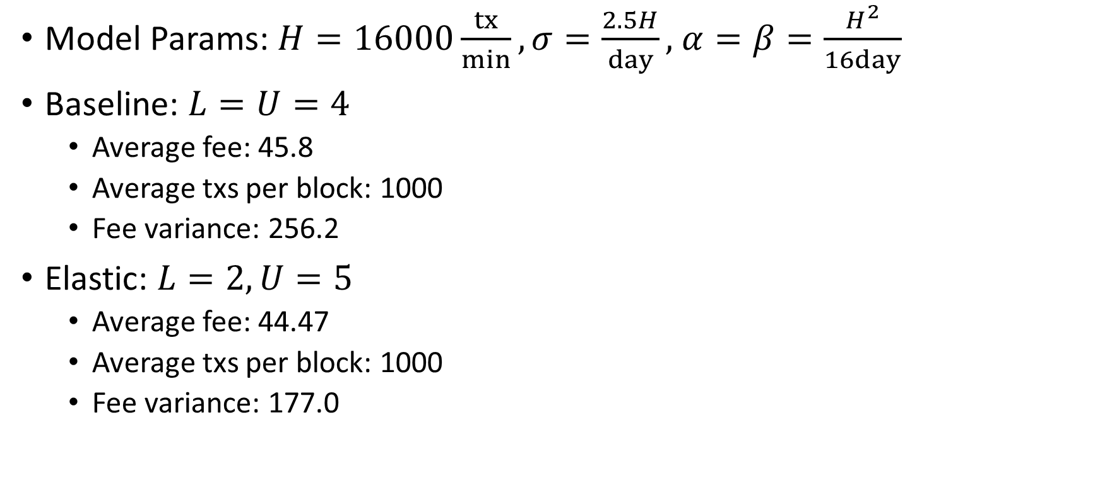
Results
    $$dV= σdB_{t}+\left(\frac{α}{V}−\frac{β}{H−V}\right)dt$$
Model Params: $H=16000\frac{tx}{min}, σ=\frac{2.5H}{day},$ $α=β=\frac{H^{2}}{16day}$
Baseline: $L=U=4$
  Average fee: 45.8
  Average txs per block: 1000
  Fee variance: 256.2
Elastic: $L=2, U=5$
  Average fee: 44.47
  Average txs per block: 1000
  Fee variance: 177.0

Slide 17
Results
By implementing elastic block caps with a modest range, fee variance can be reduced by 30%, while maintaining the same average fee and throughput
  (Standard deviation reduced by 16%)

Slide 18

Older idea – penalty based on block size
Equivalent to size based on min-fee
More “free-market”
Much more complicated to implement and reason about
Messes with inflation

Slide 19
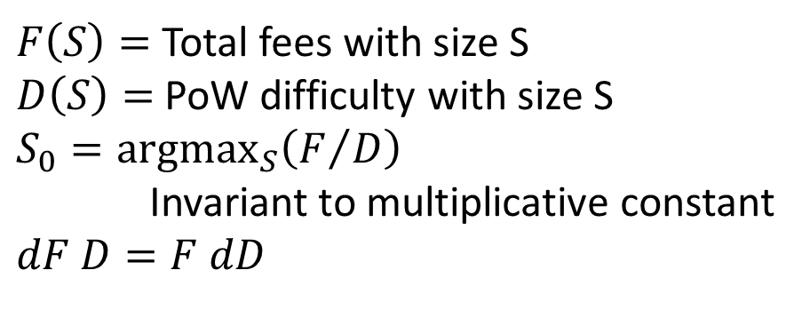
The problem with proportional penalty
%Penalty based on %Block size difference
Doesn’t actually adapt block size to network load
  When inflation is negligible
Block size should be tied to extrinsic scale
$F\left(S\right)=$ Total fees with size S
$D\left(S\right)=$ PoW difficulty with size S
$S_{0}={argmax}_{S}\left(F/D\right)$
Invariant to multiplicative constant
$dF D=F dD$

Slide 20
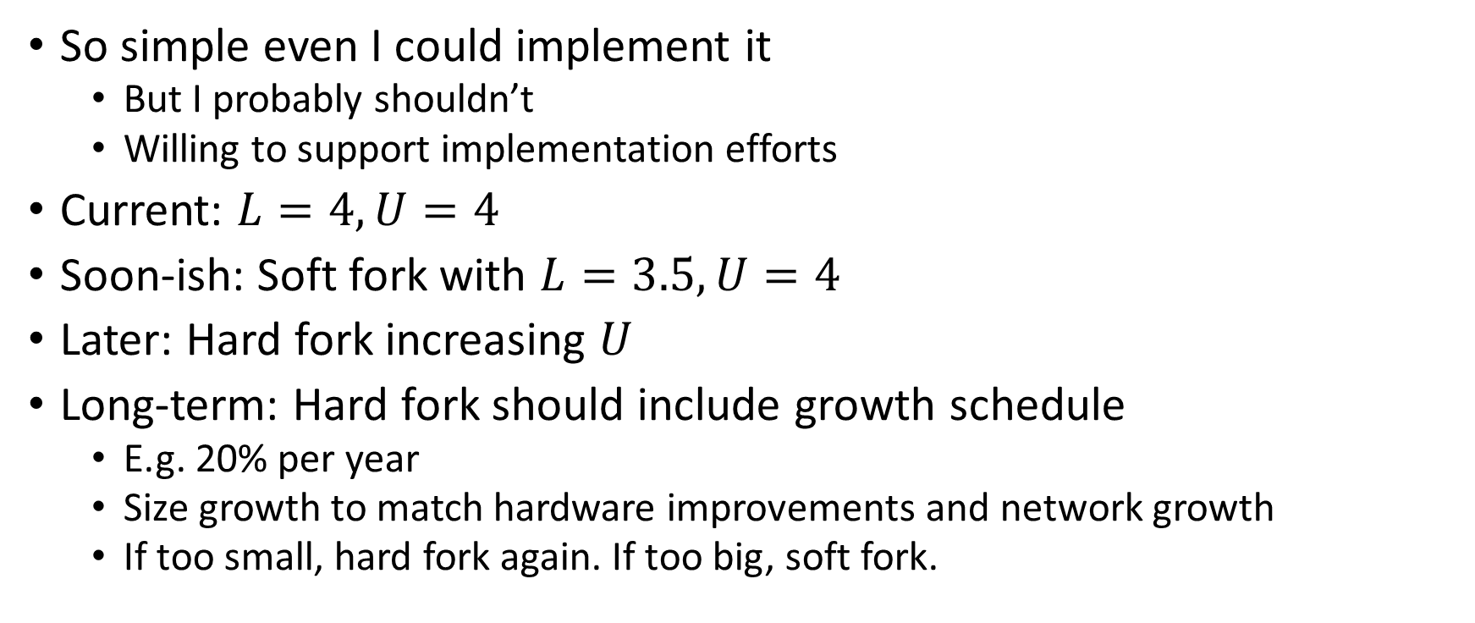
Deployment
So simple even I could implement it
  But I probably shouldn’t
  Willing to support implementation efforts
Current: $L=4, U=4$
Soon-ish: Soft fork with $L=3.5, U=4$
Later: Hard fork increasing $U$
Long-term: Hard fork should include growth schedule
  E.g. 20% per year
  Size growth to match hardware improvements and network growth
  If too small, hard fork again. If too big, soft fork.

Slide 21
Acknowledgements
Mike Hearn
  Got me thinking about this problem (but everything he said was wrong)
Jochen Hoenicke aka Johoe
  Provides the incredibly valuable mempool stats webpage
Nadav Ivgi aka shesek
  Helped obtain data, insightful conversations
Mark Friedenbach aka maaku
  Fruitful discussion

Slide 22

Questions?

Slide 23
Talk Outline
Problem statement
Background and problem details
Solution outline
Related work, and what this proposal is not
Solution details
Simulation results
Deployment
Questions

